Slide 1
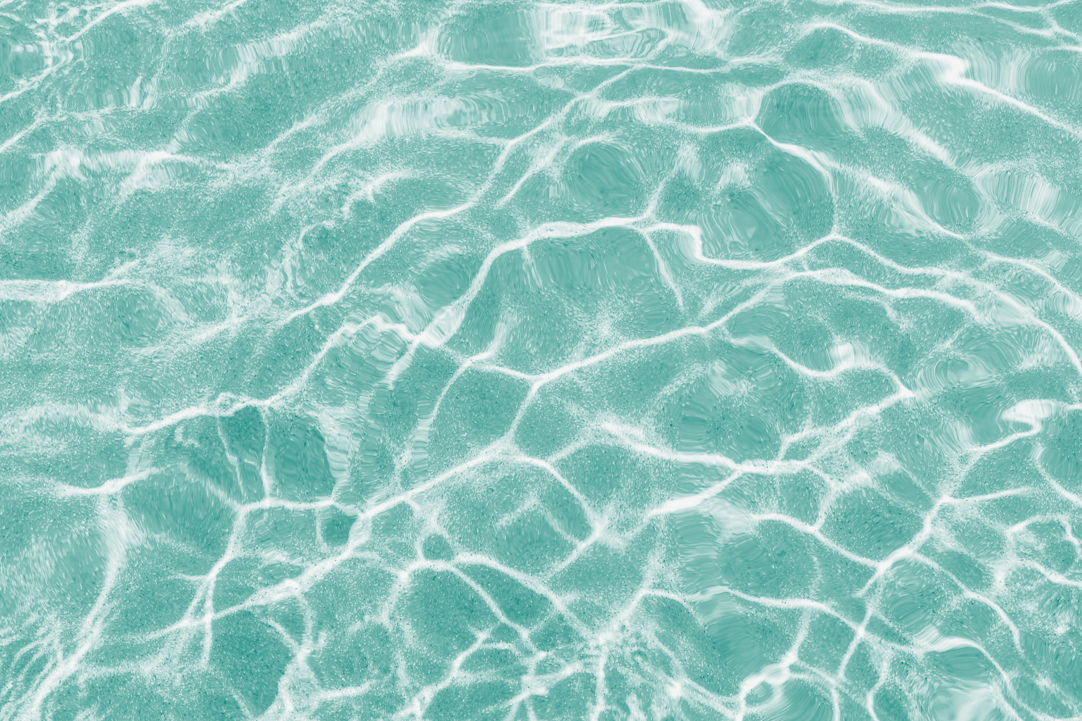
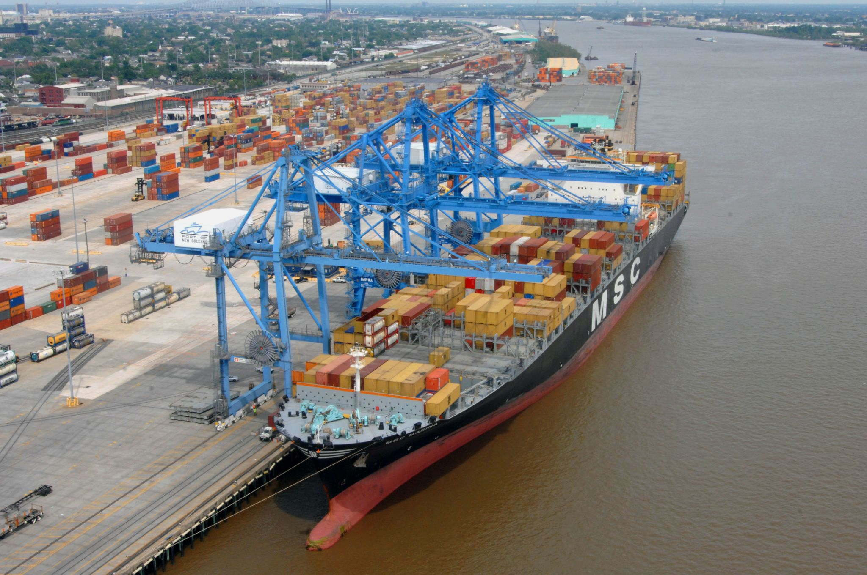
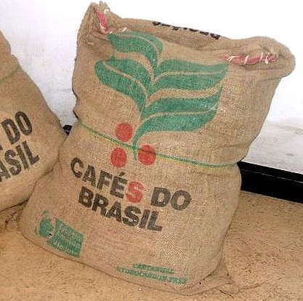
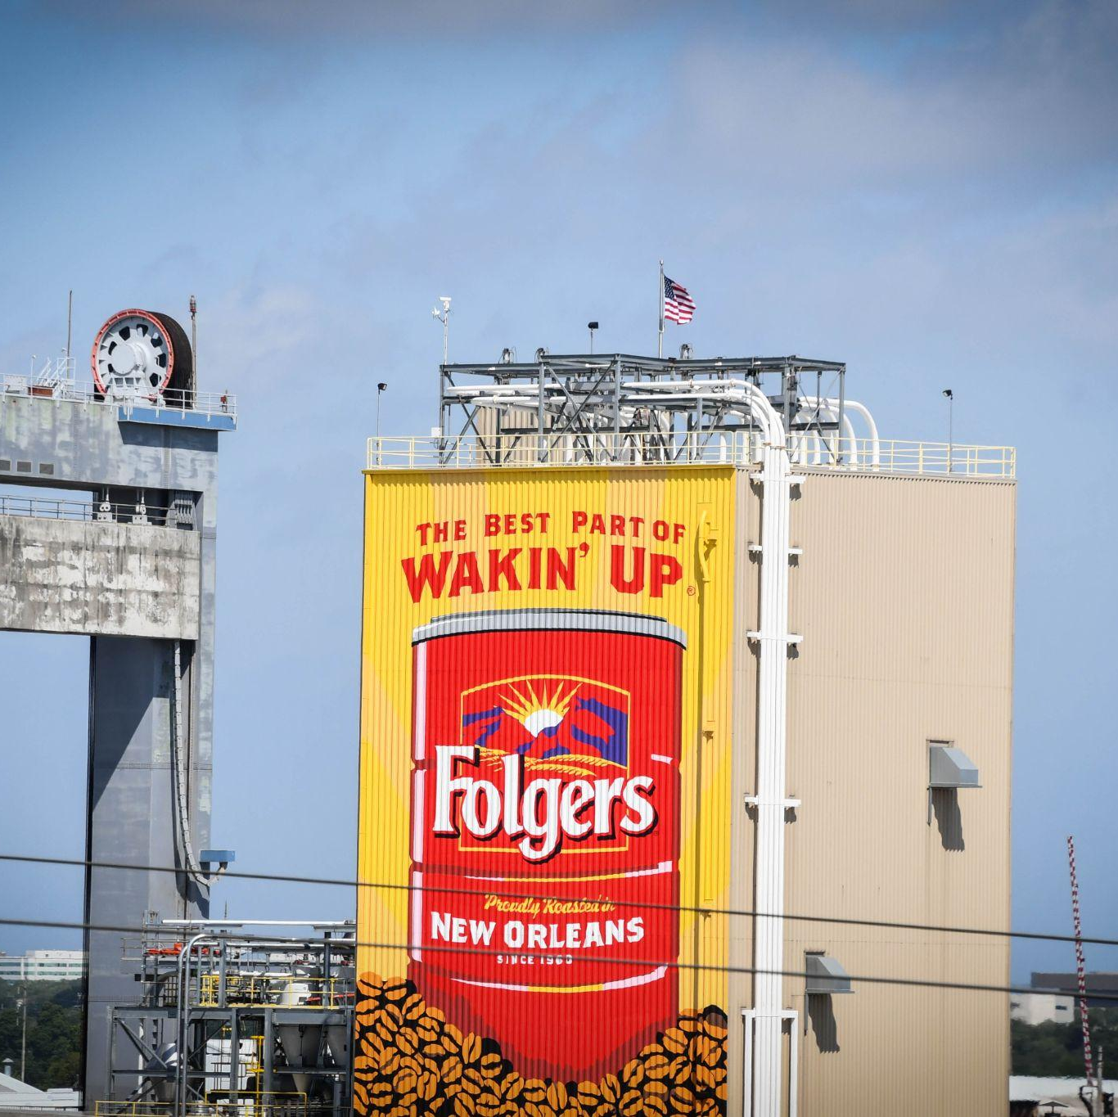
Bean Machine
How did they get here?
1
Coffee beans are grown in other countries, such as Colombia, Costa Rica, and Vietnam.
2
Next, the beans are harvested and put into bags, then these bags are loaded in the orange containers you see above.
3
The beans travel up the river on a boat. When they reach the port, the big blue cranes lift the beans off of the boat.
4
The beans are then brought to the café or market on a plane, train, or truck.

Slide 2
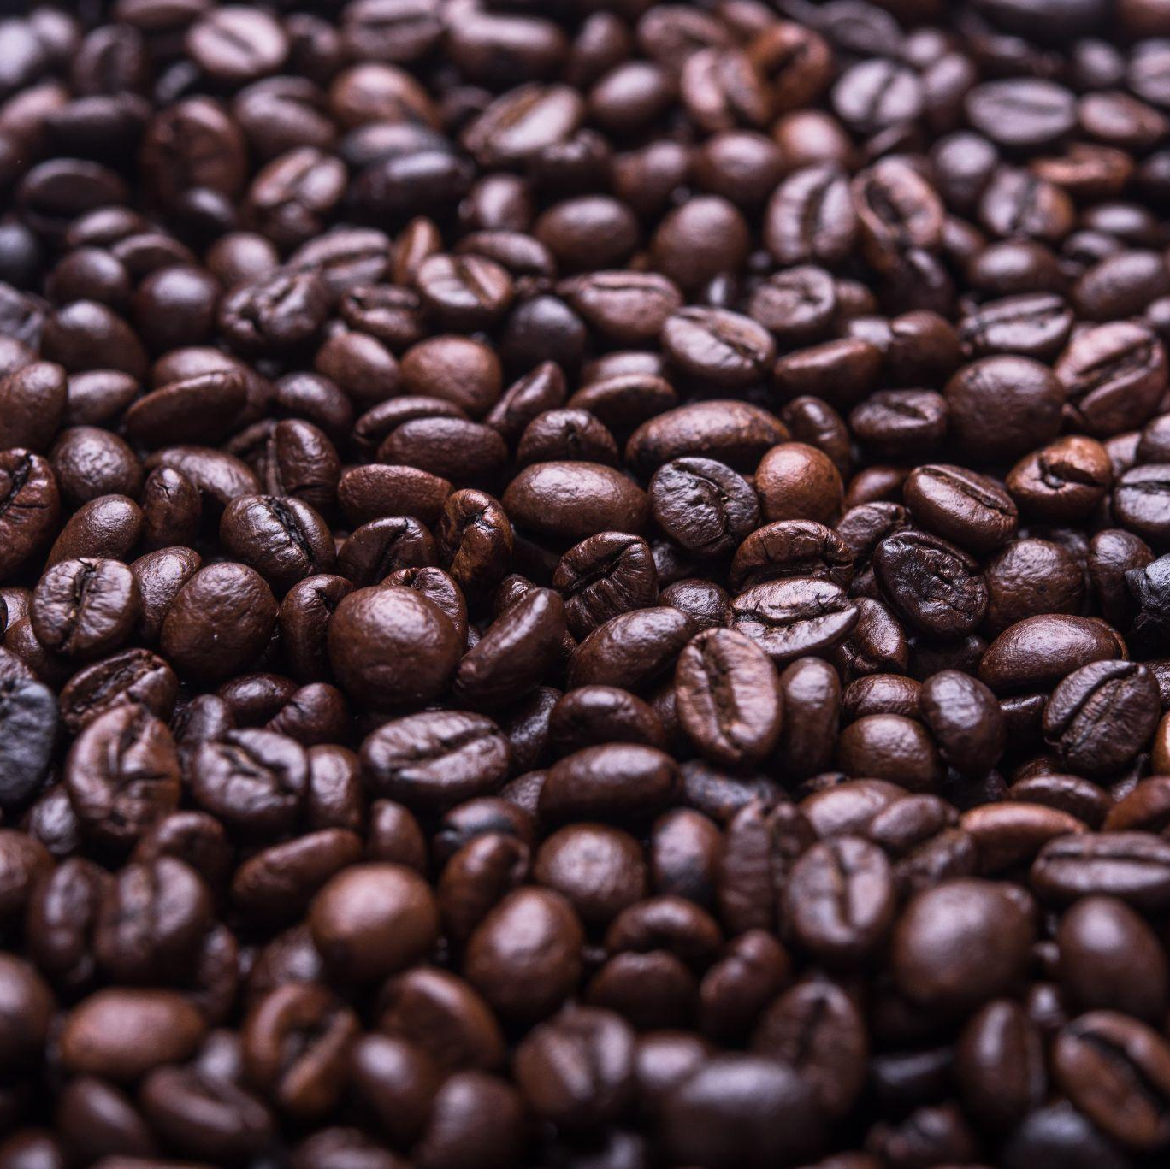
Bean Machine
Of all of the ports in the U.S.A, the Port of New Orleans imports the most coffee - enough to brew twenty billion cups each year!
Can you move beans through the entire machine?
Remember:
Don’t spill the beans!
Play by yourself, or with a friend!
Stand at one of the three green tubs filled with black beans.
Imagine each bean is a bag of coffee. Your coffee needs to pass through each part of the machine before importing.
Observe the bean machine.
What levers do you need to pull?
What tubes do you need to move?
If you spill the beans, you lose money!

Slide 3
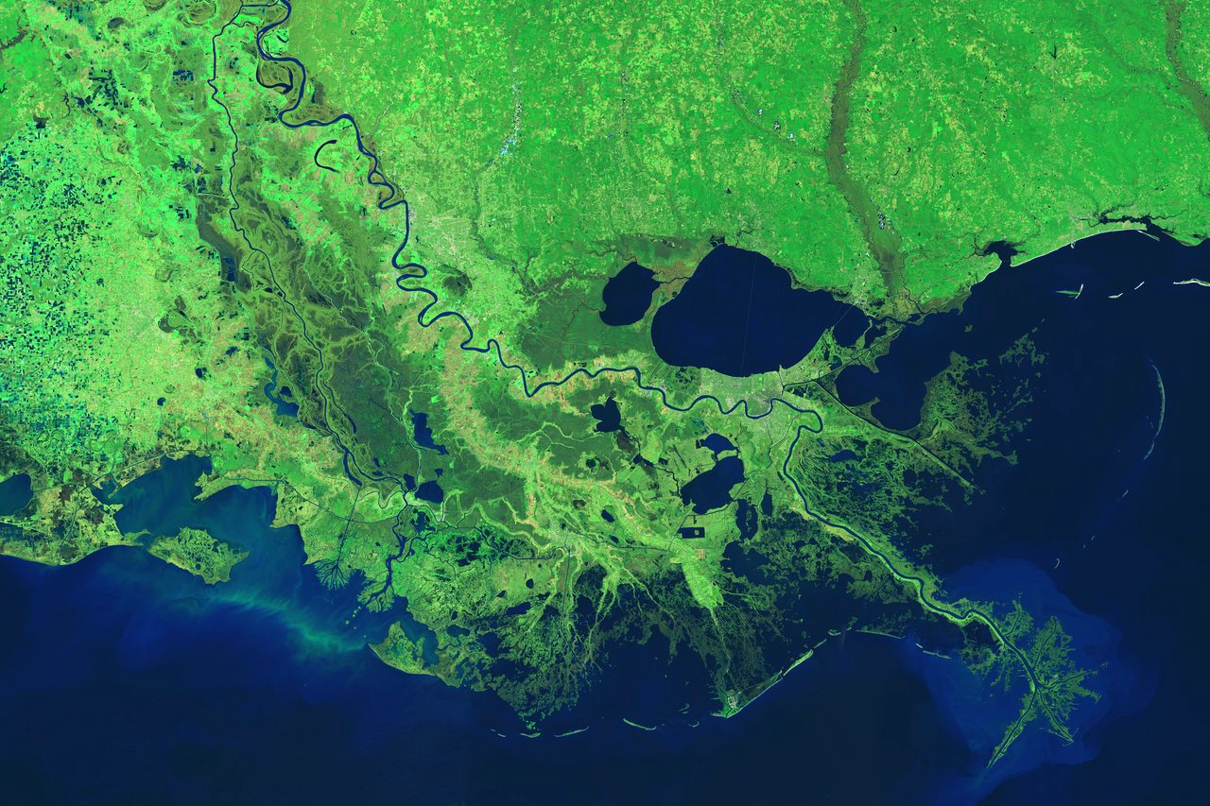
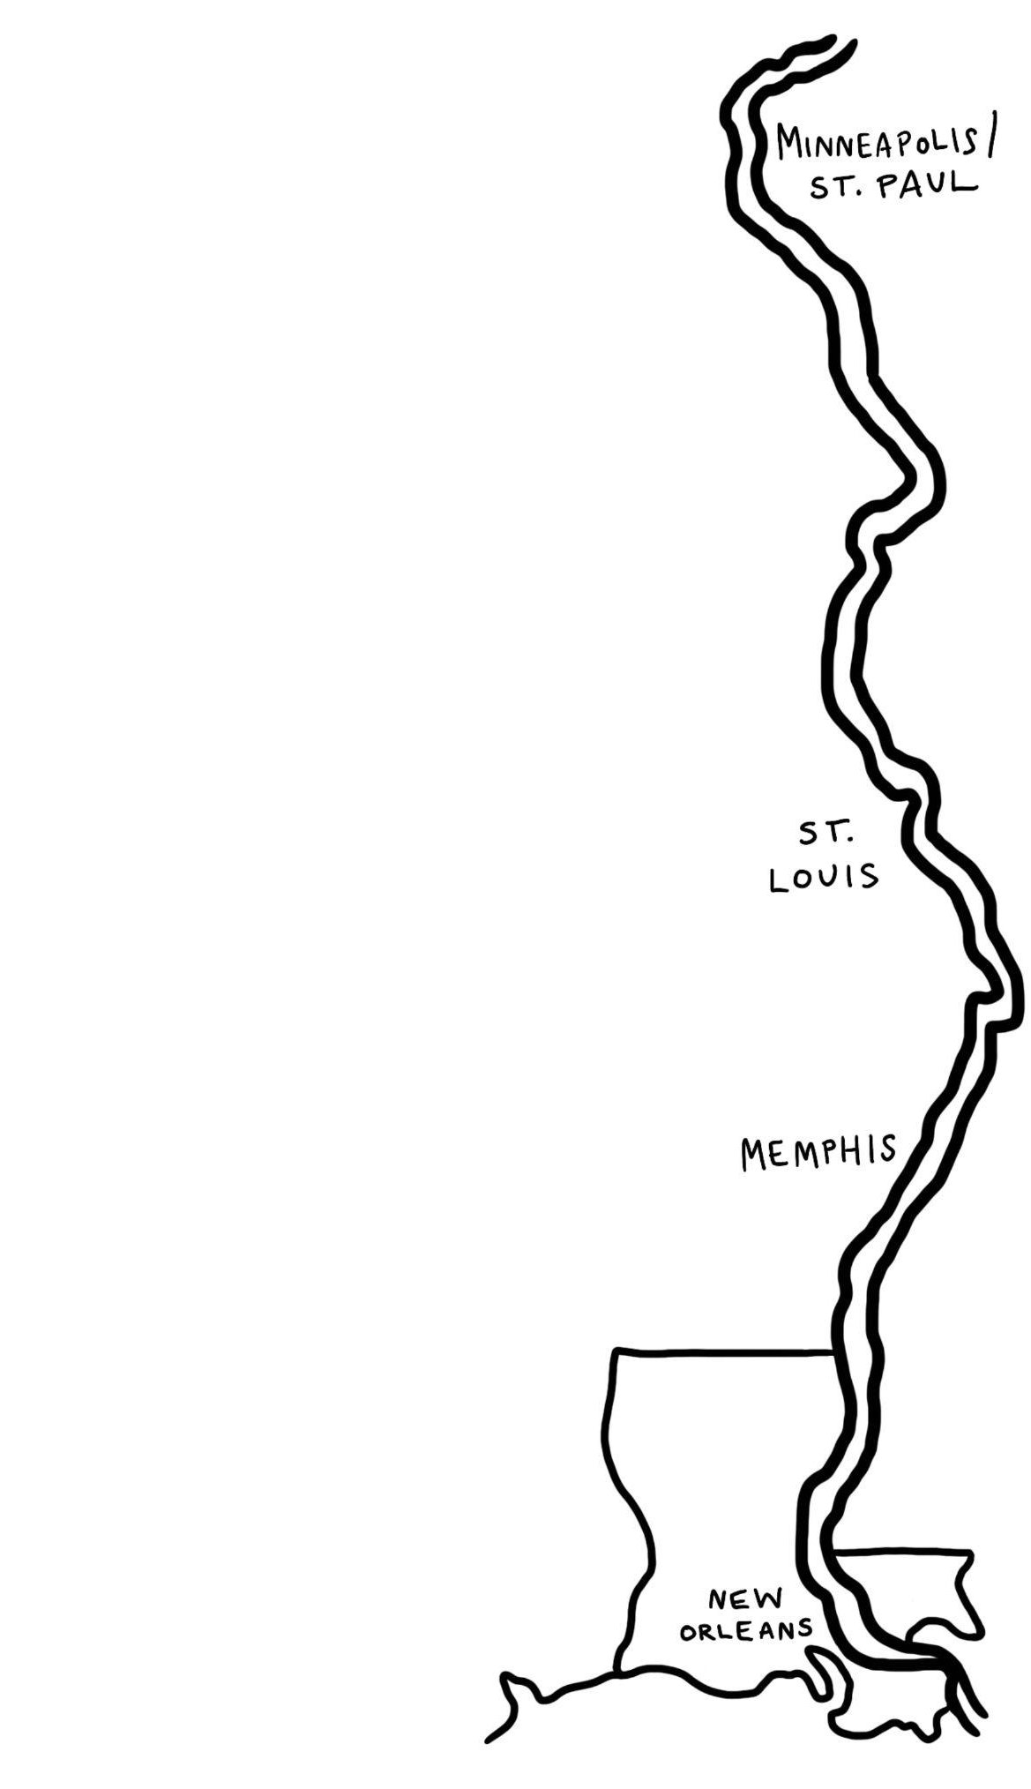
Follow that Food
Moving Up the Mississippi River
Start
Many of the foods we eat traveled from far away places to end up on our plates.
Fruits and veggies grown around the world are brought inland, or up the river, by boat.
The Mississippi River flows through the center of the U.S., past many major cities.
It is an essential pathway for importing food to places that are far from the ocean.

Slide 4
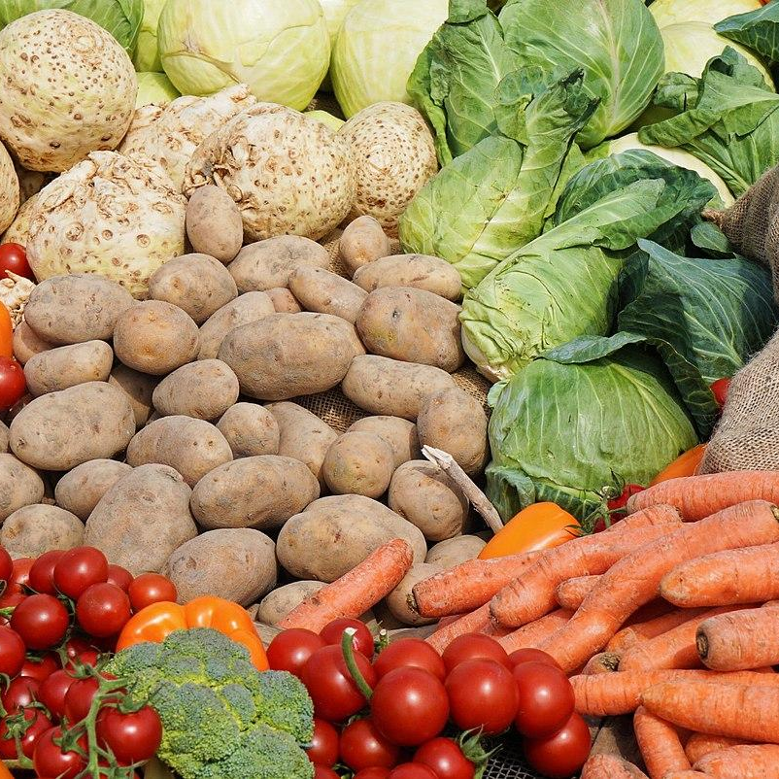
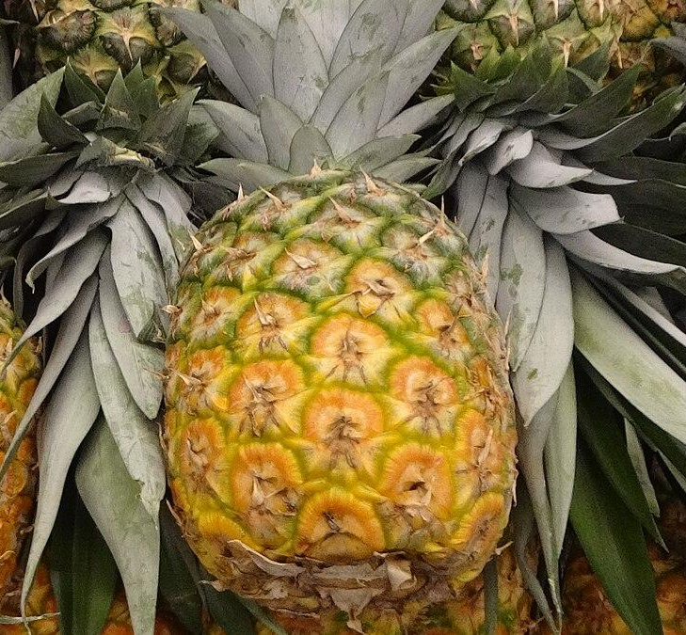
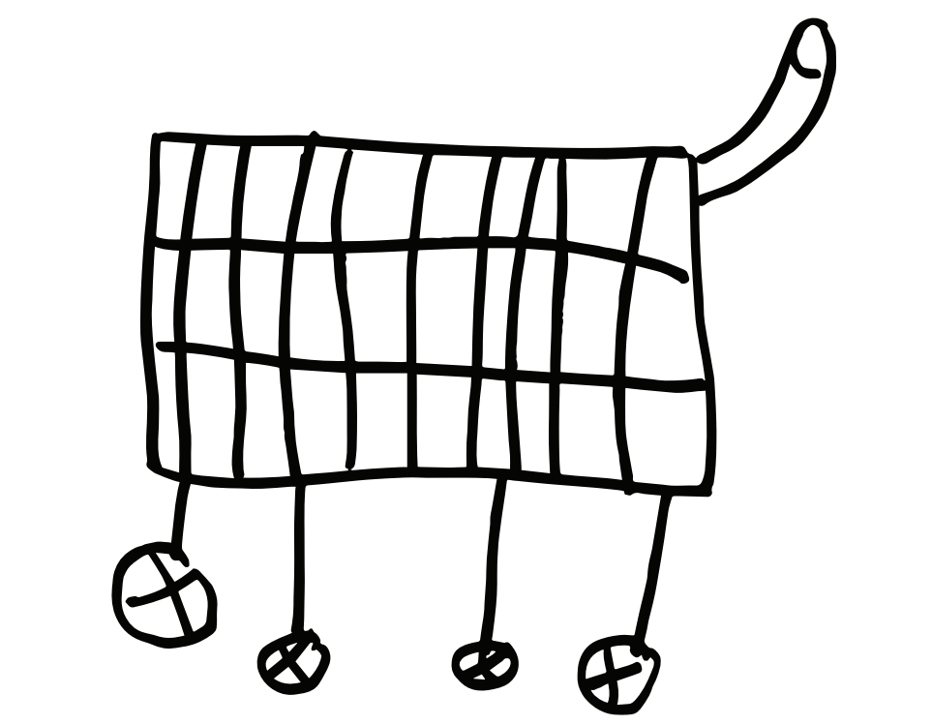
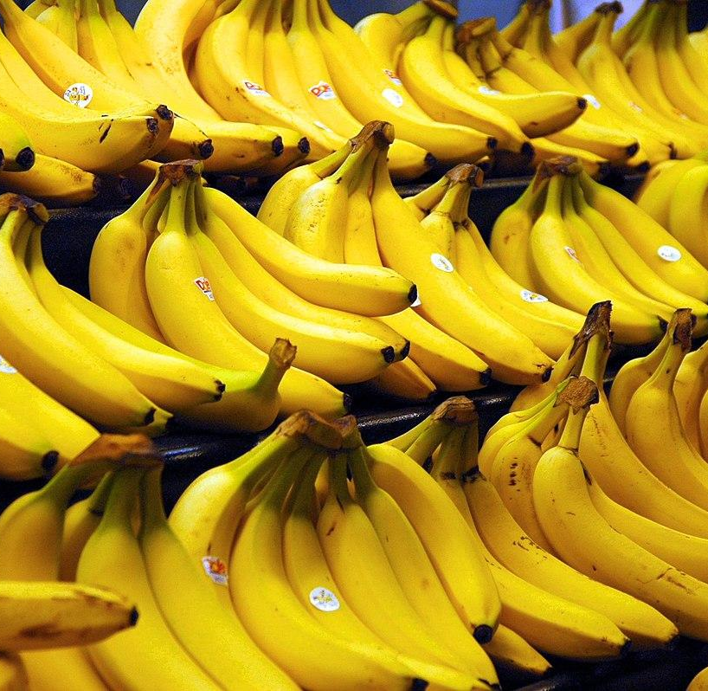
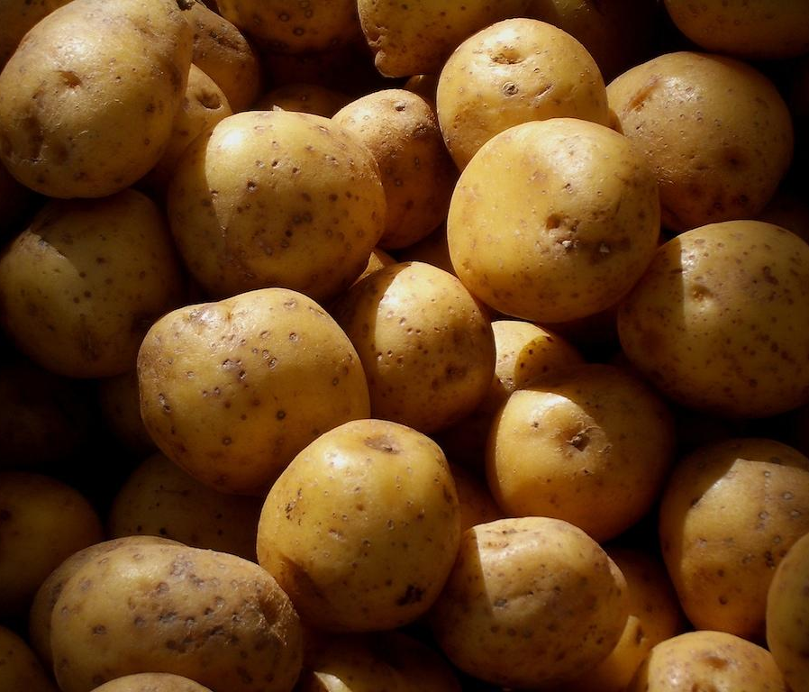
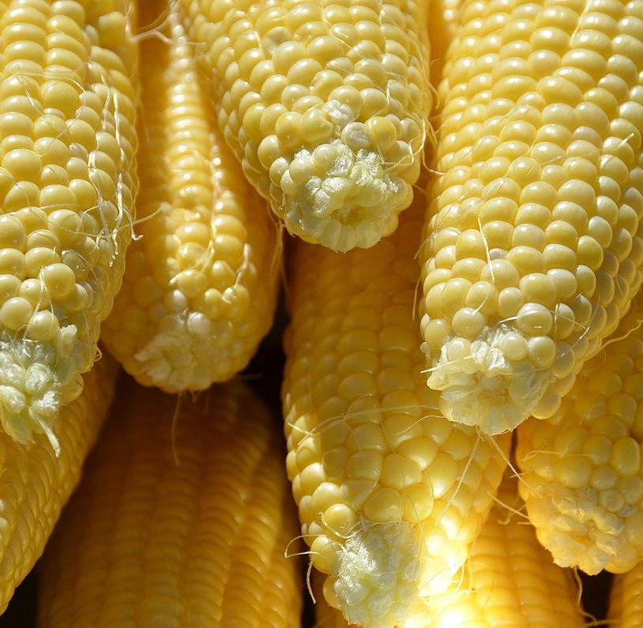
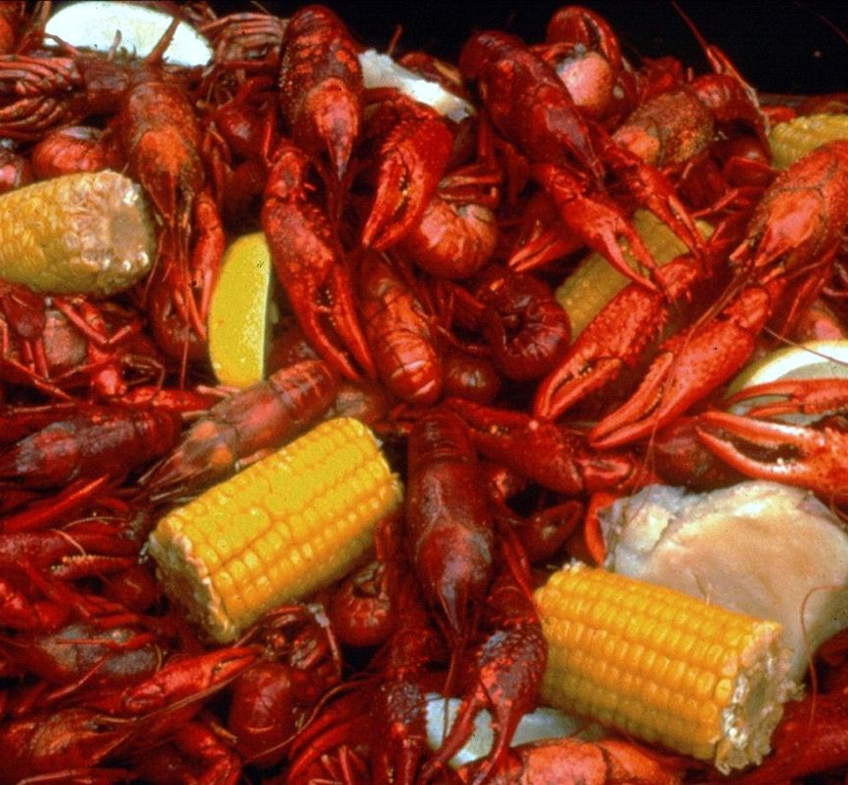
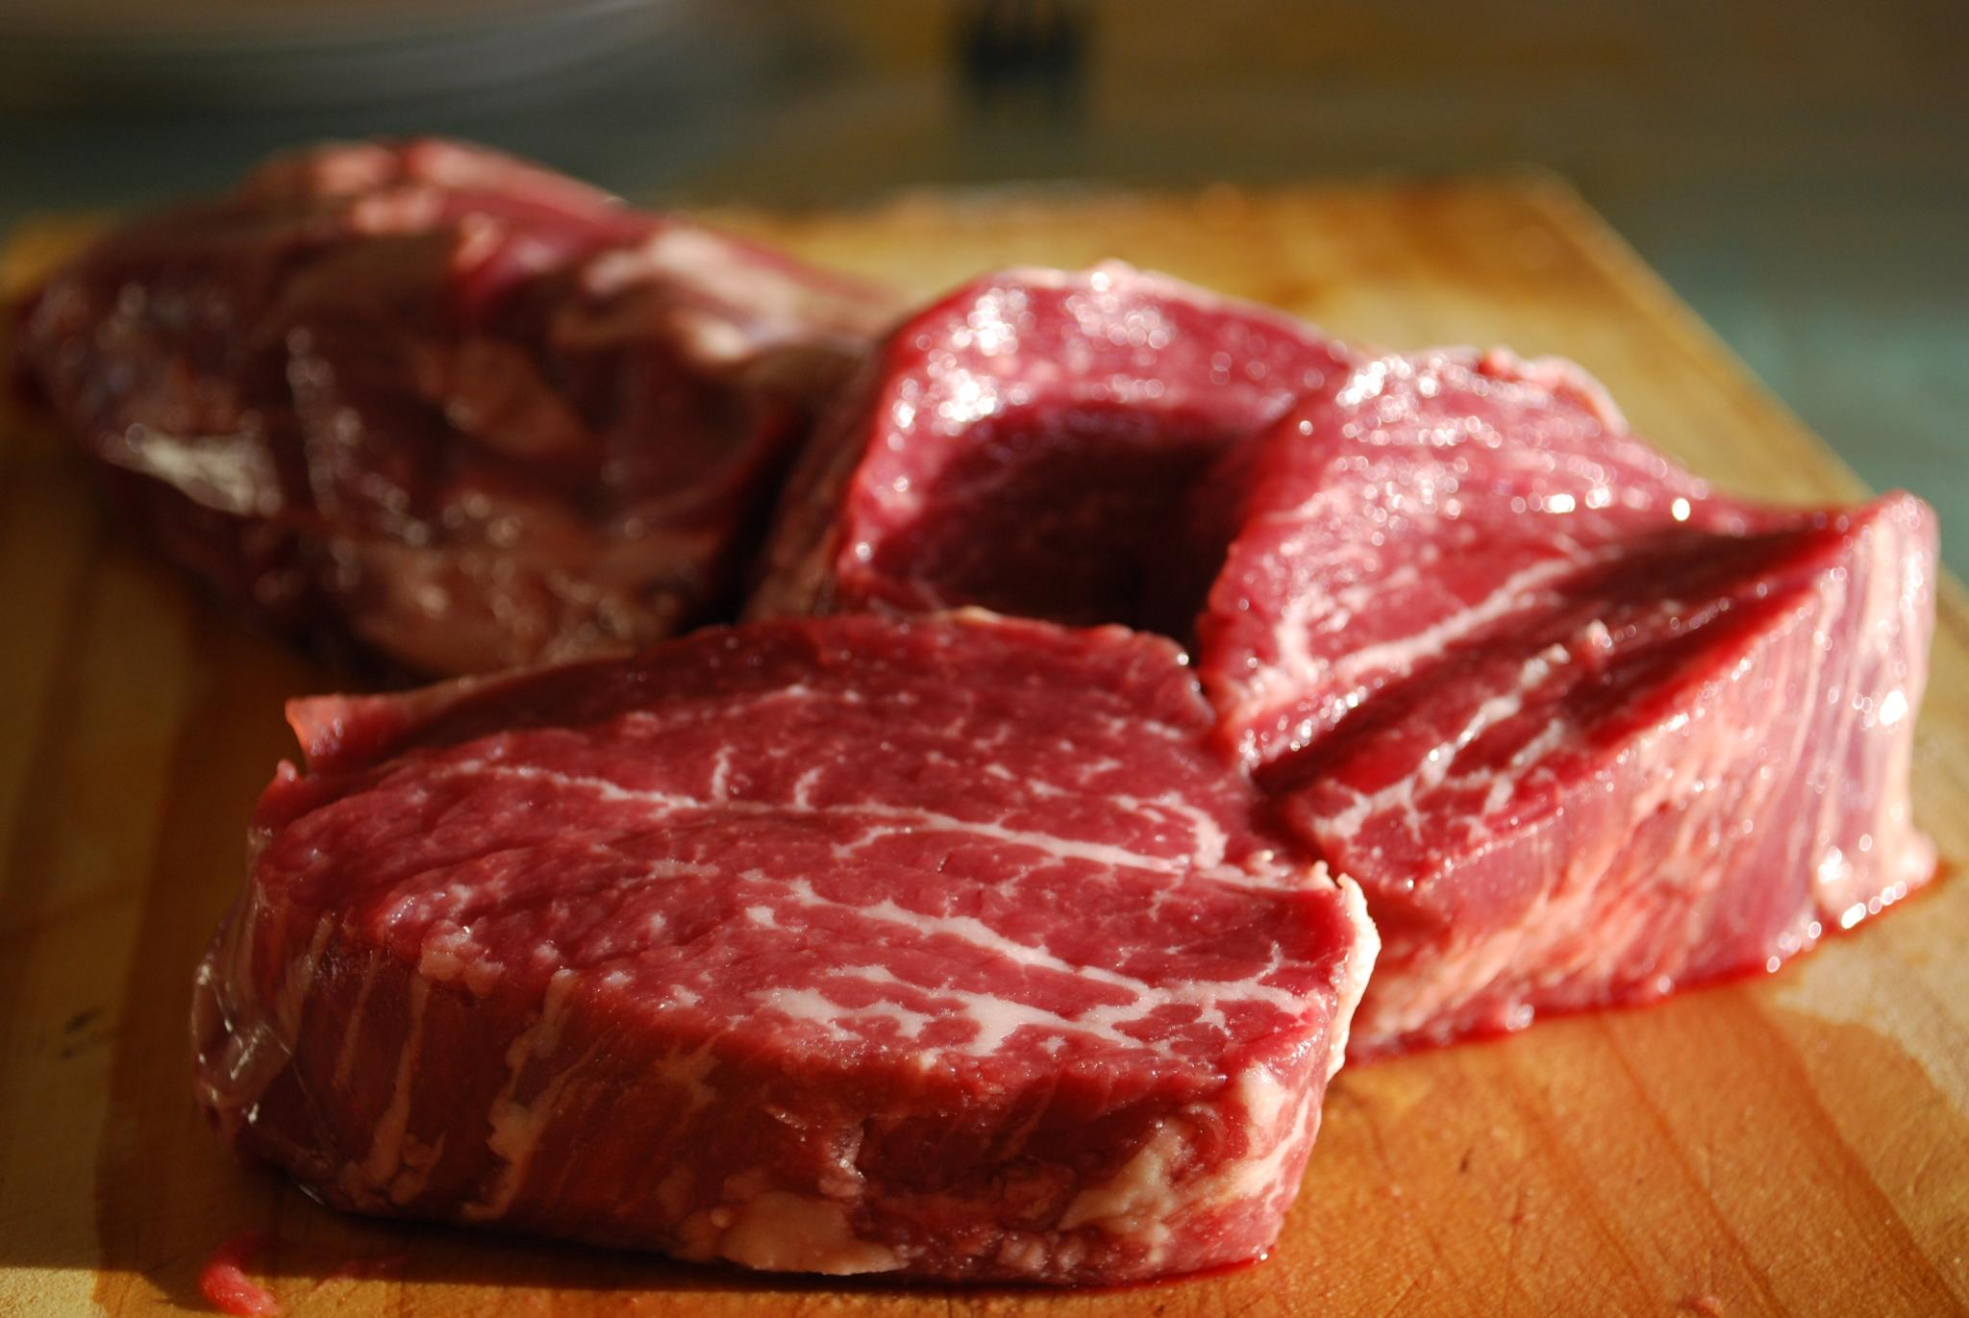
Follow that Food
We import foods grown far away, and we export foods that are grown close to our homes. Where do you think your lunch was grown? What makes you think so?
Can you find 3 imports?
pineapple
banana
potato
Can you find 3 exports?
corn
meat
seafood

Slide 5
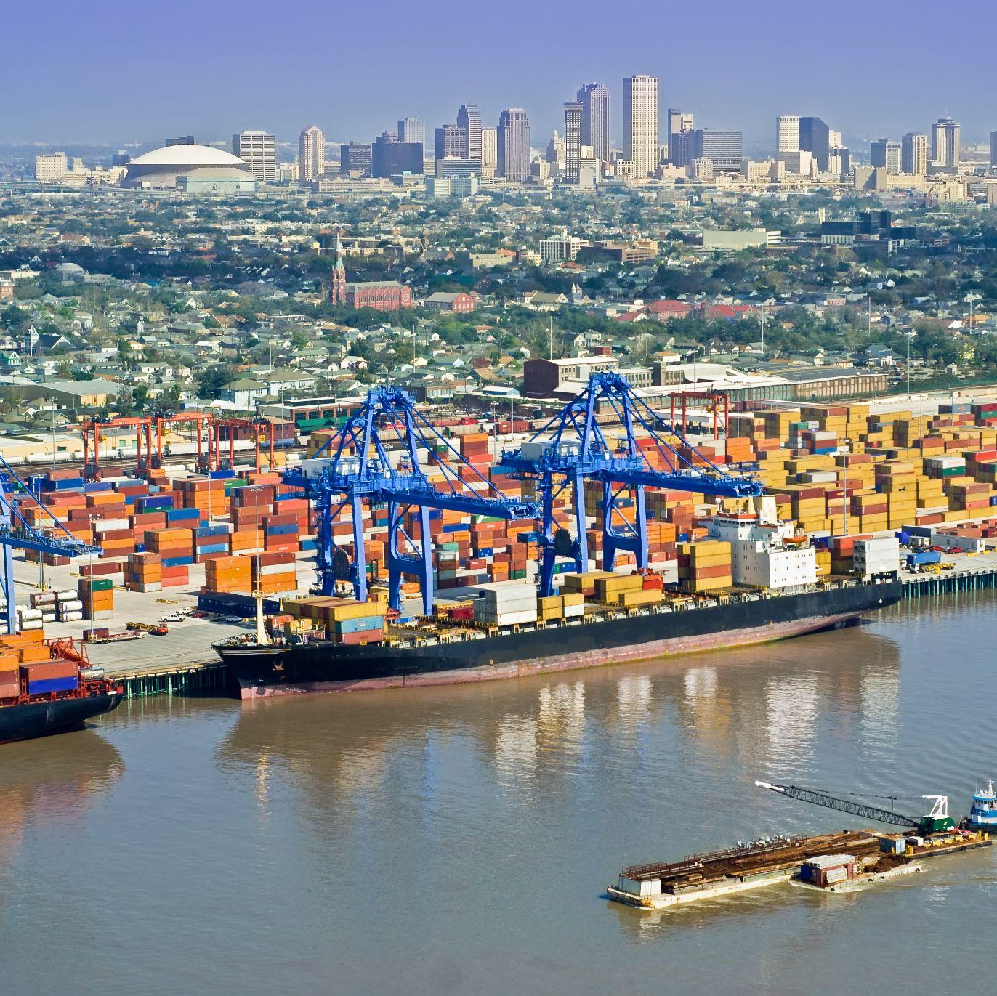
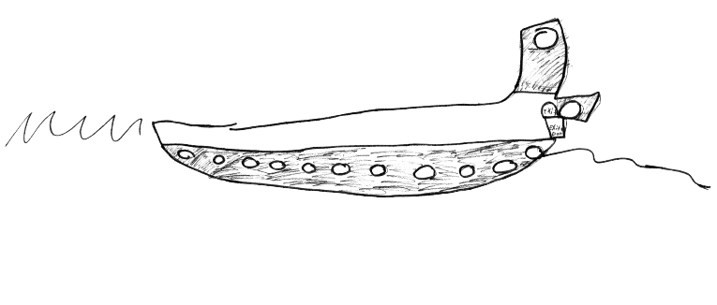
Cargo Captains
Mouth of the Mississippi River
The Port of New Orleans is one of the largest in the U.S. Many of the foods we eat are imported from other countries. Cargo is carried up the Mississippi River by boat, then brought to stores around the country by plane, train, or truck.
Why is New Orleans an important port city?
How do boats move against the flow of water?
Why do humans want to travel up the river?

Slide 6
Cargo Captains
Fill your boat with ping-pong balls, then relay race upriver!
If you run or lose any cargo, you must start over!
6 people can play!
2 teams of 3
One teammate should stand:
At the mouth of the Mississippi
Behind the blue circle “New Orleans”
Behind the area labeled “Industrial”
Player at the mouth of the Mississippi: Fill your boat with ping-pong ball cargo. Each color is a different import.
Use the string to pull your boat upriver
Pass the string to your teammate
Be careful! Don’t run or drop the boat!
Pass the string at the Industrial area
When you get to the dam at the top of the river, see what cargo you imported!

Slide 7
Mayor for a Month
If you were the mayor, how would you live with water?
Design and build a resilient city safe from storms
Play by yourself, or with a friend!
Grab 3 blocks, then sit on a purple stool:
1 block is your house
1 block is your school
1 block is a park, levee, or pond
Place your blocks on the table. The silver line in the middle of the table represents the Mississippi River.
Oh no! A hurricane! The block closest to the river flooded.
Move 1 block so this building is safe.
Why is it now protected from flooding?
Oh no! A drought!
How would you use water from the river to help the people and plants at school?

Slide 8
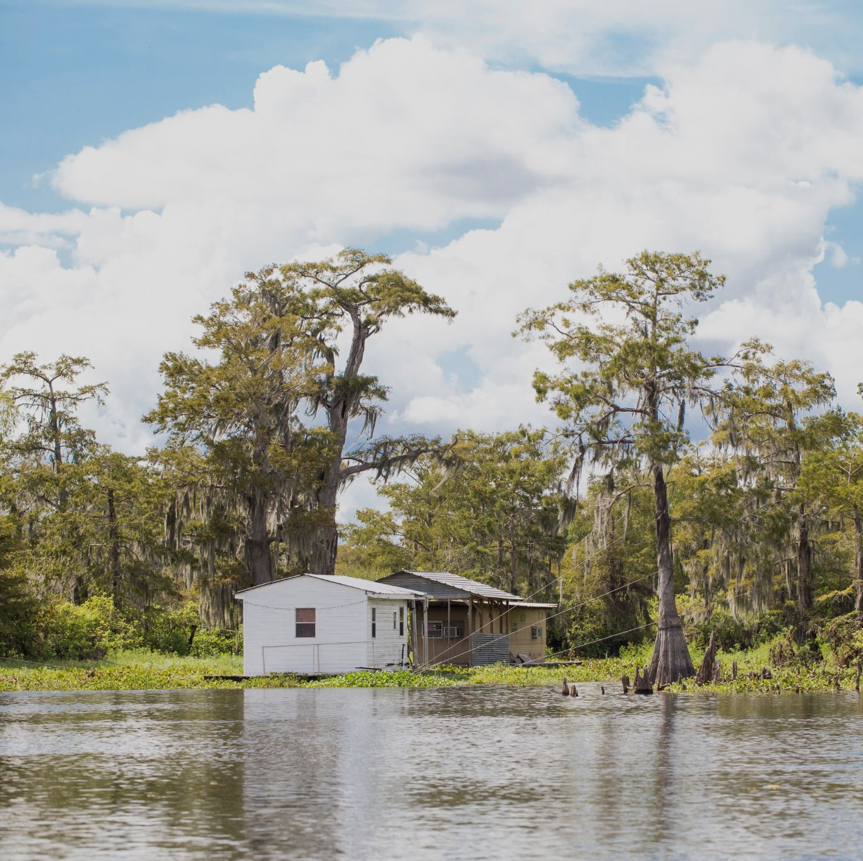
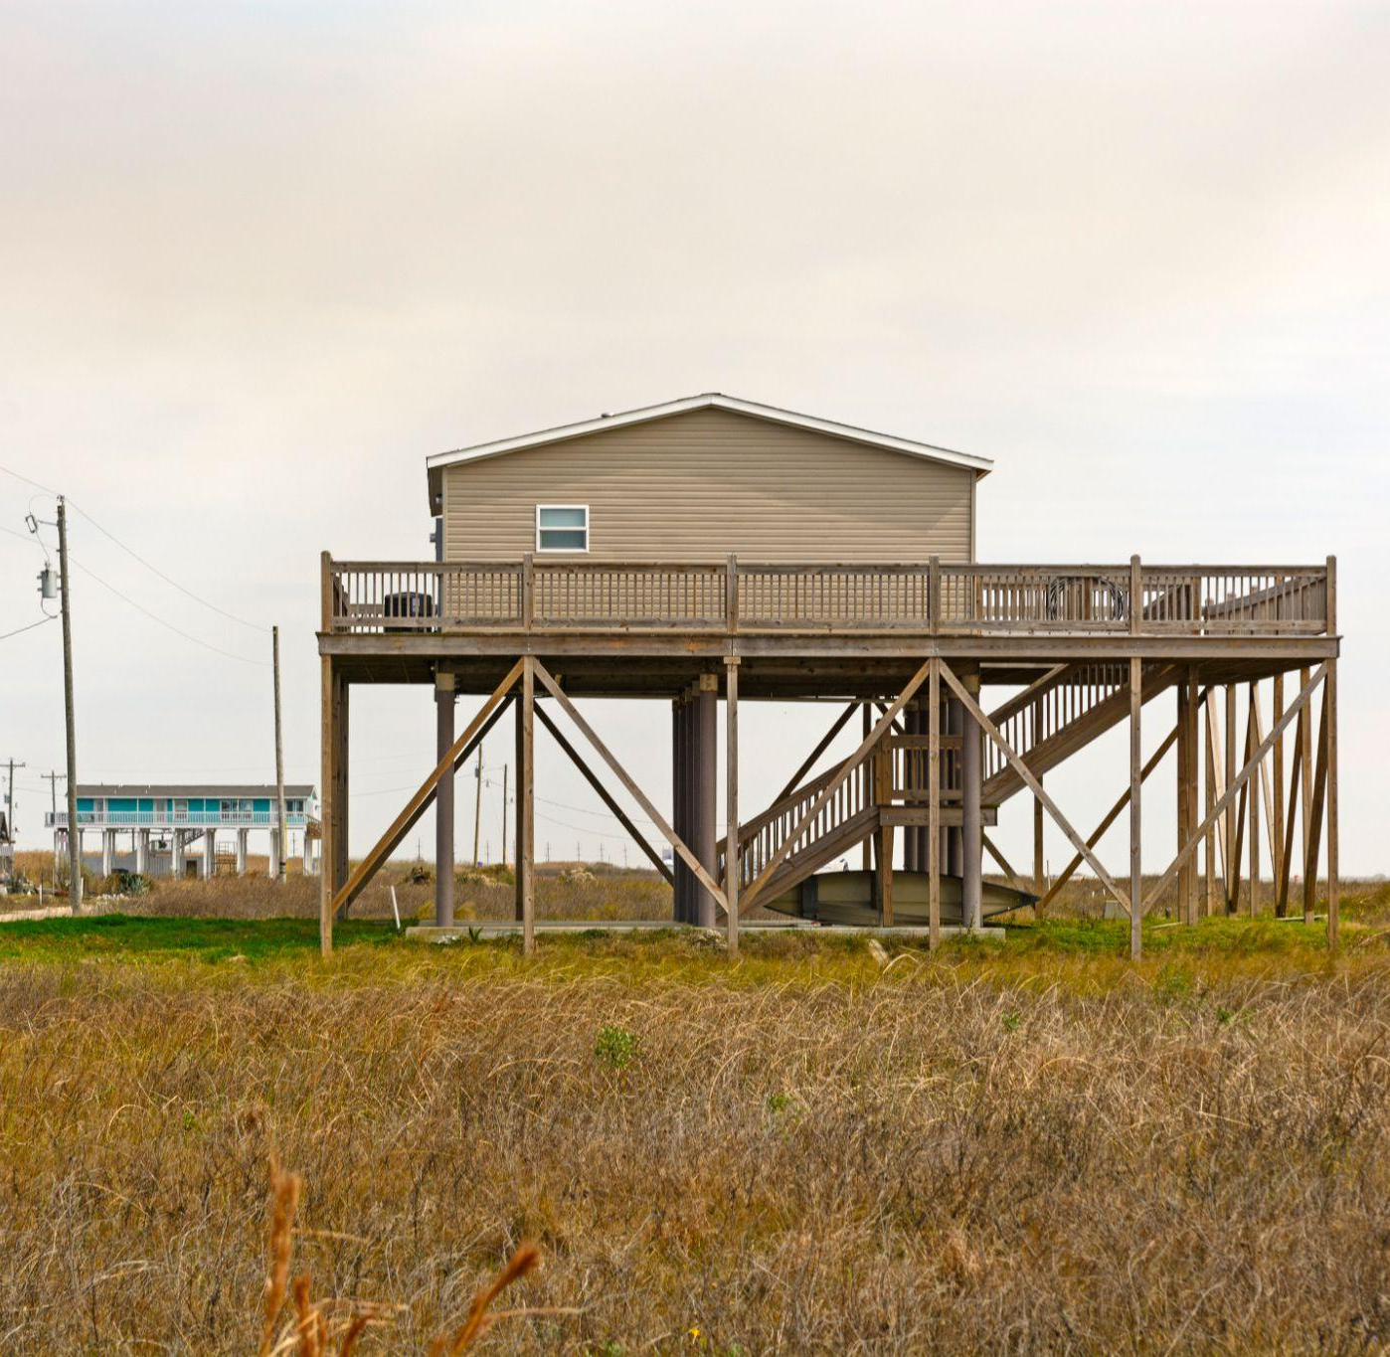
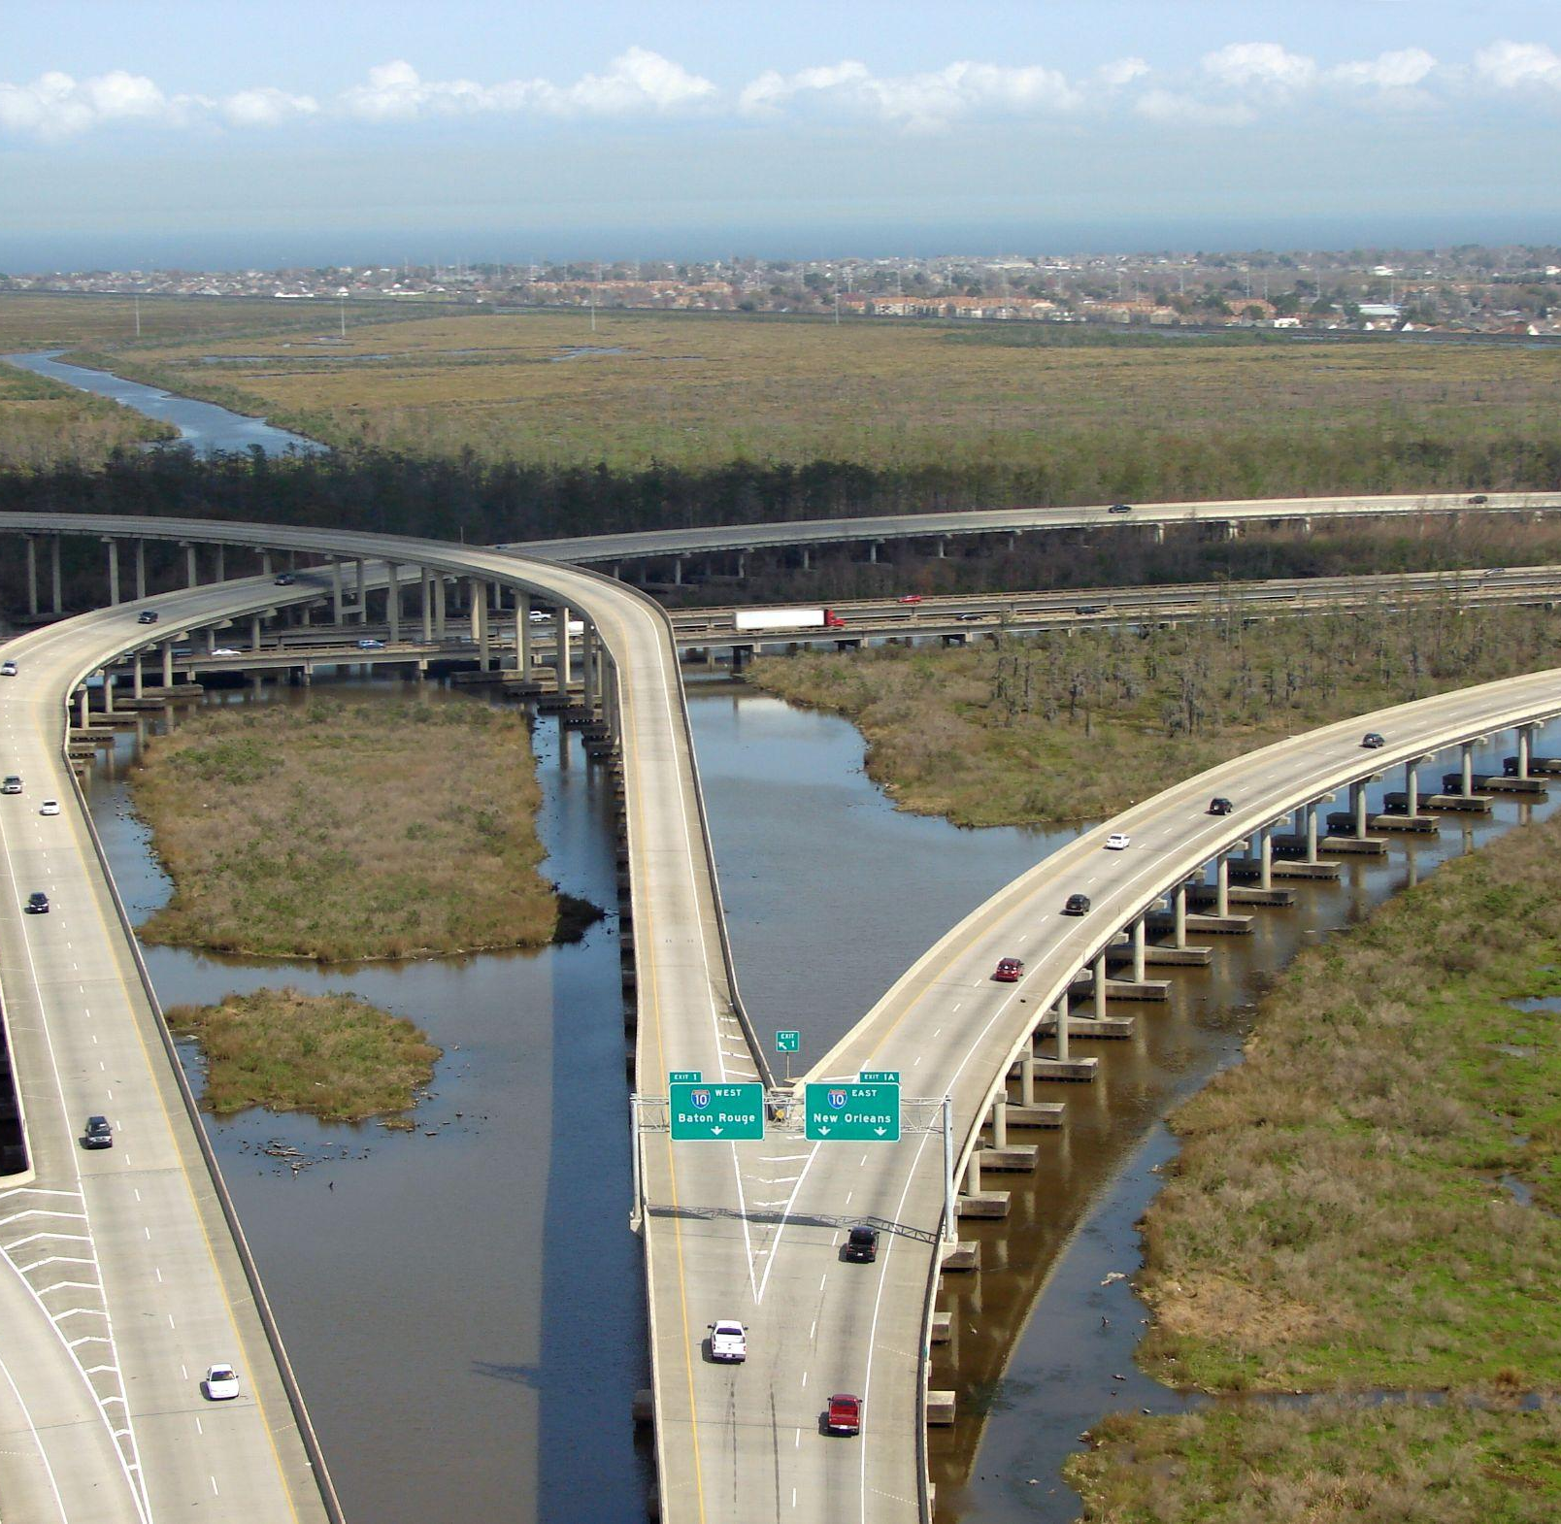
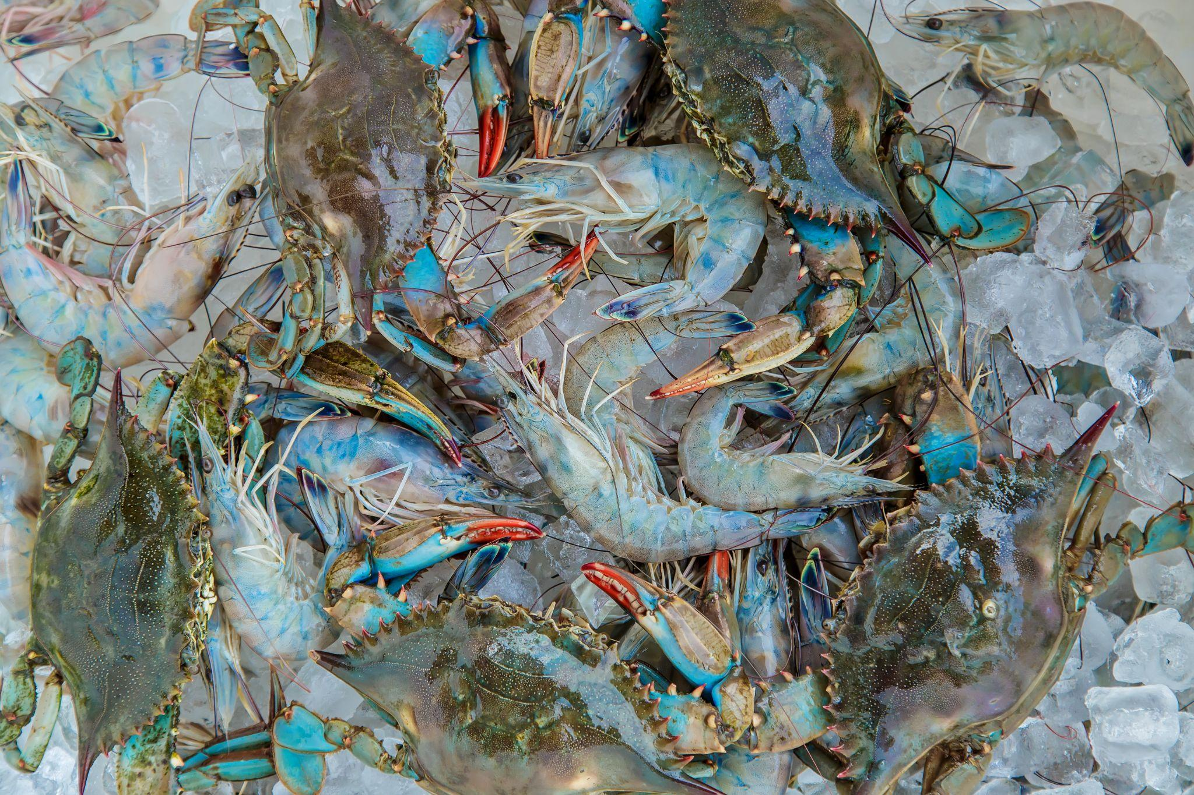
Swamp in a Sack
The land in coastal Louisiana is made up of absorbent soils, water-tolerant trees, and animals ready to adapt to the wetland ecosystem. Human beings have found ways to live with water, too.
how we build
how we move
how we eat

Slide 9
Swamp in a Sack
Watch how the water flows, and observe how the sediment moves!
Where should you place your swamp? Why?
3 teams can play
at the same time
New Orleans
Look at the Sedimentation Table.
How is the water moving the sediment?
Where is sediment building?
Where is sediment eroding?
Where do you think a wetland would naturally form if this was the landscape?
What buildings do you need to protect?
Talk with your team and decide where to place your Swamp in a Sack.
Put your Swamp on the table at the same time as the other teams
Take notes about what you observe!
What swamp is more absorbent?
What swamp holds together better?

Slide 10
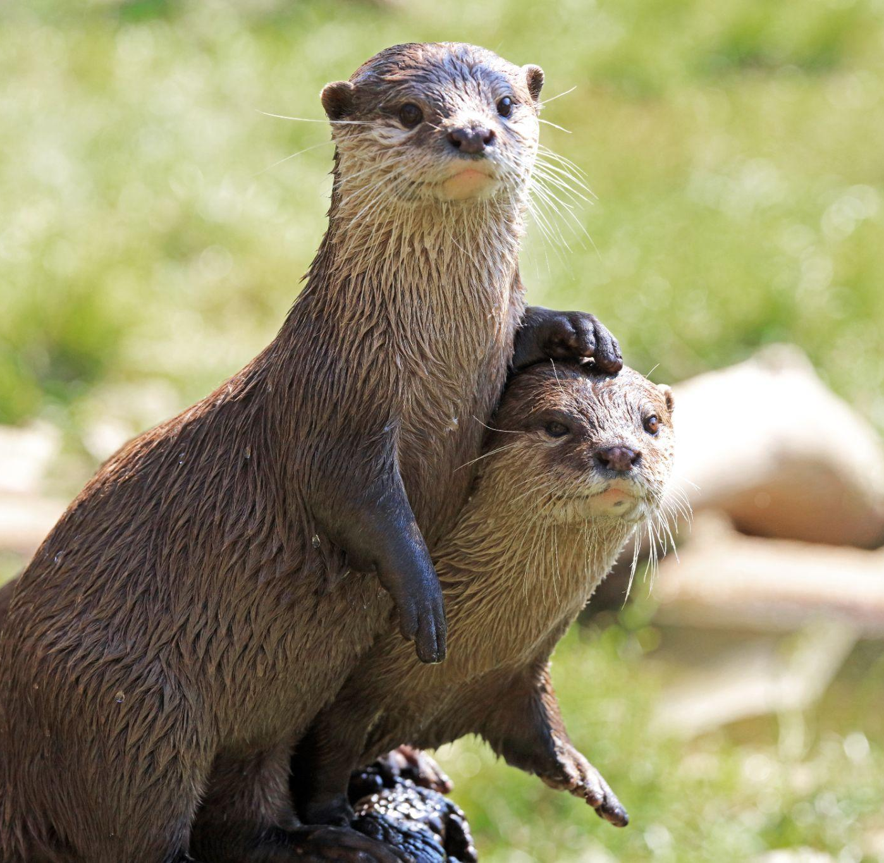
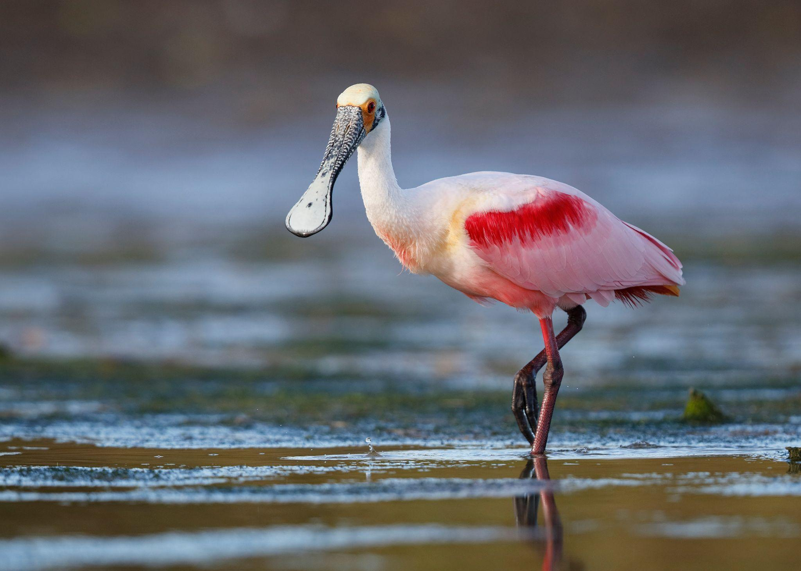
Nature Notes
How have the plants and animals you see adapted to the wetland environment?
Why do they live here, and not somewhere else?
New Orleans
What would happen if one species left?
How did they adapt?
roots
beak
fur
color

Slide 11
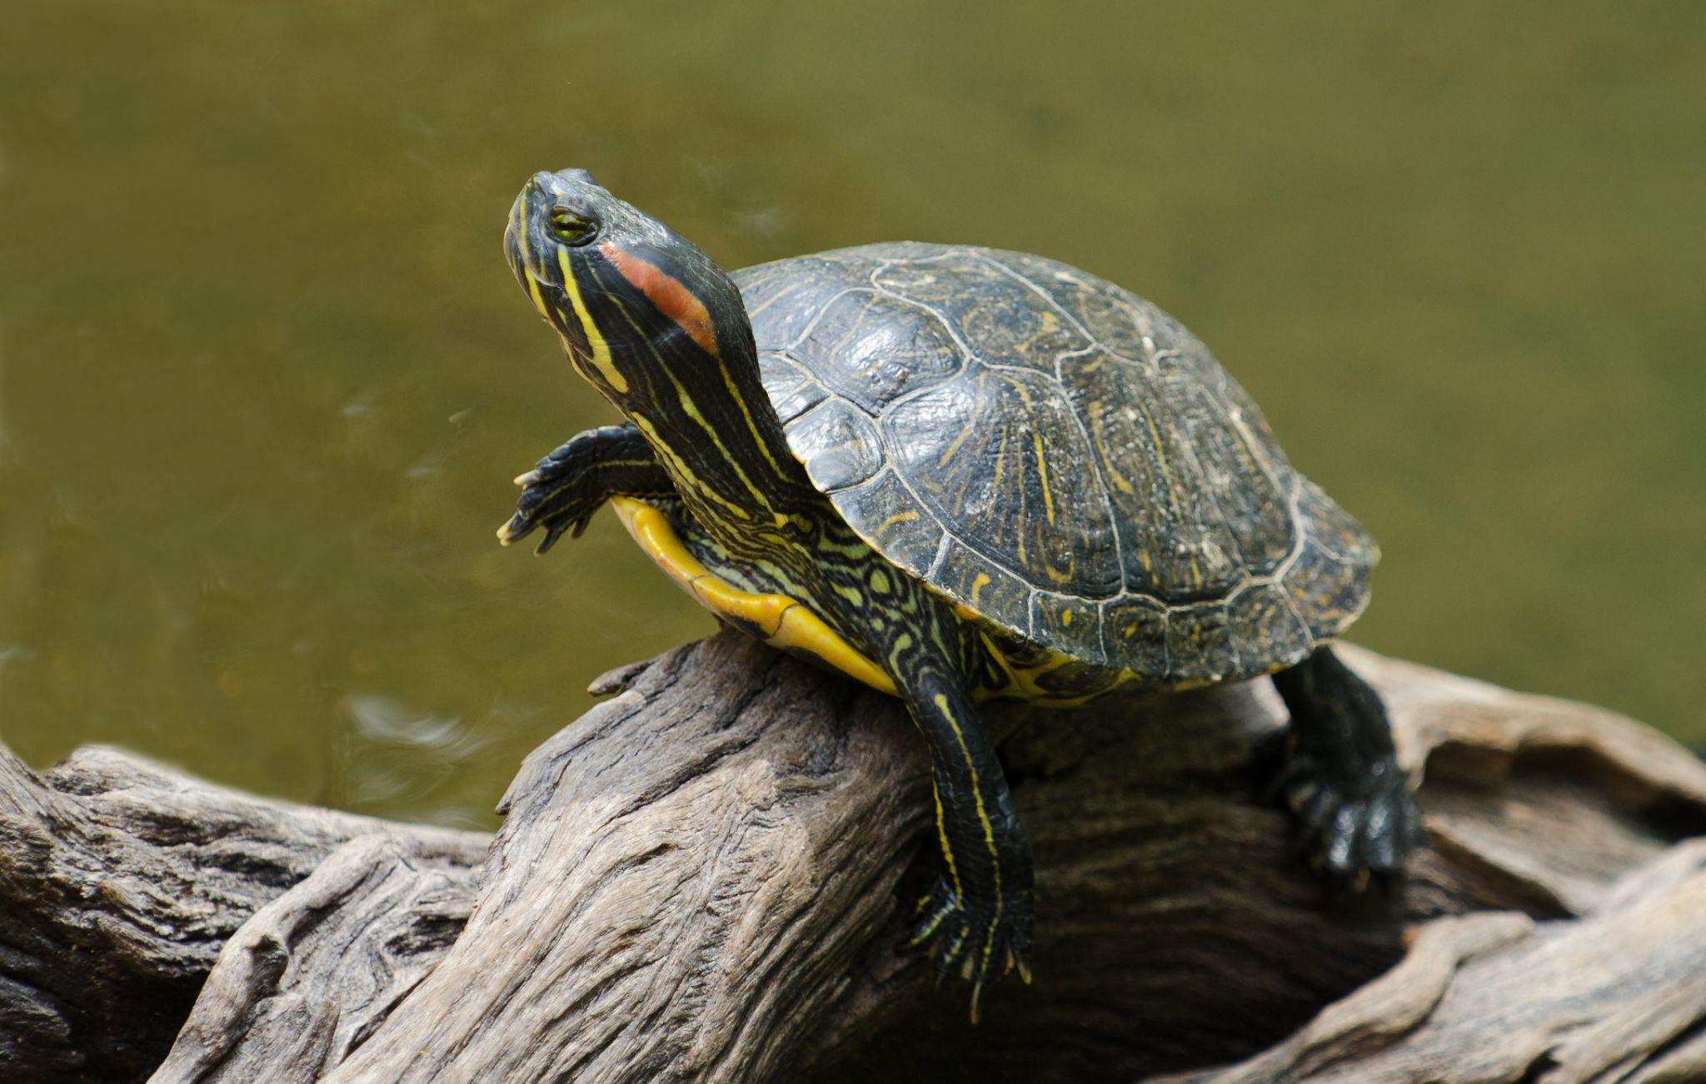
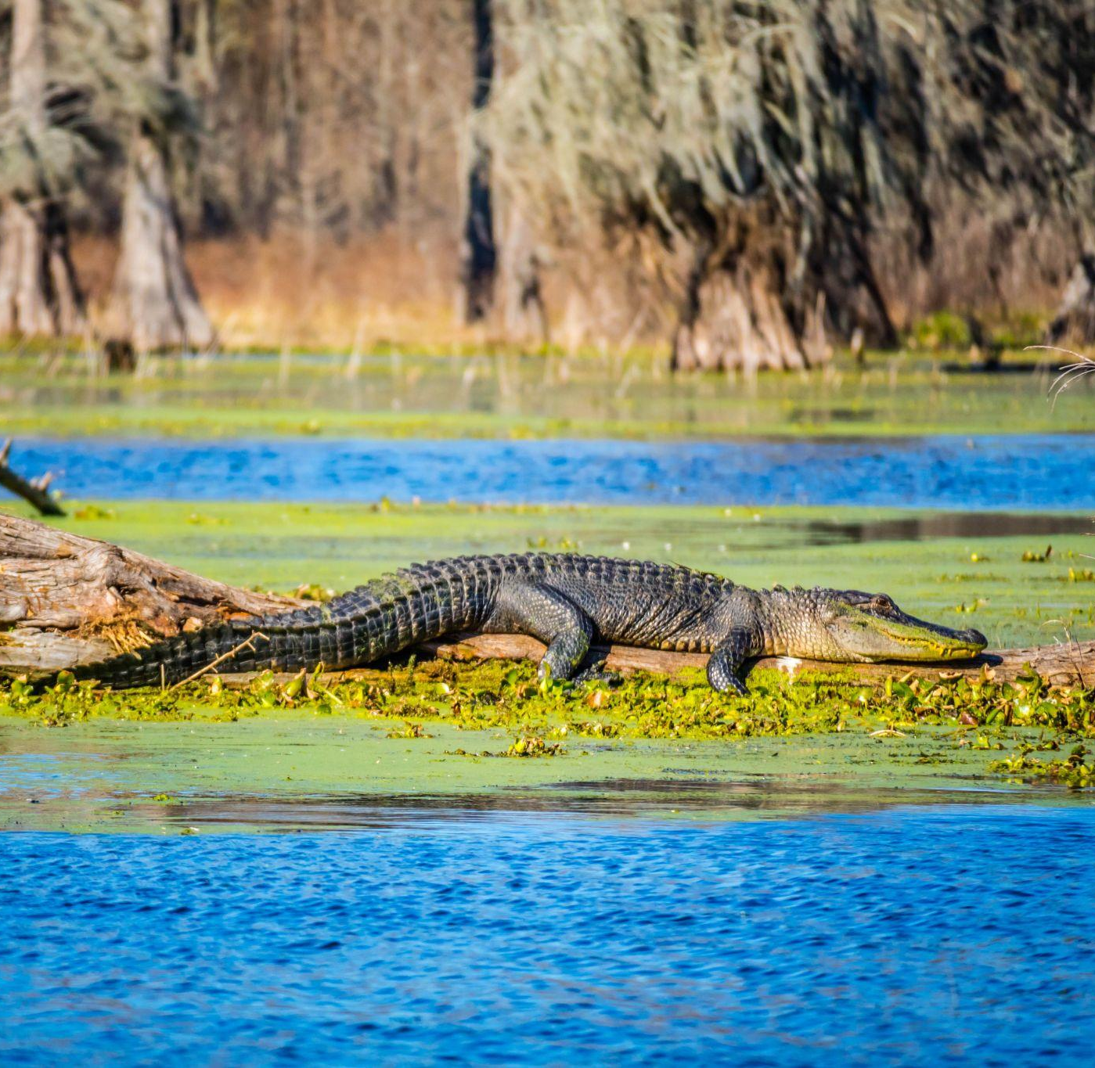
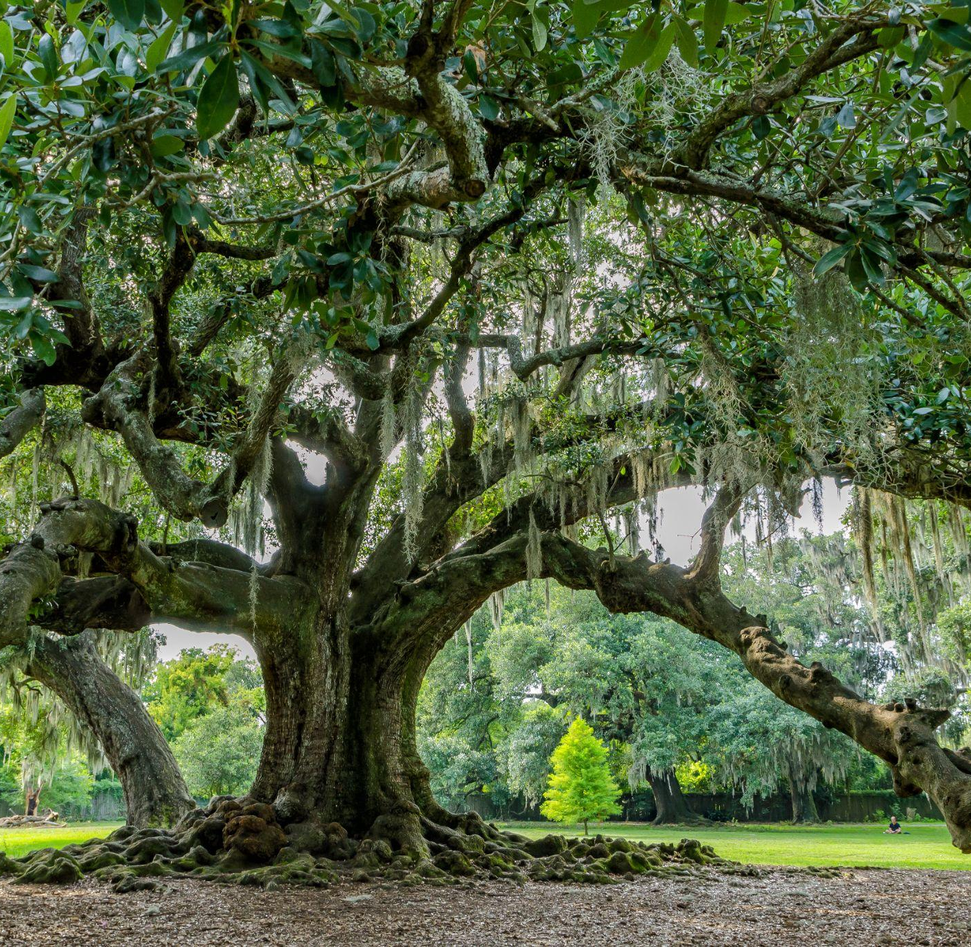
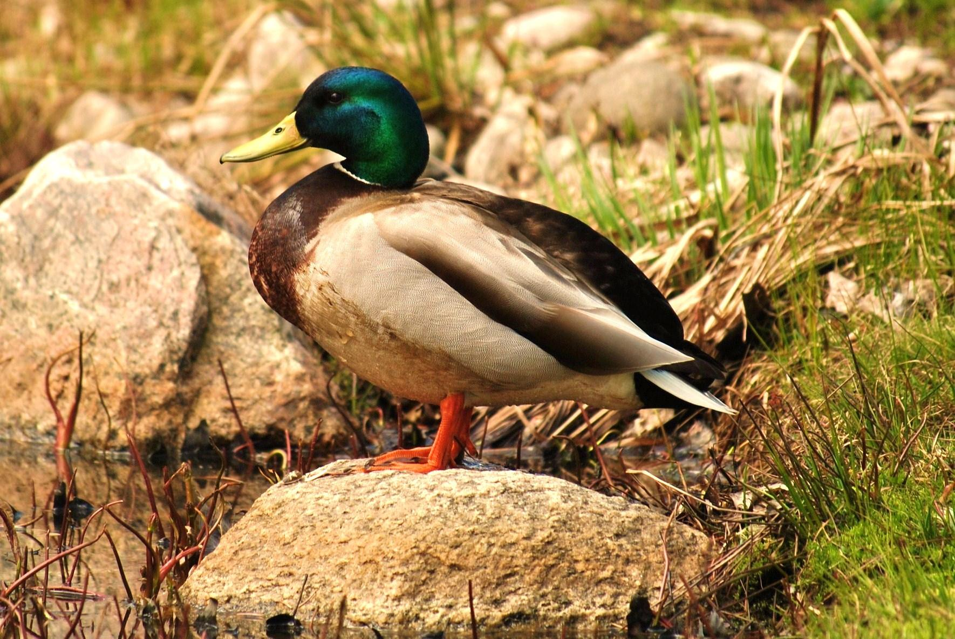
Nature Notes
New Orleans
Who lives at LCM?
turtle
alligator
egret
blue heron
live oak
mallard duck

Slide 12
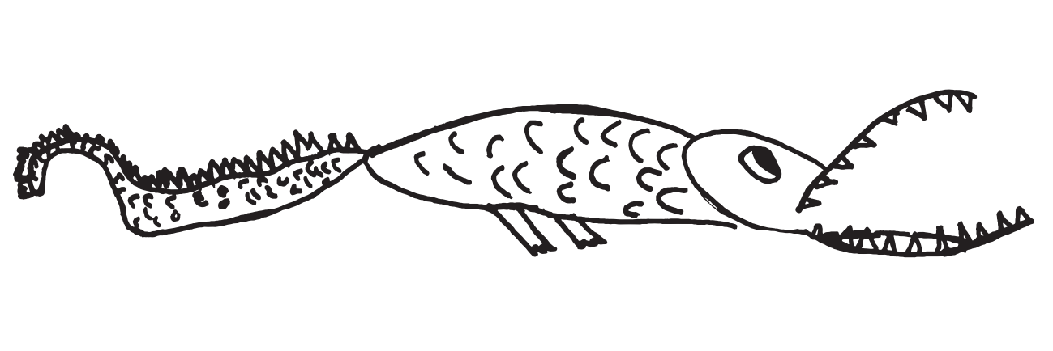
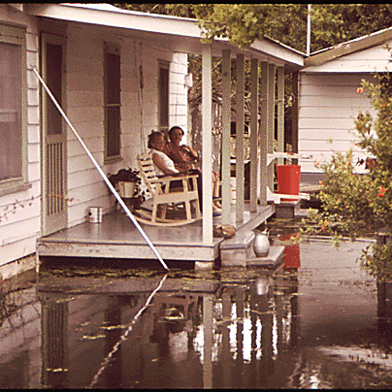
What is a Wetland?
How are wetland plants and animals alike? How are they different?
Why are wetlands important?
New Orleans
New Orleans
How does sediment absorb water?
Using the paper on the tables around you, design a solution for flooding. How do we keep our cities safe living with water? Draw a map showing your idea!
How can water be used for good, as an asset? What benefits do we have living so close to rivers, lakes, bayous, and the Gulf of Mexico?

Slide 13
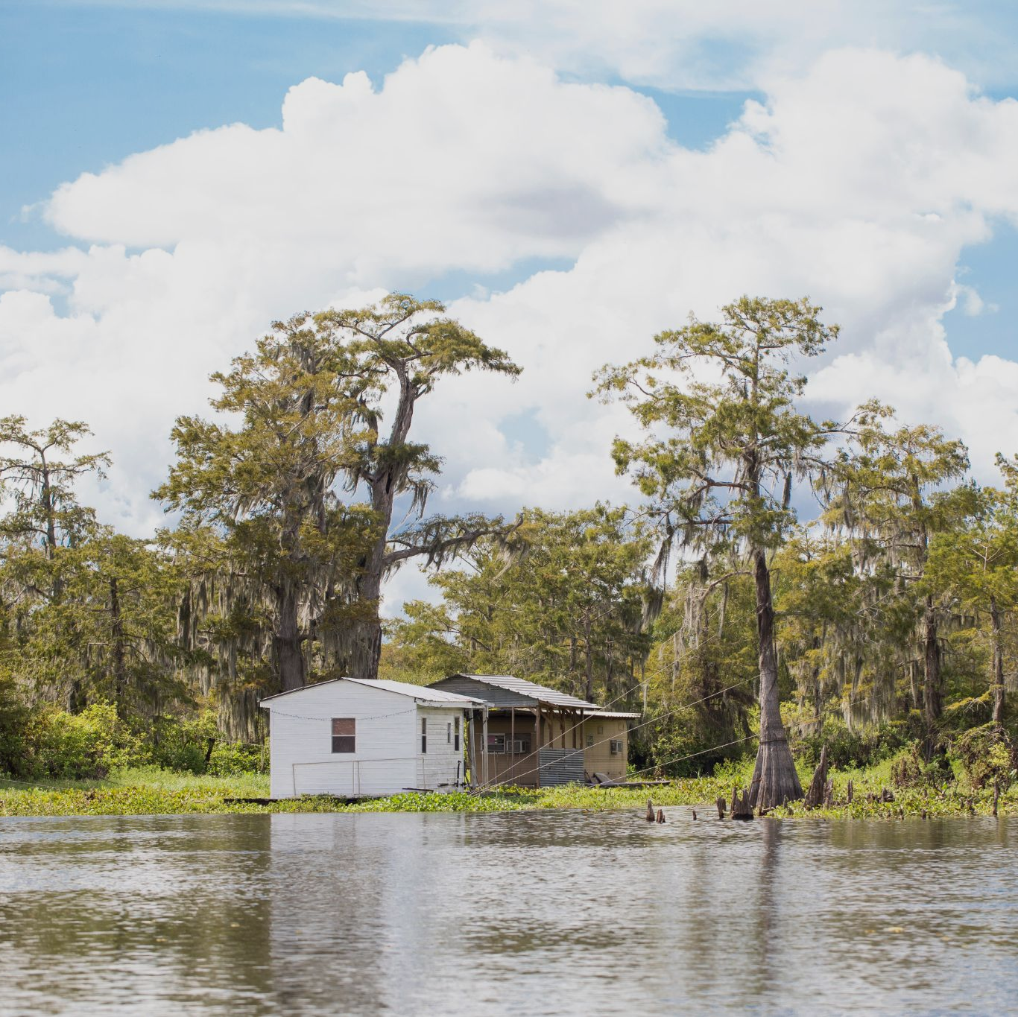
What is a Wetland?
New Orleans
What was your favorite animal from “Over in the Wetlands”?
Draw a picture of the animal!
If you were to invent an animal, what special feature would it have to help it survive in the wetlands? Draw a picture of your animal & label its adaptation.
What role do plants play in the wetlands? How do trees grow when they are underwater? Draw the roots of this tree!
Imagine you live deep in the swampy wetlands….
Draw a picture of what your house or boat might look like.

