Slide 1
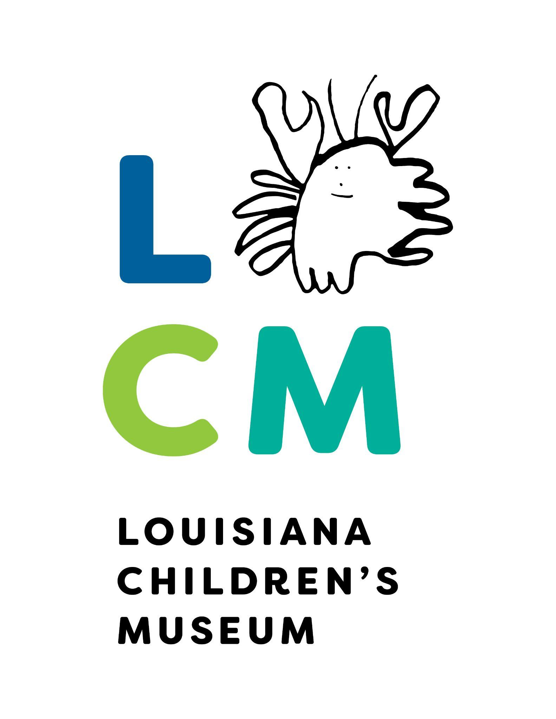
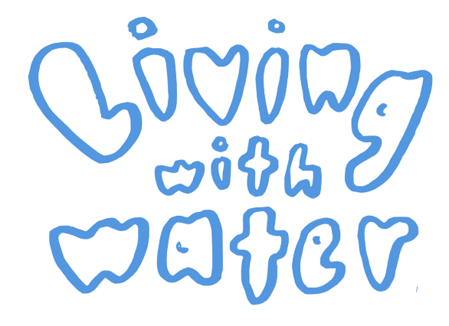
This project was made possible in part by the Institute of Museum and Library Services:
MA-249538-OMS-21
Notes:
Today we will start a fun new program called “Living with Water”. These lessons will be a little different from our usual work, and everything you do will be collected in a special work book called a “Water Journal”. These booklets are yours to keep, so feel free to decorate the front and back cover of your booklets, but please do not write on the pages until we get there as a class.

Slide 2
Lesson 1:
What is a wetland?
Notes:
Today we will start a fun new program called “Living with Water”. These lessons will be a little different from our usual work, and everything you do will be collected in a special work book called a “Water Journal”. These booklets are yours to keep, so feel free to decorate the front and back cover of your booklets, but please do not write on the pages until we get there as a class.

Slide 3
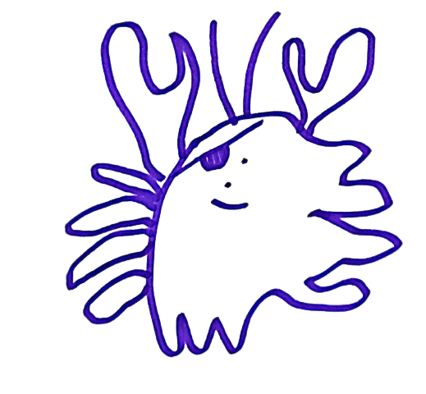
If you see this crab with an eyepatch on the screen, that means it’s time to work in your Water Journal!
Hi!
Notes:
Be sure to keep your eyes peeled for this little crab wearing an eyepatch. If you ever see him on the screen, you should know that it is time to work in your Water Journal

Slide 4
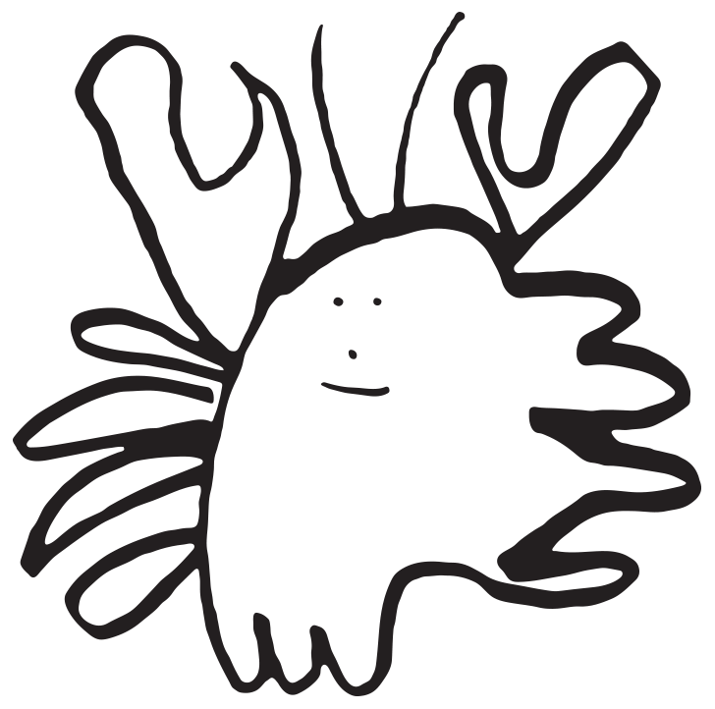
If you are not sure what an underlined word means, be sure to check the definitions at the start of each lesson.
(Hint: look at pages 4, 8, and 12)
Notes:
While reading your water journal, you may see some words you don’t recognize. If the word is underlined, then you can find out what is means by looking at the “words to know” section at the start of each lesson.

Slide 5
Open your Water Journals to page 3. Answer the two questions, then turn the page to follow along!
Notes:
So, it’s time to dive right in!, Please open your Water Journals to page 3. Do any of you know what a wetland is? Before you shout out your answers, please write them down in your Water Journals. Remember, there are no wrong answers to these questions, we just want to see what you already know about wetlands before we start the lesson.

Slide 6
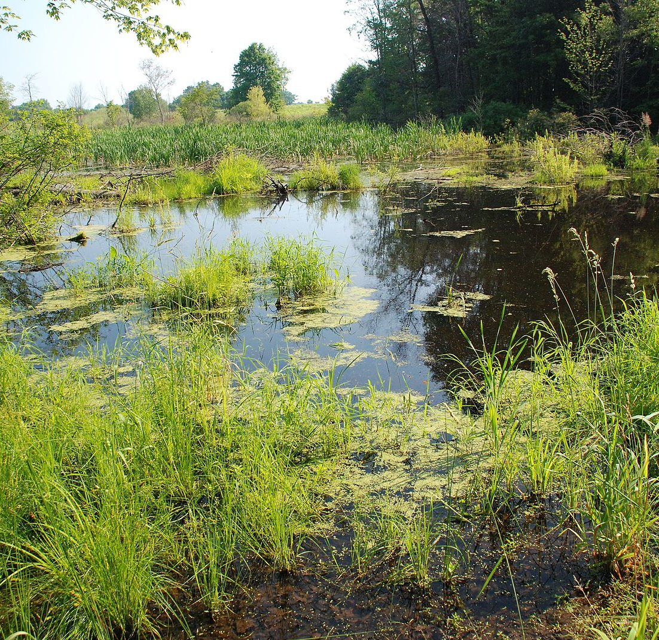
What is a wetland?
Wet!
Wetlands are under water for at least part of the year
Found close by lakes and rivers, or near to the ocean
Wetland soil is like a sponge
Rocks can’t soak up water…
But loosely packed dirt can!
Notes:
Wetlands are formed where the ground is underwater for part of the year.
Wetlands are often found where the land meets the water, at the edge of the sea, ocean, river, pond, bayou, creek, or stream. Wetlands can also form in dry areas where water bubbles up from the ground.
The soil in wetlands is loosely packed dirt, sand, and mud. These soils are porous, which means they can absorb water, unlike the boulders and rocks you will find in places with mountains and high elevation.

Slide 7
What is sediment?
Sediment is a natural material that has been ground down into smaller pieces by strong water or wind.
As rivers flow downstream, they grind giant rocks and pebbles into small specks of dirt and dust.
Sediment floats within waterways until it settles on land
Notes:
Wetland soils are largely made up of sediment deposited by rivers. Sediment is just sand and soil floating within water. Rivers carry sediment from the tops of mountains down stream, and the force of the water breaks rocks down into tiny little pebbles and specks of dirt.
When there is a lot of rain, a river can overflow, meaning it spills over its normal boundary known as a riverbank. When a river overflows, sediment that was once carried in the water might stick to the dry land. Riverbanks are often taller than surrounding areas, because sediment continues to stick together and build levees.

Slide 8
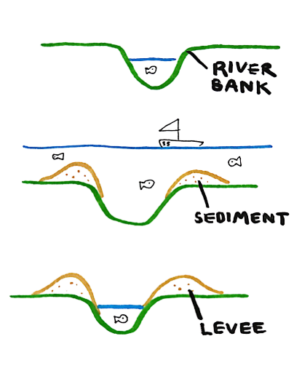
What is a levee?
Sediment floats within waterways until it settles on land
When sediment sticks to itself, land starts to build up
Each time a river floods, more sediment is left behind, and the levee grows higher.
Notes:
A levee is basically a hill that forms naturally or is built near to a body of water. Levees are naturally built adjacent to rivers because rivers leave behind sediment on the river’s bank when they flood.
When there is a lot of rain, a river can overflow, meaning it spills over its normal edge, known as a riverbank. When a river overflows, sediment that was once carried in the water might stick to the dry land. Riverbanks are often taller than surrounding areas, because sediment continues to stick together and build levees.
Every time the river floods, the sediment sticks together and the levee builds a little higher. Next time, it will take even more water for the river to flood.

Slide 9
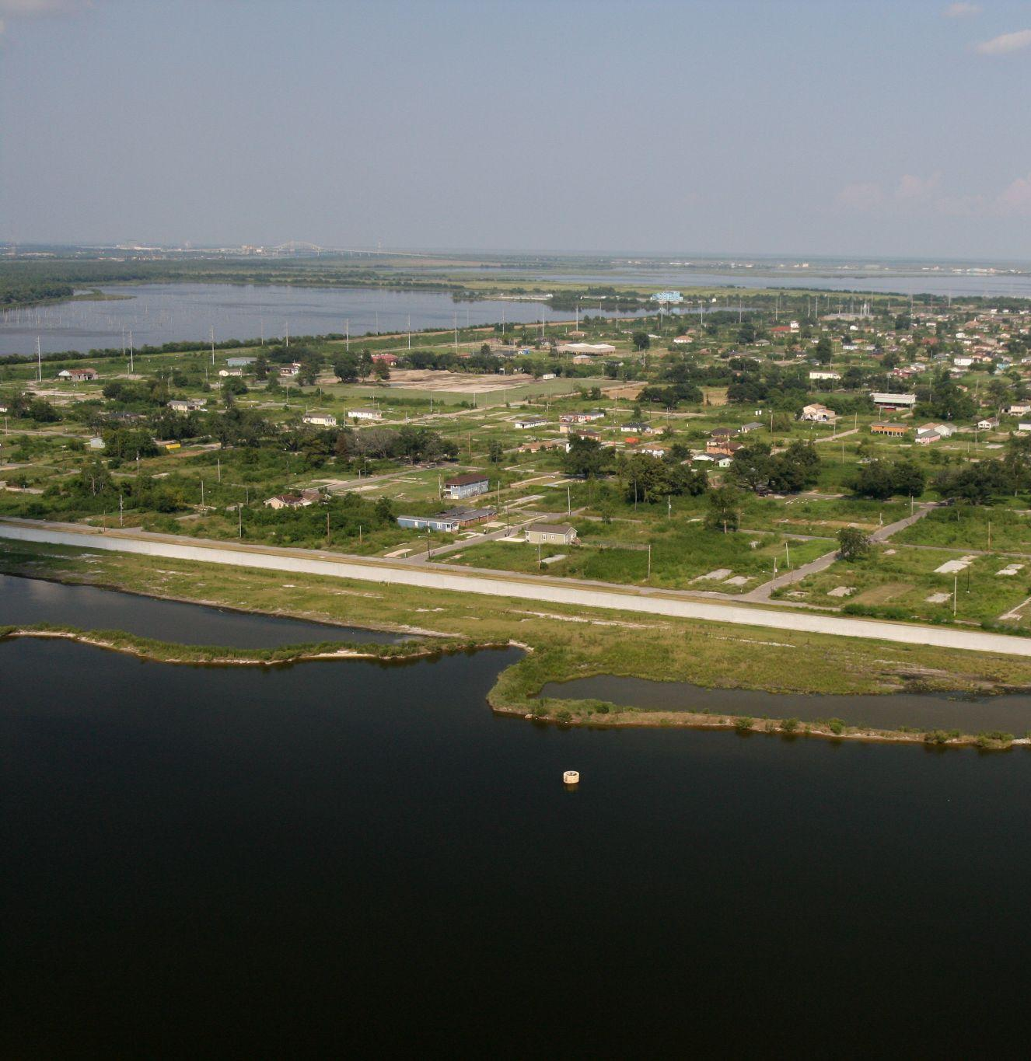
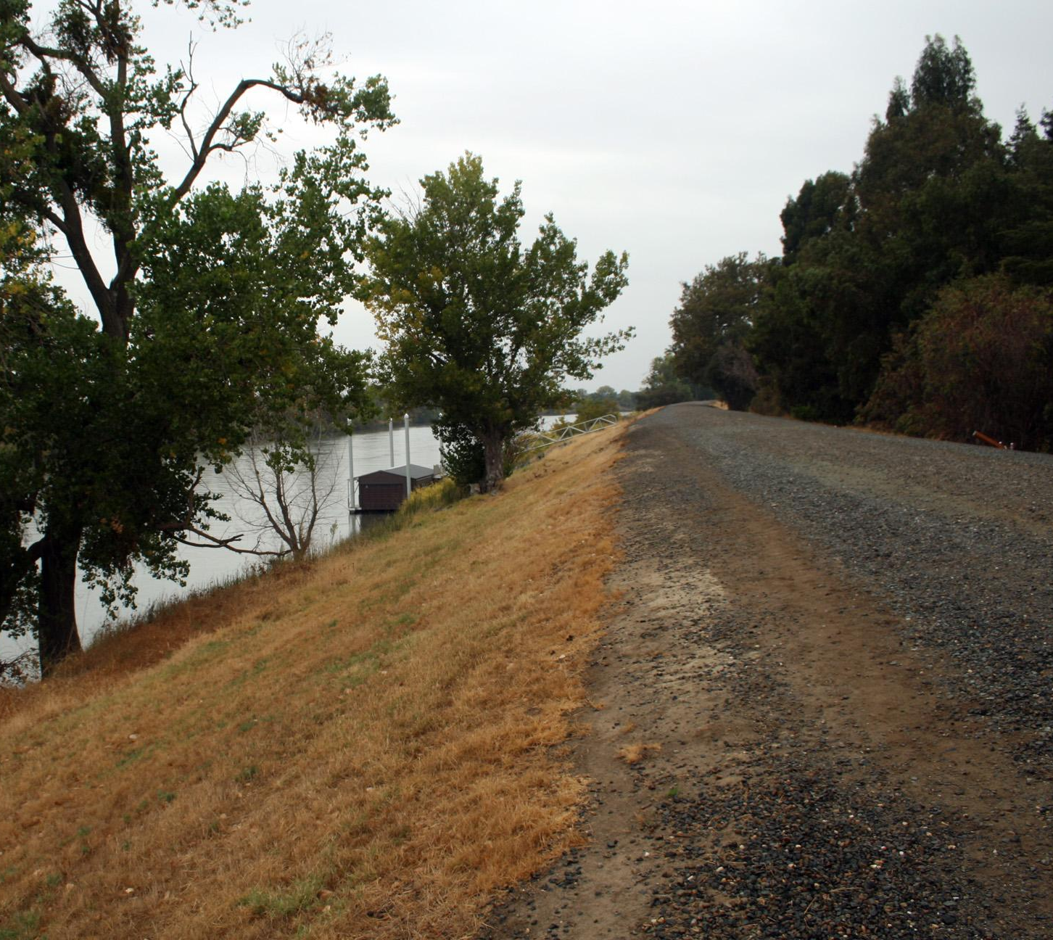
What is a levee?
Notes:
Levees restrict the flow of water, until the levee breaks or is breached, or over filled.
The levee on the right is a man made levee in New Orleans. During Hurricane Katrina, this levee was breached and flooded the lower 9th ward community.

Slide 10
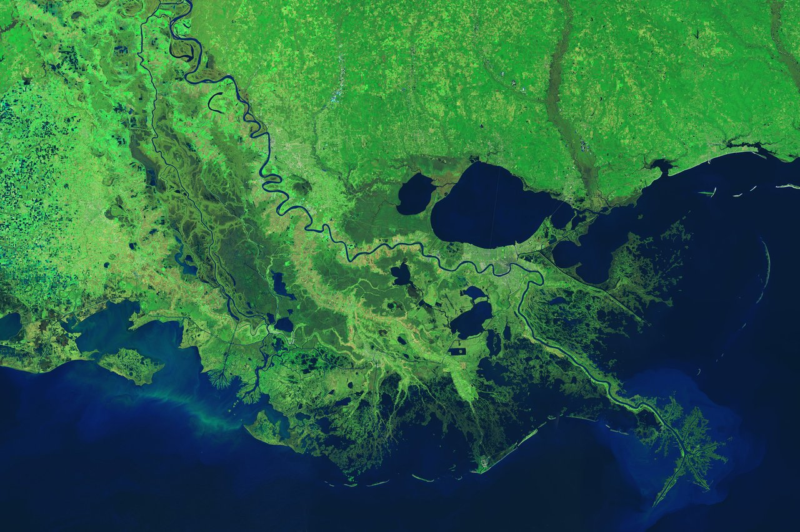
New Orleans
Notes:
You may be asking yourself, why do I need to know about wetlands? The answer is because you live in Louisiana!
This is a photograph of the Earth that was taken by a satellite in space.
The green shows happy trees and plants on land, while the blue areas are water.
The white arrow is pointing to New Orleans, which is along the river bank of the Mississippi River. The blue-green areas all around the city are actually wetlands!

Slide 11
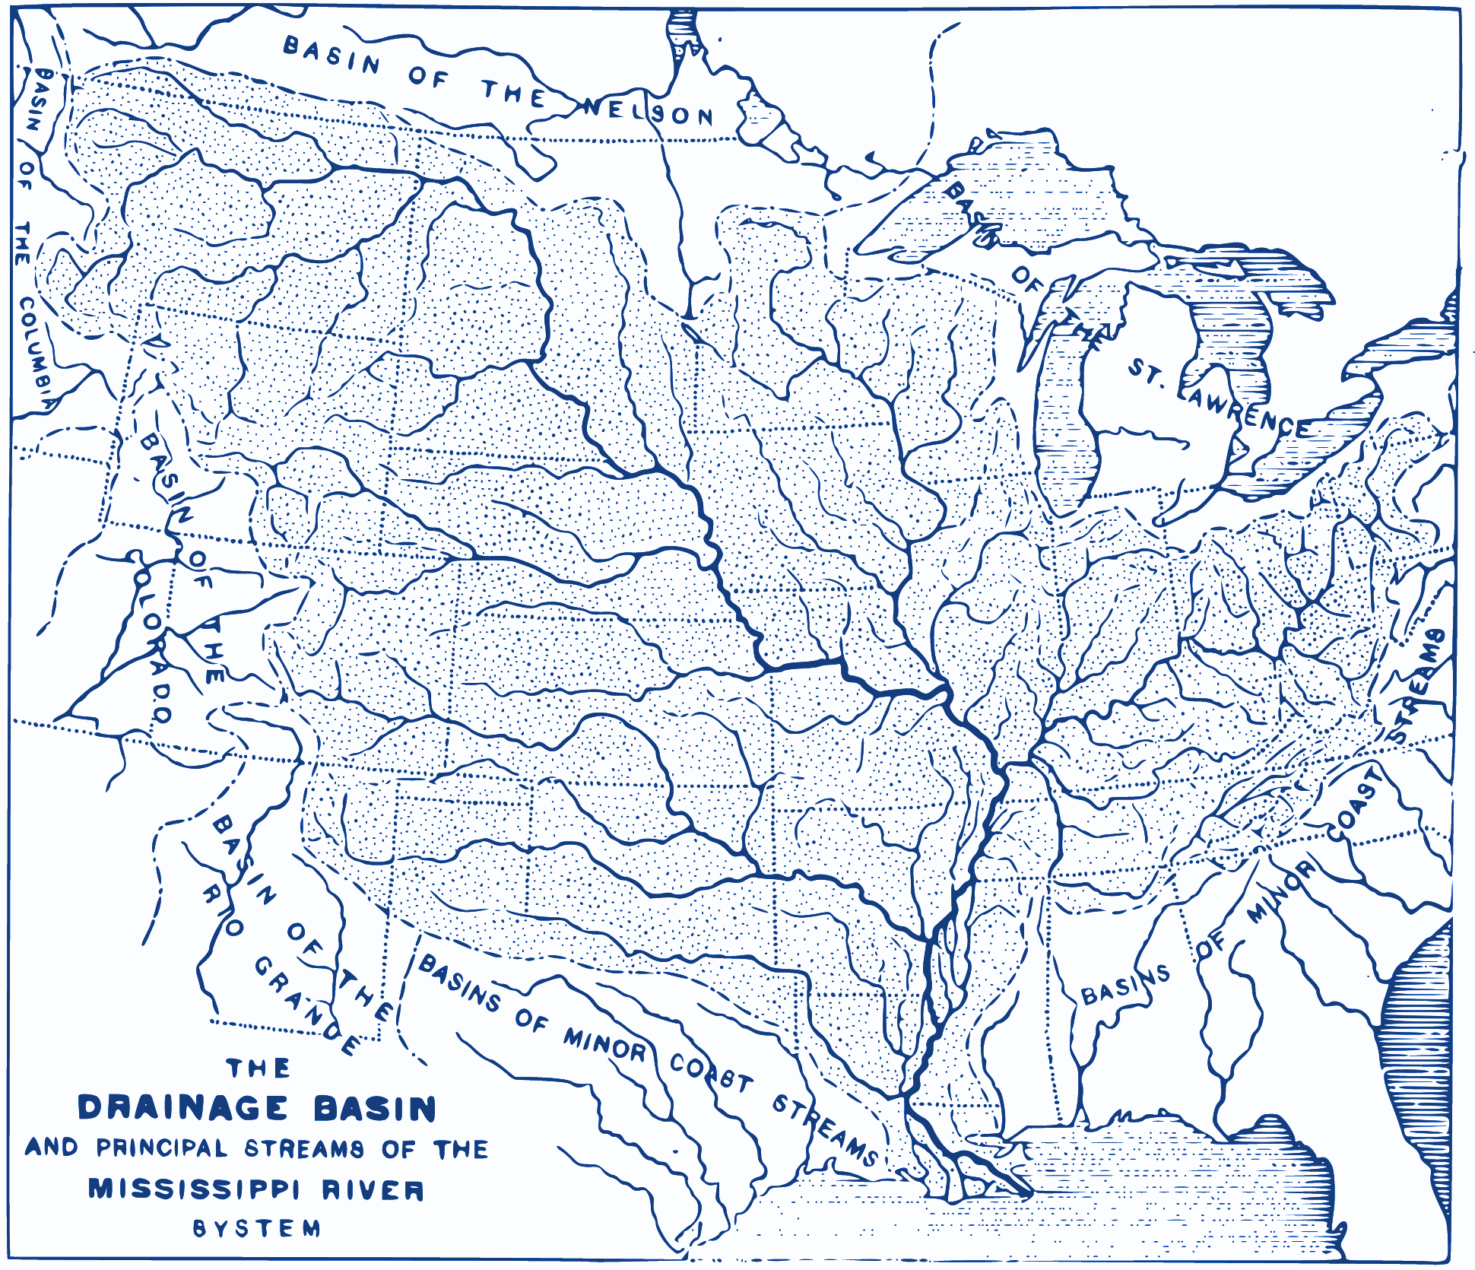
Why are there so many wetlands in Louisiana?
Louisiana is surrounded by water
bayou, lake, marsh, the Gulf…
We are located at the mouth of the Mississippi River, so water from across the nation passes by New Orleans as it drains into the Gulf of Mexico.
Notes:
As you saw on the last slide, Louisiana is surrounded by water!
In addition to being surrounded by water, we also get a lot of rain storms and hurricanes. Our state gets 60 inches of rain every year, the second wettest state in the U.S.
Louisiana is part of the Mississippi River Delta, meaning our land is built by the Mississippi River.
Louisiana is located at the mouth, or end, of the Mississippi River. This river is the largest drainage basin in the United States, so water from all over the country flows downhill into the Mississippi River.
The water that flows past New Orleans in the Mississippi River likely started as snow at the top of a mountain thousands of miles to the north of Louisiana. As snow melts, it flows downhill and forms streams, and these streams continue flowing downstream until they join with a bigger stream, river, lake, or ocean.

Slide 12
How do rivers build land?
Thousands of years ago, the ground we stand on was actually a part of the Gulf of Mexico.
The Mississippi River left sediment at its mouth and built land.
Notes:
The Mississippi River ends at the Gulf of Mexico and all of the river water flows out into the open ocean. At the end of its journey, sediment that was carried within the river either
Continues to float around, making the water a muddy brown color
Or sticks to other sediments and starts to build land
If Louisiana is shaped like a boot, the toe of that boot is newly built land created by river sediment forming piles at the mouth of the Mississippi River. Thousands of years ago, the ground we stand on was actually a part of the Gulf of Mexico.

Slide 13
Why are wetlands important?
All species play an important role in the ecosystem.
River sediment is full of fresh nutrients that plants, bugs, and animals feed off of.
Wetlands provide special habitat for unique species that are happiest living in very wet landscapes.
Without wetlands, our cities lose storm protection, human beings lose access to the delicious seafood that we catch and eat, and the shrimpers and loggers lose their jobs!
Notes:
You may be wondering why this is important for you to learn. Because you live in New Orleans, you are part of Louisiana’s ecosystem too! An ecosystem is a biological community of interacting organisms and their physical environment. If one species were to exit the ecosystem, it would have impacts on many other species. For example, without crabs and crawfish, we would have nothing to eat and people who’s job it is to catch seafood would have to find a new way to make money!

Slide 14
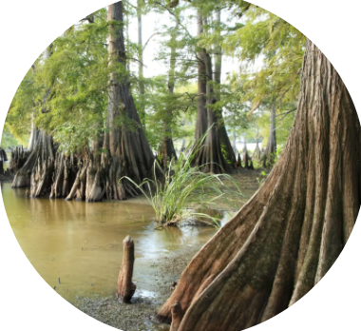
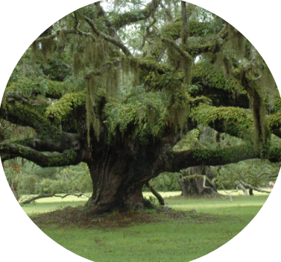
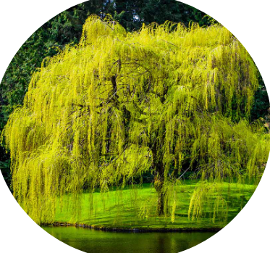
What plants live in the wetlands?
Cypress
Live Oak
Willow
Notes:
Here are some examples of wetland tree species. The cypress tree is very common around here. Cypress trees have knees, or roots that grow up from the ground. Cypress knees are an adaptation that helps the tree to get oxygen from the air when it is underwater.
Live oaks are also very common wetland tree species. You can see Live Oaks along the streets in New Orleans, such as Esplanade and St. Charles Avenues.
Willows are another tree species you have likely seen around your neighborhood. Willows are often called Weeping Willows, because the branches are long and droopy so it looks like the tree is crying.

Slide 15
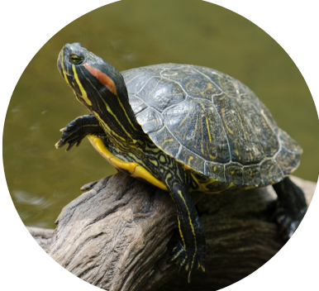
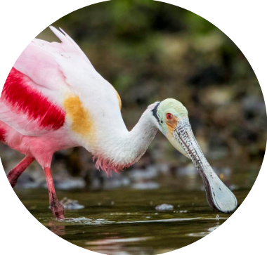
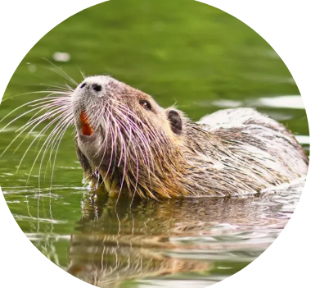
What animals live in the wetlands?
Red-eared Slider Turtle
Roseate Spoonbill
Nutria
Notes:
You may recognize some of these critters from the story Over in the Wetland.
There are so many unique species that live only in Louisiana because we have such a special environment and an abundance of wetlands.
The Roseate Spoonbill is sort of like a local flamingo. It’s bright pink color comes from all of the seafood and crustaceans that it eats, food that it can find most easily in the wetlands! The pink color can be considered an adaptation, because many Spoonbills have chosen to live in Louisiana and change colors because their favorite food is plentiful in our wetlands.
Nutria rats are not native to Louisiana, but they’ve chosen to live here because their favorite food is a baby cypress tree and there are more cypress trees in Louisiana wetlands than anywhere else in the U.S.! Much like their cousin the River otter, nutrias have waxy slick fur so that water slides off of them instead of absorbing into their fur like a wet towel.

Slide 16
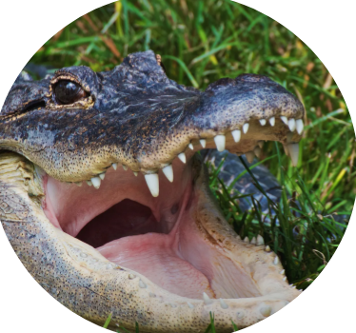
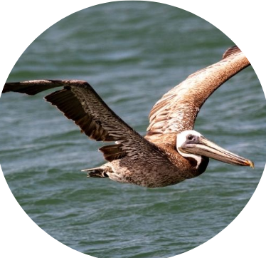
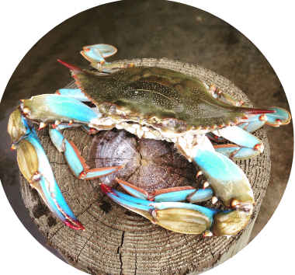
What animals live in the wetlands?
American Alligator
Brown Pelican
Blue Crab
Notes:
As you saw in the story, the American Alligator carries its babies in its mouth to keep them safe during storms.
Alligators have evolved a thick skin to protect them from danger, and they have two sets of eyelids to help protect their eyes while diving. They have an invisible adaptation as well - a special flap that can seal water out of their ears and make swimming much easier.
Pelicans have funny shaped beaks that help them to scoop up fish from the water while flying in the air. Can you imagine trying to fly and catch a fish at the same time? Of course, some pelicans are more graceful than others. In order to protect themselves from getting hurt while flying, Pelicans have a special air sac beneath their skin that inflates before they run into something so that their important organs aren’t hurt even if they have a crash landing.
Can you think of any other adaptations you saw in the story Over in the Wetlands?

Slide 17
Open your Water Journals to page 7, then use your pencil to answer the two questions
Notes:
Please open your Water Journals to Page 7. Answer the two questions about adaptations. Remember, humans and animals adapt to their environment by changing things about themselves and the ways they live to survive better. If you need a hint, read the definitions on page 4. The next slide will show you some images from Over in the Wetlands to jog your memory.

Slide 18
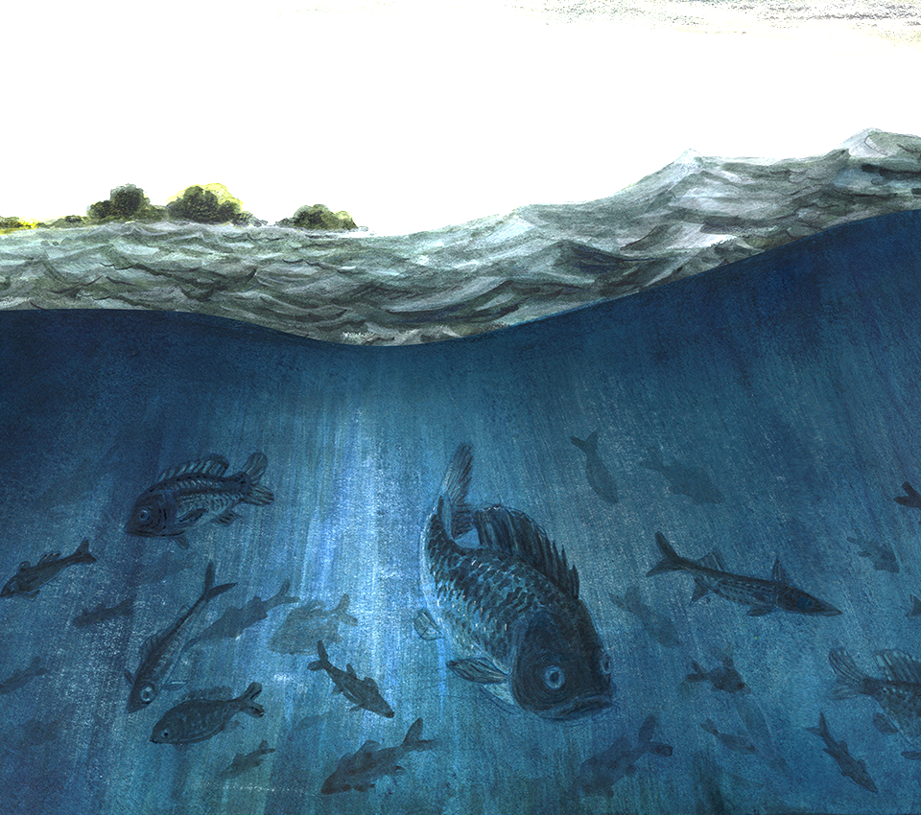
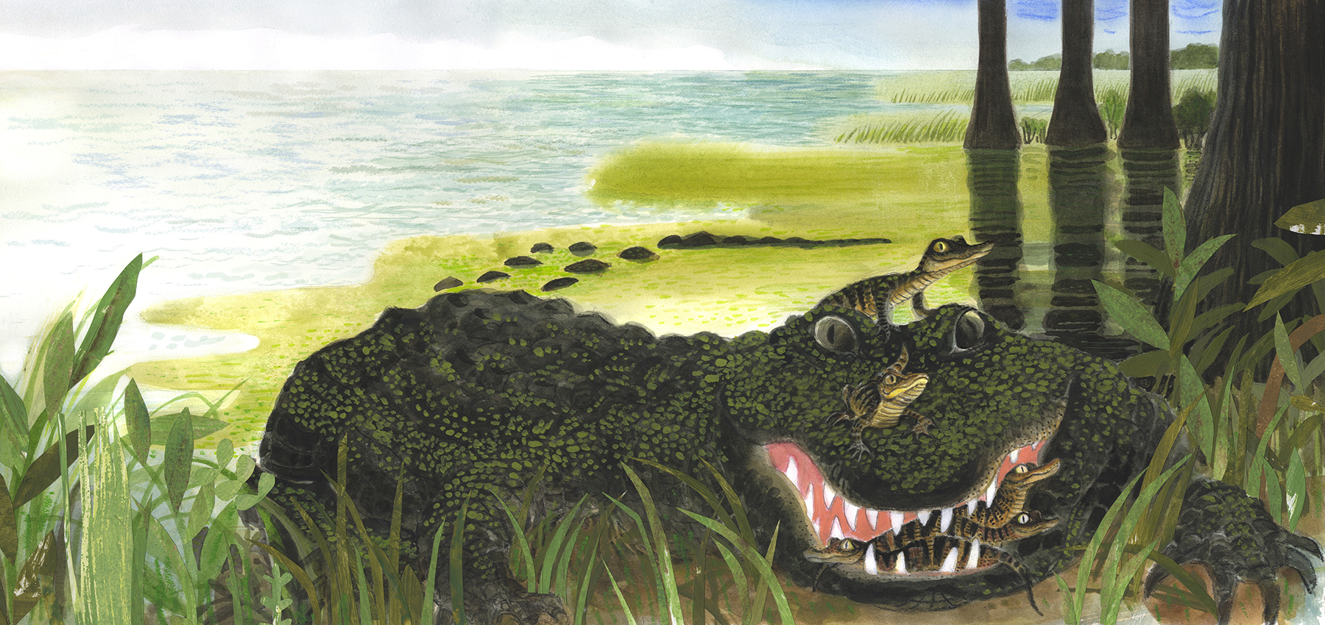

Slide 19
Great work! Please put away your Water Journal, and keep them safe until our next lesson.
Next time, we will build a swamp!

Slide 20
Lesson 2:
What do wetlands do?
Notes:
Today we will be learning more about what wetlands do. We already know how they are formed and why they are important here in Louisiana, so today we will talk about the role wetlands play in the ecosystem.

Slide 21
Open your Water Journals to page 8 to follow along!
Notes:
Before we get started, please open your Water Journals to page 8 if you’d like to follow along.

Slide 22
What do wetlands do?
Wetlands make it possible for humans to live in coastal areas.
Wetland soils absorb water to prevent flooding
Wetland vegetation has roots that hold soils together
Wetland trees block hurricane wind and waves from damaging coastal cities like New Orleans
Notes:
The most important thing that wetlands do is make it possible for humans to live in coastal areas. But how?
The spongy soils absorb rainwater that could cause flooding, roots of plants hold sediment together and prevent soil erosion, and wetland trees block hurricane waves from crashing into coastal cities, like New Orleans.
Sadly, many people do not understand the important role that wetlands play in our lives.

Slide 23
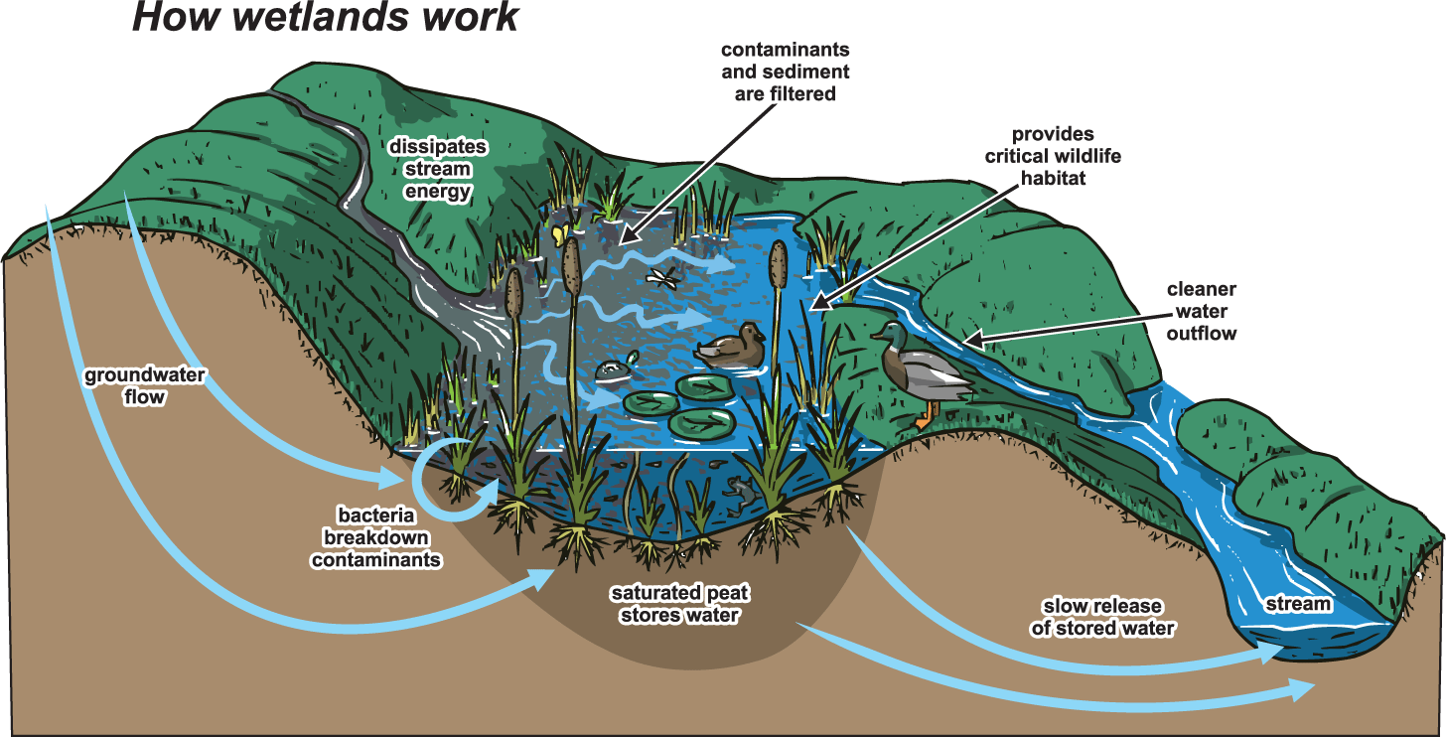
image via kanabec swcd
Notes:
As you will read on page 8 of your Water Journals, the special soils and plants found in wetlands are part of an ecosystem that provides habitat for animals and protection for people.
Loose soils act like a sponge to absorb water from rainstorms, hurricanes, and floods so that the water doesn’t fill in our cities and homes
Wetlands act as a reservoir, which is basically just a big pool where water is stored until it is needed for drinking or watering crops.
The roots of wetland plants trap dirt, sand, and sediment so that it doesn’t float downstream. As sediment continues to collect and compact, the ground becomes less spongy and more solid.
This prevents soil erosion that happens when strong waves crash onto the shore during hurricanes, and it takes dirt out of the water so fish can breathe easily.
Wetland plants filter pollutants like nitrogen and phosphorus from farms up river so that water flowing into the Gulf of Mexico is clean and clear.
Wetlands provide habitat for the fish, crabs, and nutria that other creatures eat, and they create jobs for hunters, fishers, and crabbers.

Slide 24
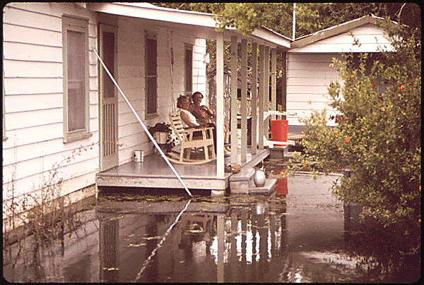
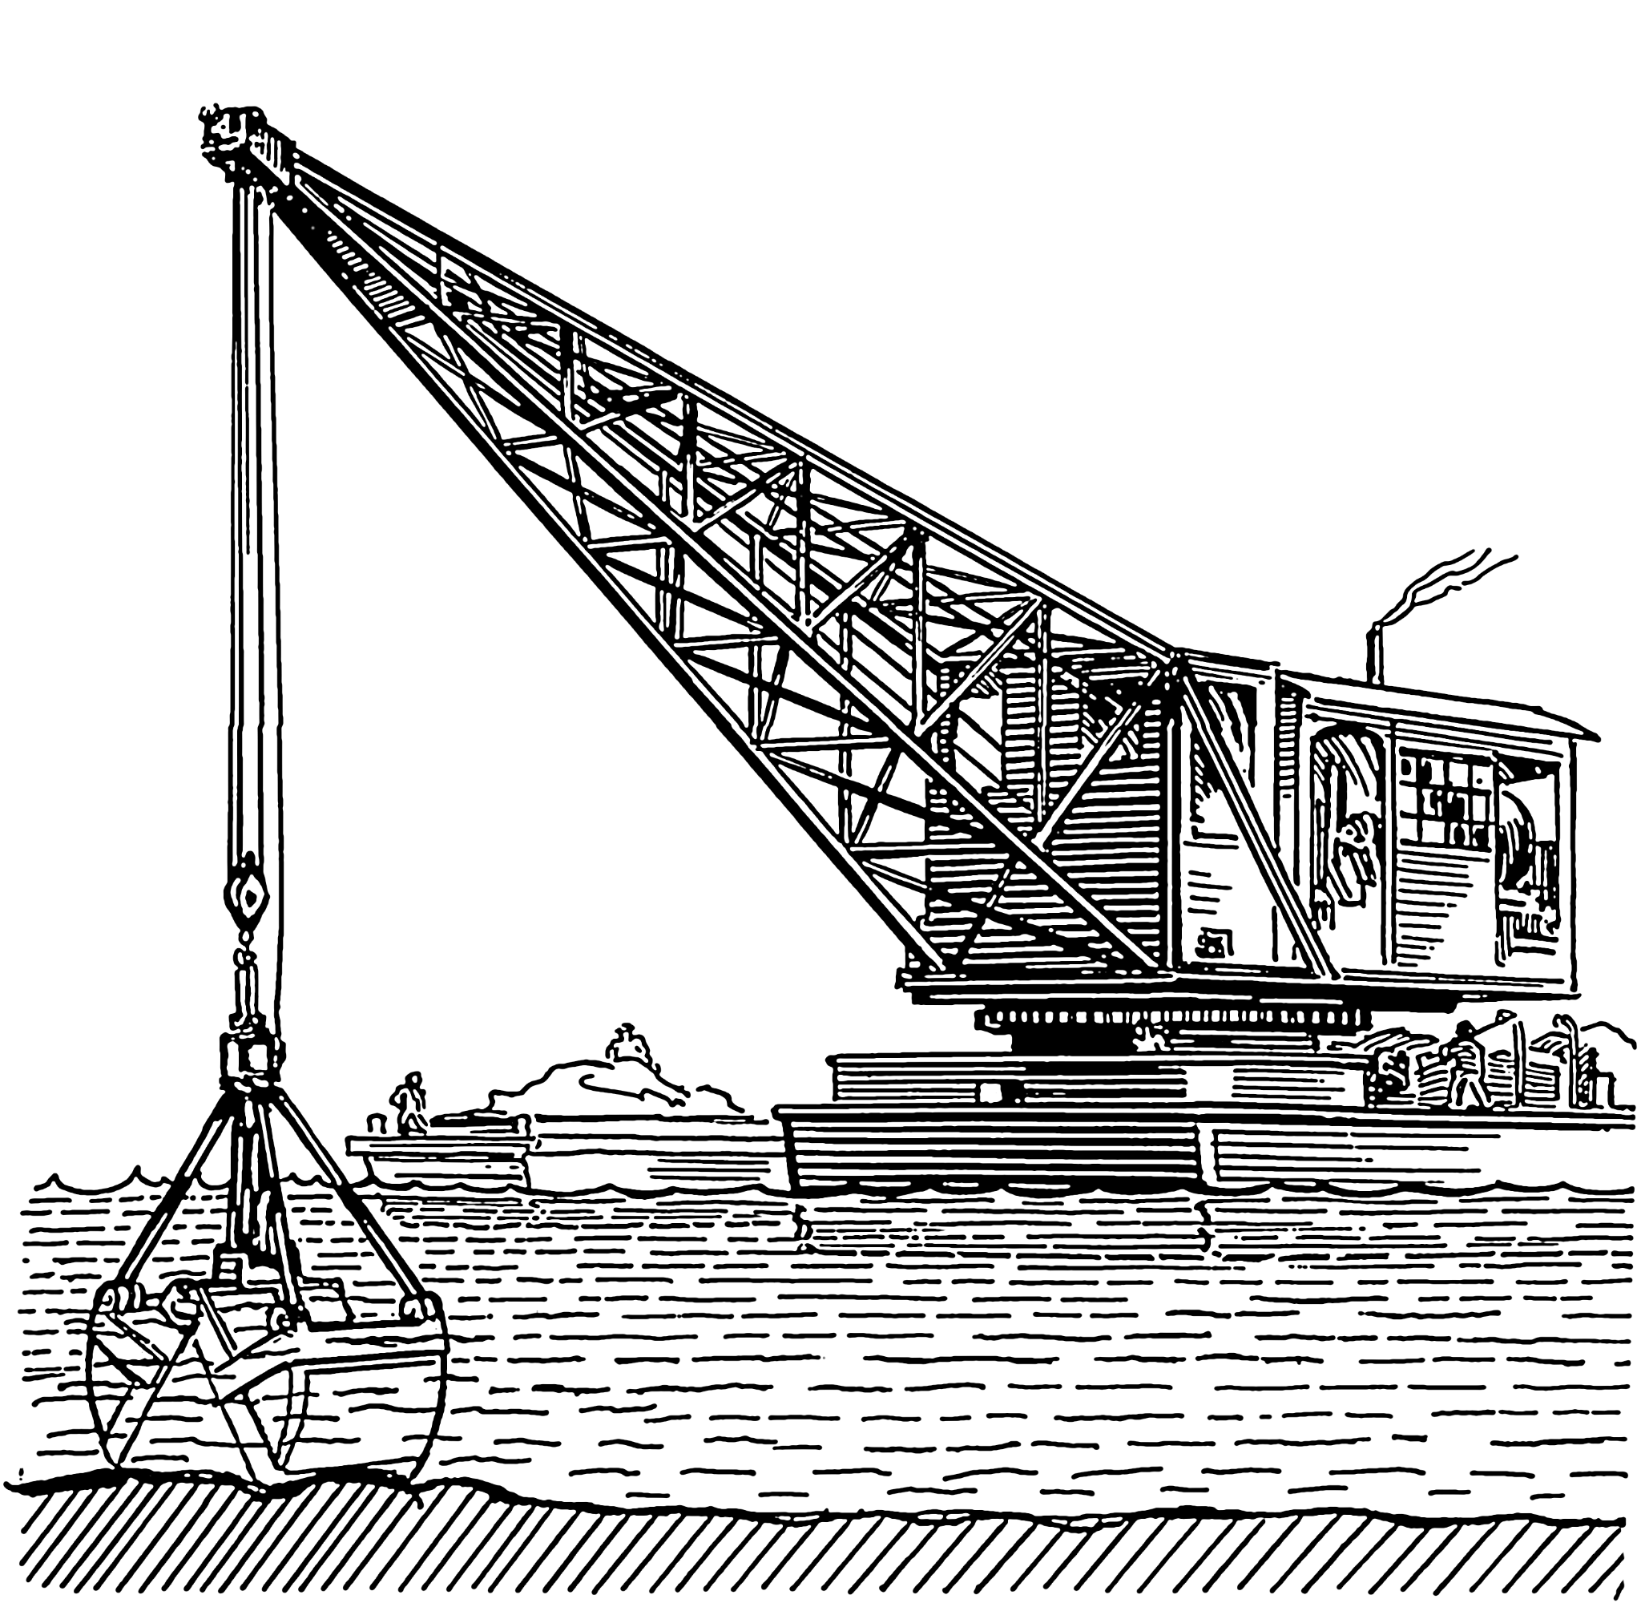
Why are wetlands disappearing?
Notes:
Wetlands are very important for people who live near to bodies of water.
In Louisiana, we are surrounded by rivers, bayous, lakes, and the Gulf, so wetlands help us to live with all this water!
Unfortunately, many human beings do not understand that wetlands provide protection, and so they destroy these special ecosystems by
Dredging, or removing the fresh river sediment out of wetlands so that it can be used to build land somewhere else. You can see a dredging machine on the right.
or filling the spongy wetlands in with rock and concrete so that new buildings can be built where wetlands once were.
Without wetlands to capture and hold water, the chance of flooding in coastal cities increases!

Slide 25
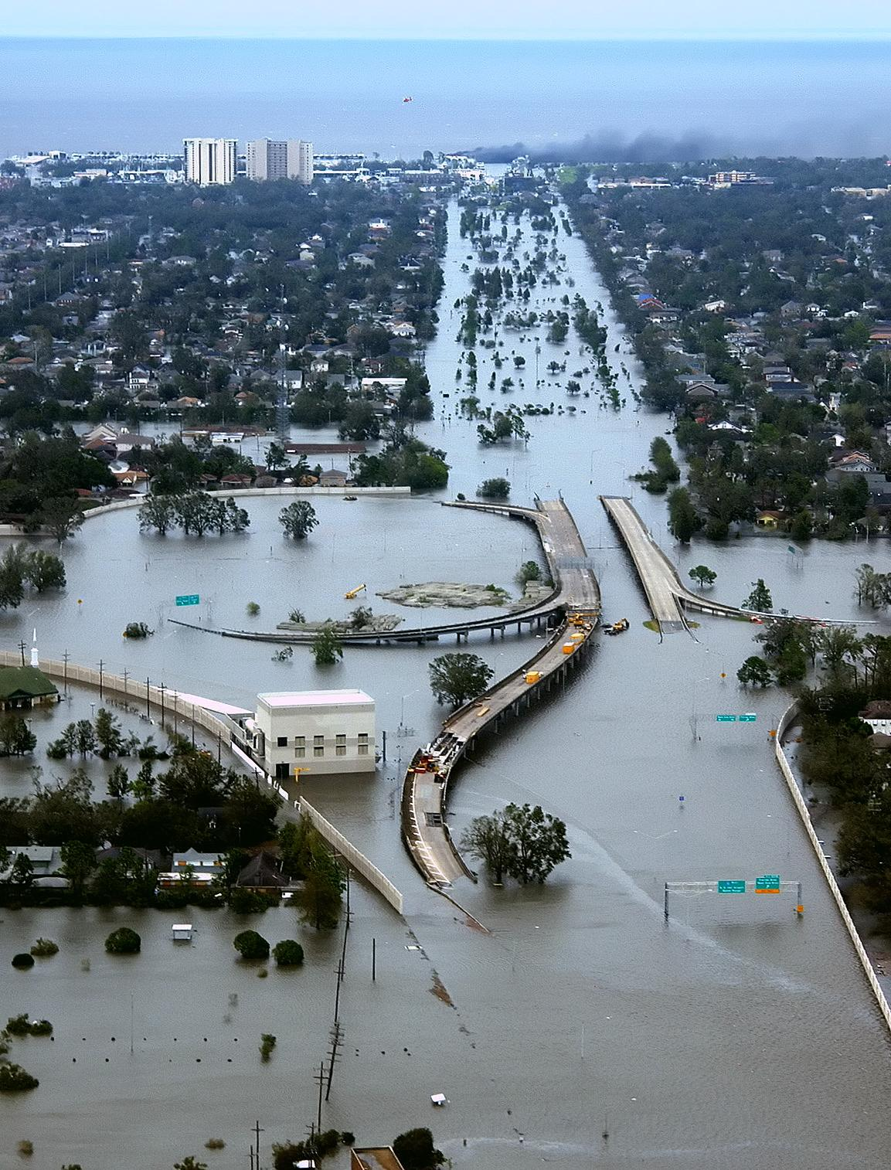
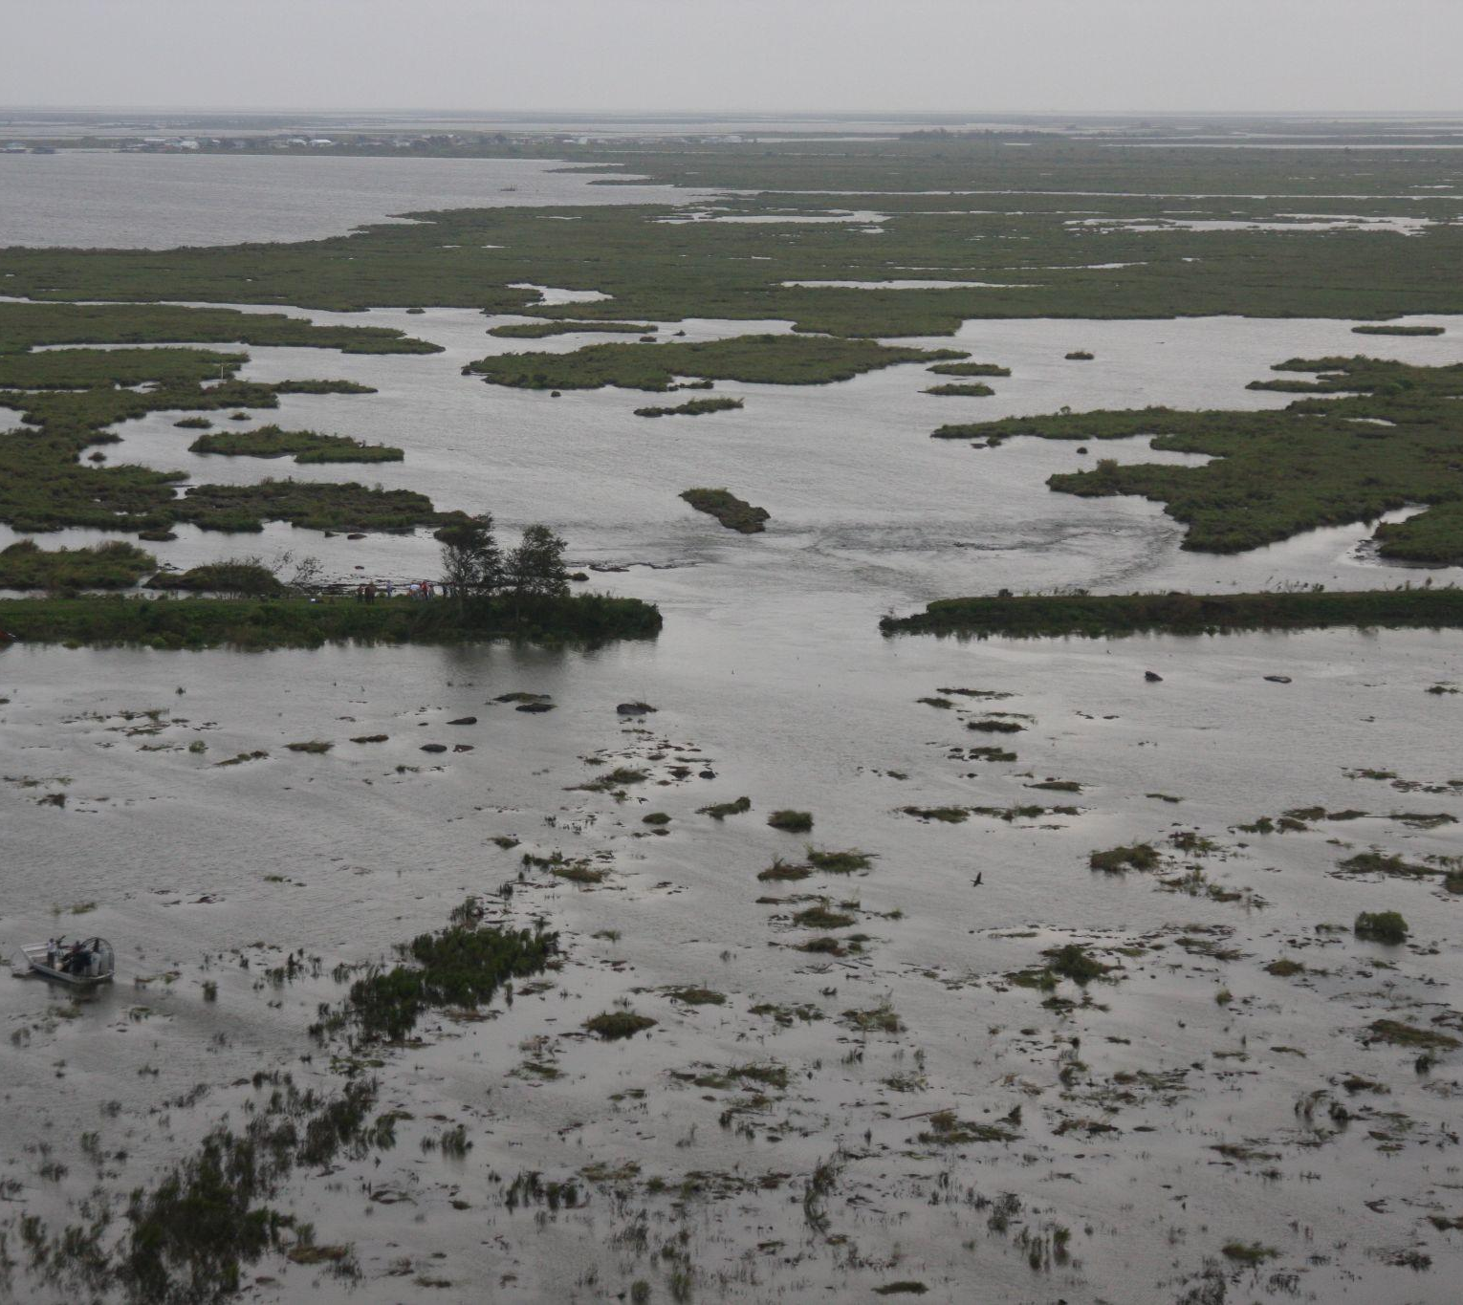
Why are wetlands disappearing?
Notes:
Wetlands are difficult to build in because they are so wet and the soil is often in motion. As cities get bigger, wetlands are often filled in with concrete to create dry land. Concrete, like rock, does not absorb water.
The image on the right shows New Orleans after Hurricane Katrina. As you can see, the houses, buildings, roads, and bridges are all under water. New Orleans was built on top of a filled in wetland, and so when a levee protecting the city broke, the city flooded. If there were more wetlands within our city, some of this water might have been absorbed safely.
Human beings have also destroyed wetlands by building ditches, shipping canals, and pipelines through the wetlands. As tunnels are dug from the Gulf through the wetlands, saltwater from the Gulf of Mexico flows inland through these man-made waterways. As Saltwater intrudes into the freshwater in the wetlands. Most wetland plants and animals can not live in salty water, so they have to move or they may die.

Slide 26
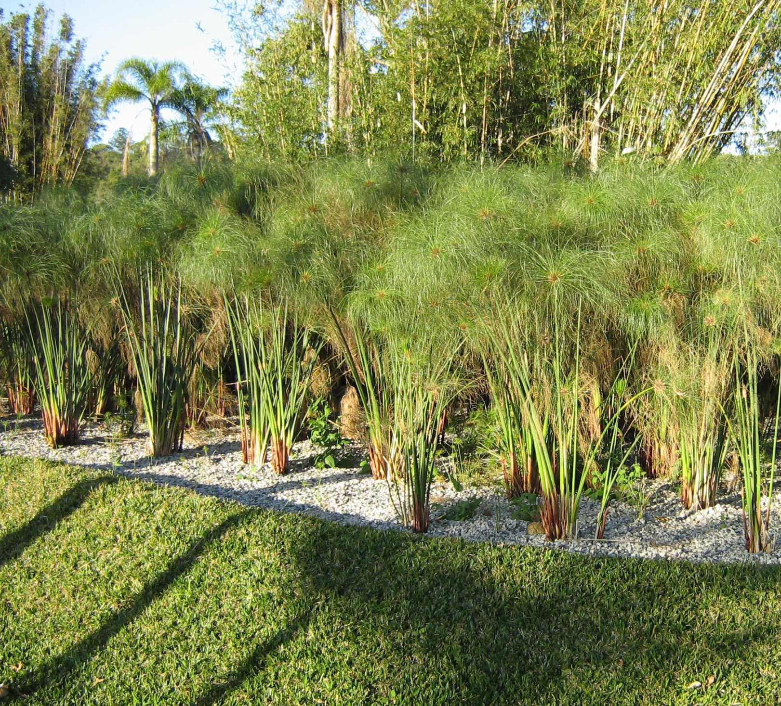
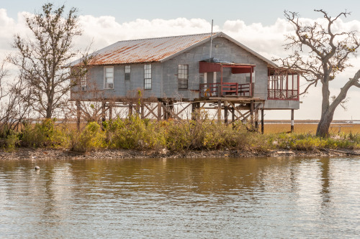
What can humans do to keep our communities safe?
Notes:
Over time, human beings have learned a lot about the dangers of the environment and the weather here in South Louisiana. We have changed the way that we build things so that they are stronger against hurricanes and raised higher against floods. Just like the plants and animals that live in the Wetlands…
Human beings have adapted the way we build our cities so that we can survive in very wet coastal environments.
For example. in Louisiana, we build our houses on stilts so that they stay dry even when the water from the rivers and bayous gets too high and starts to flood.
States along the Gulf of Mexico (Texas, Louisiana, Mississippi, Alabama, and Florida) have spent money to replant wetland trees in areas that were destroyed, as you can see on the right. These man-made wetlands are a way that humans have adapted.
These states have also made laws to stop builders from filling in wetlands.

Slide 27
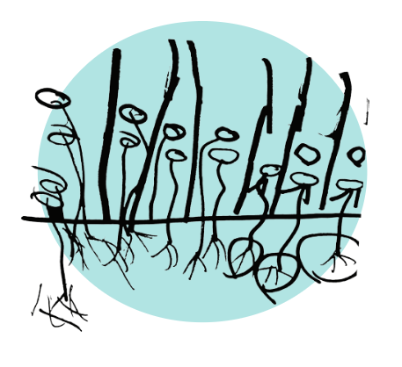
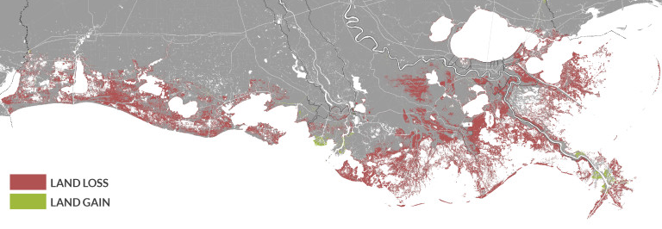
What do wetlands do?
Notes:
This map shows the amount of land that Louisiana could lose in the next 50 years if we don’t do something to prevent coastal erosion. The land we may lose is shown is red, and the majority of this land is actually wetland habitats. You may remember from earlier in this lesson that one of the best ways to prevent erosion is to keep your wetland plants happy, so their roots stay strong and hold all of the sediment left by the river together. Without plant roots to trap and compact the spongy wetland soils, all of that land might wash away into the Gulf of Mexico leaving cities like New Orleans and Baton Rouge unprotected from future hurricanes.

Slide 28
Lesson 2:
Activity time!
Notes:
And that’s where you all come in! For this lesson, we will be building our own wetlands, or “swamps in a sack”. Your design should show off all of the cool facts that you now know about wetlands and the important roles they play in the ecosystem!

Slide 29
Open your Water Journals to page 10. Let’s build a “Swamp in a Sack”!
Notes:
Please open your Water Journals to Page 10 and read the instructions for building a Swamp in a Sack.

Slide 30
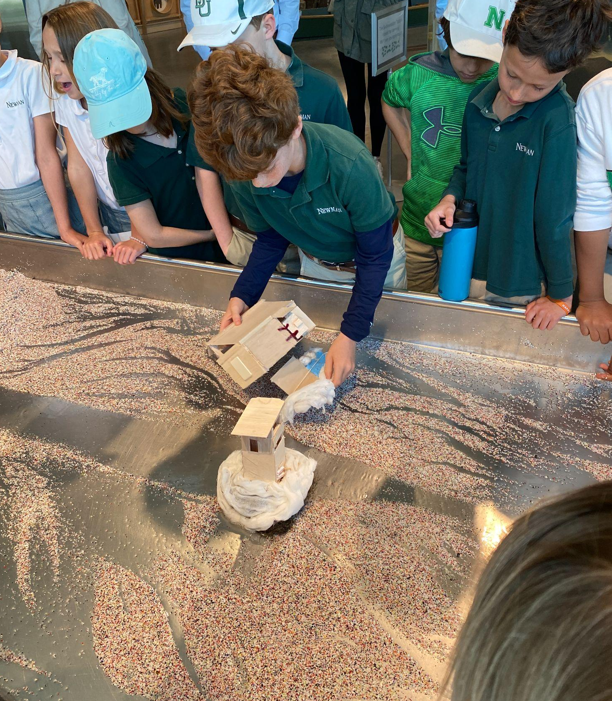
Building a “Swamp in a Sack”
When you visit the Louisiana Children’s Museum, we will put your Swamps on our model River - Sedimentation Table
Your swamp in a sack should absorb like a wetland, but be strong enough to endure the force of a river or a hurricane.
Notes:
Before you start building, I want to remind you all what we will be doing with your final projects.
When you visit the Louisiana Children’s Museum, we will put your Swamps on LCM’s model River - called the Sedimentation Table
The sedimentation table acts like a river, and so your swamps will act like wetlands for this experiment.

Slide 31
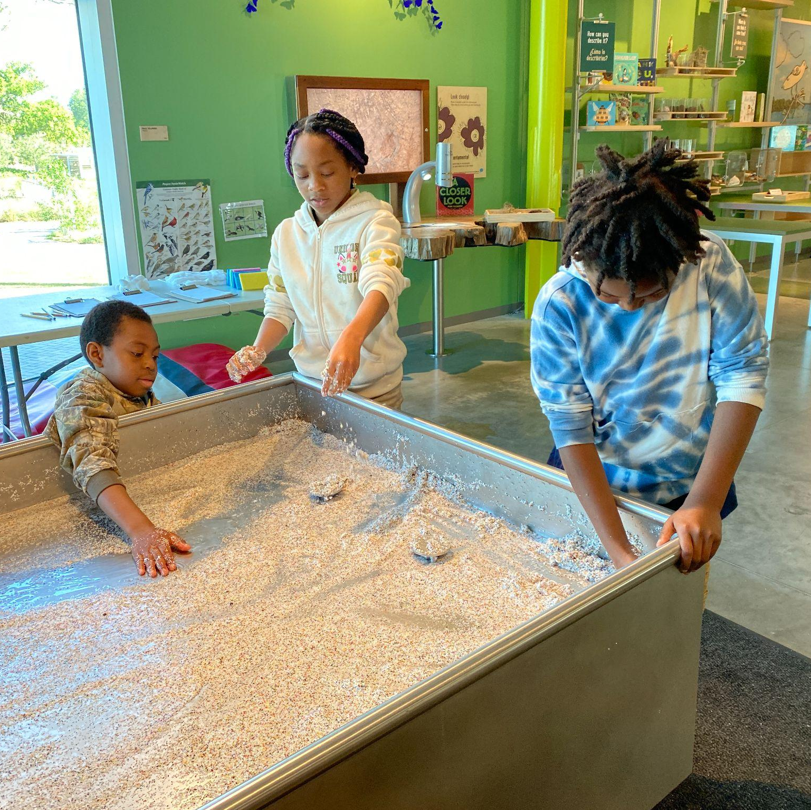
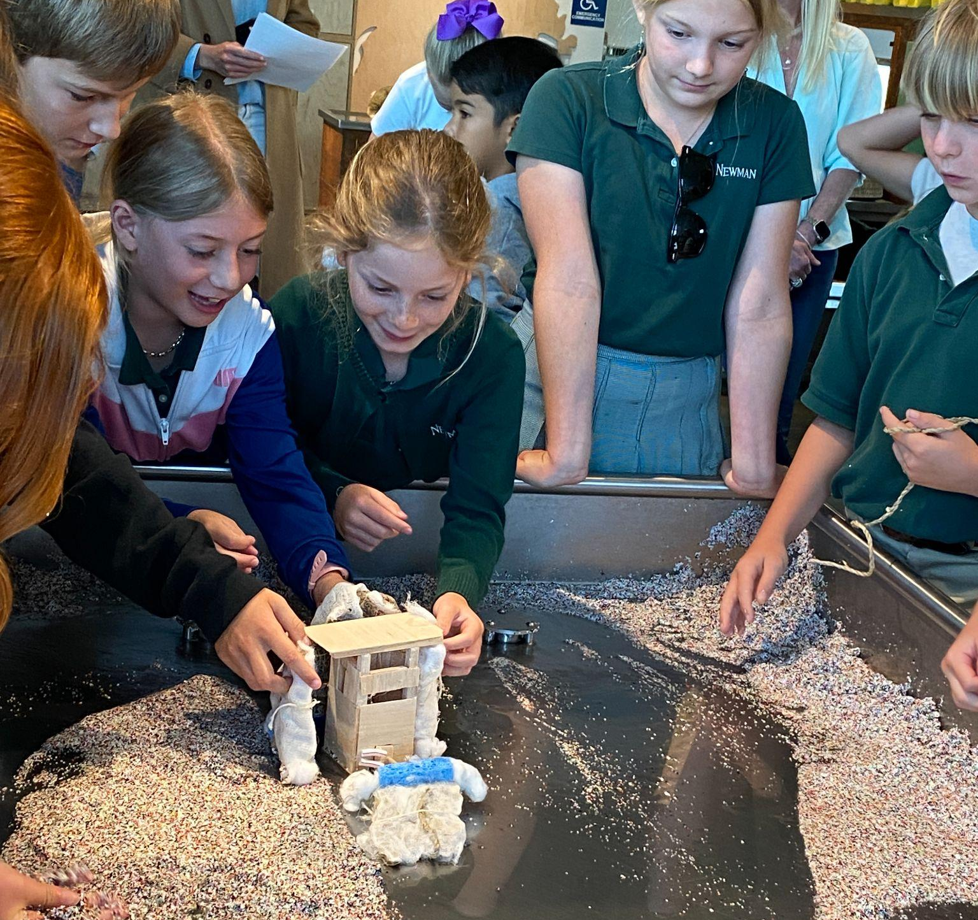
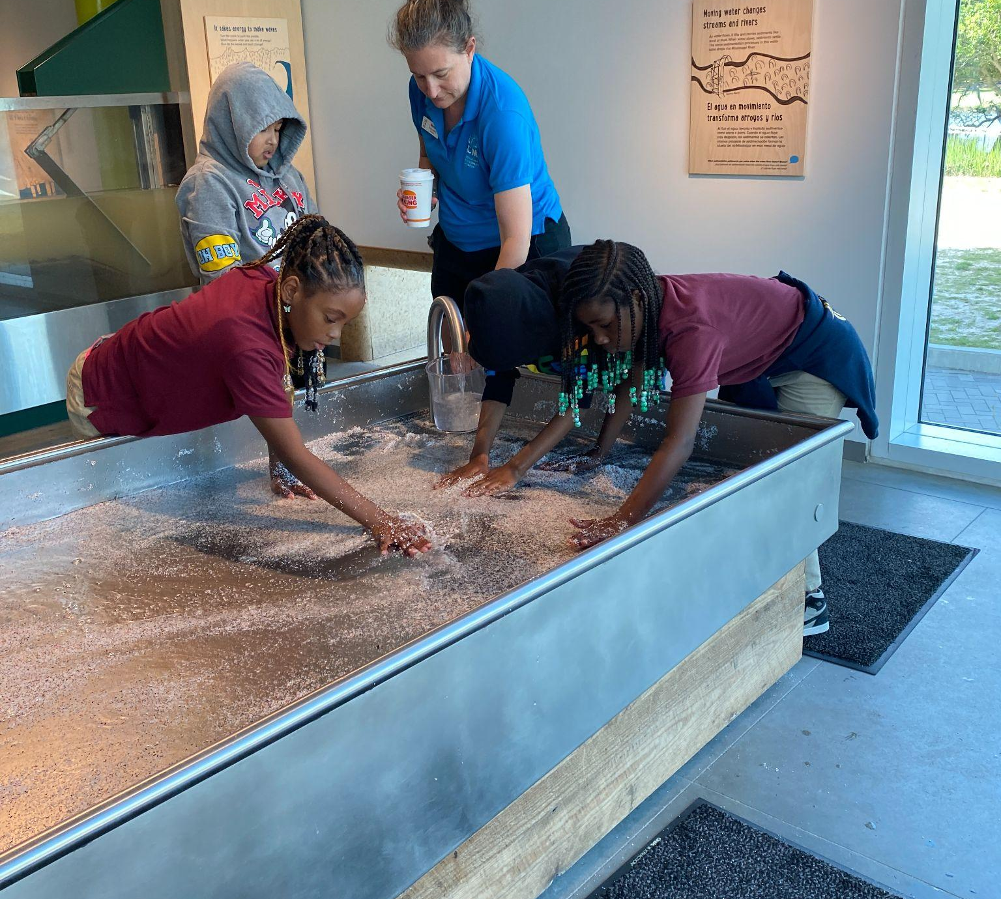
Sedimentation Table
Notes:
Here are some photos of the sedimentation table at the Museum.
The sedimentation table is like a miniature Mississippi River. Water flows from a high elevation and moves the sediment down the table. This models the actions of a river, and over time rivers, islands, bayous, and other water ways are formed.
At the Children’s Museum, we are going to build a miniature city on the sedimentation table, then we will test your swamp in a sack to determine what design is most absorbent and strong. The goal is to keep the miniature city safe and dry using the man-made wetlands that you and your classmates built!

Slide 32
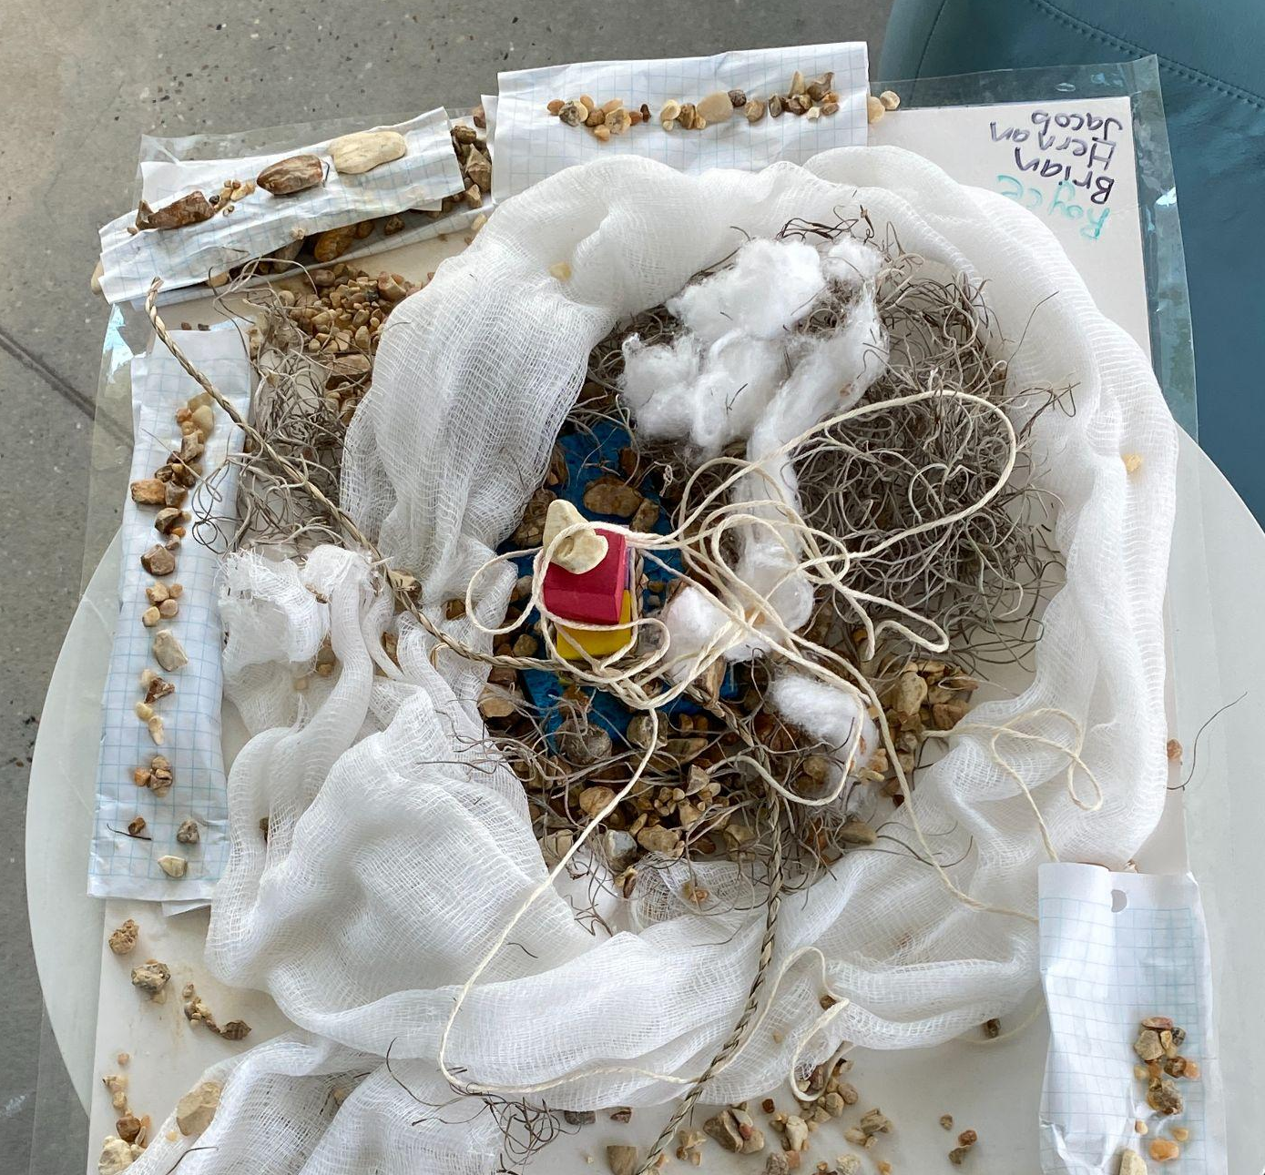
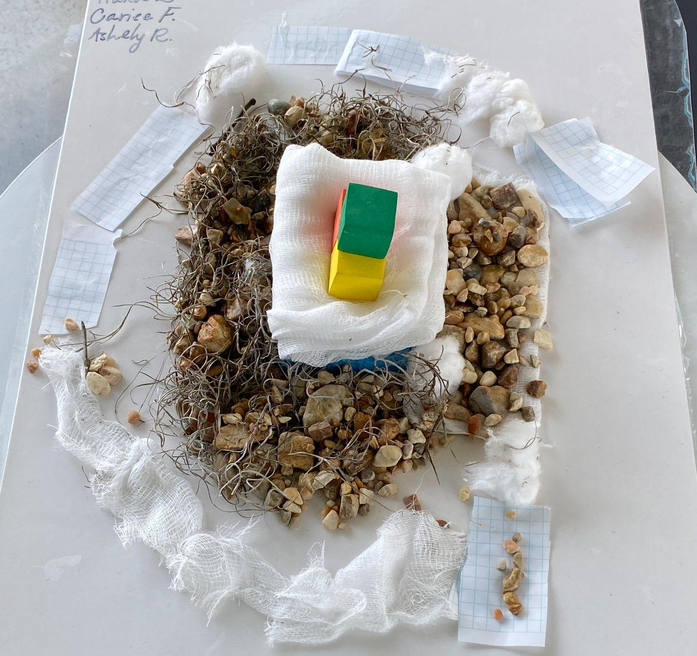
Example Swamps
What items would you use for your Swamp in a Sack?
Sponge
Cotton Balls
Moss
Twine
String
What else?
Notes:
Here are some examples of Swamps in a Sack that were used last year.
These students determined that rocks were not a good material to use because they aren’t absorbent, whereas Spanish moss was very absorbent.
What items would you use for your Swamp in a Sack? We have all of the items you can see here, sponges, cotton balls, twine, and string. What else do you think would be a good material to use?
Remember, you want your wetland to be absorbent, but also for it to hold together like soil trapped by plant roots.

Slide 33
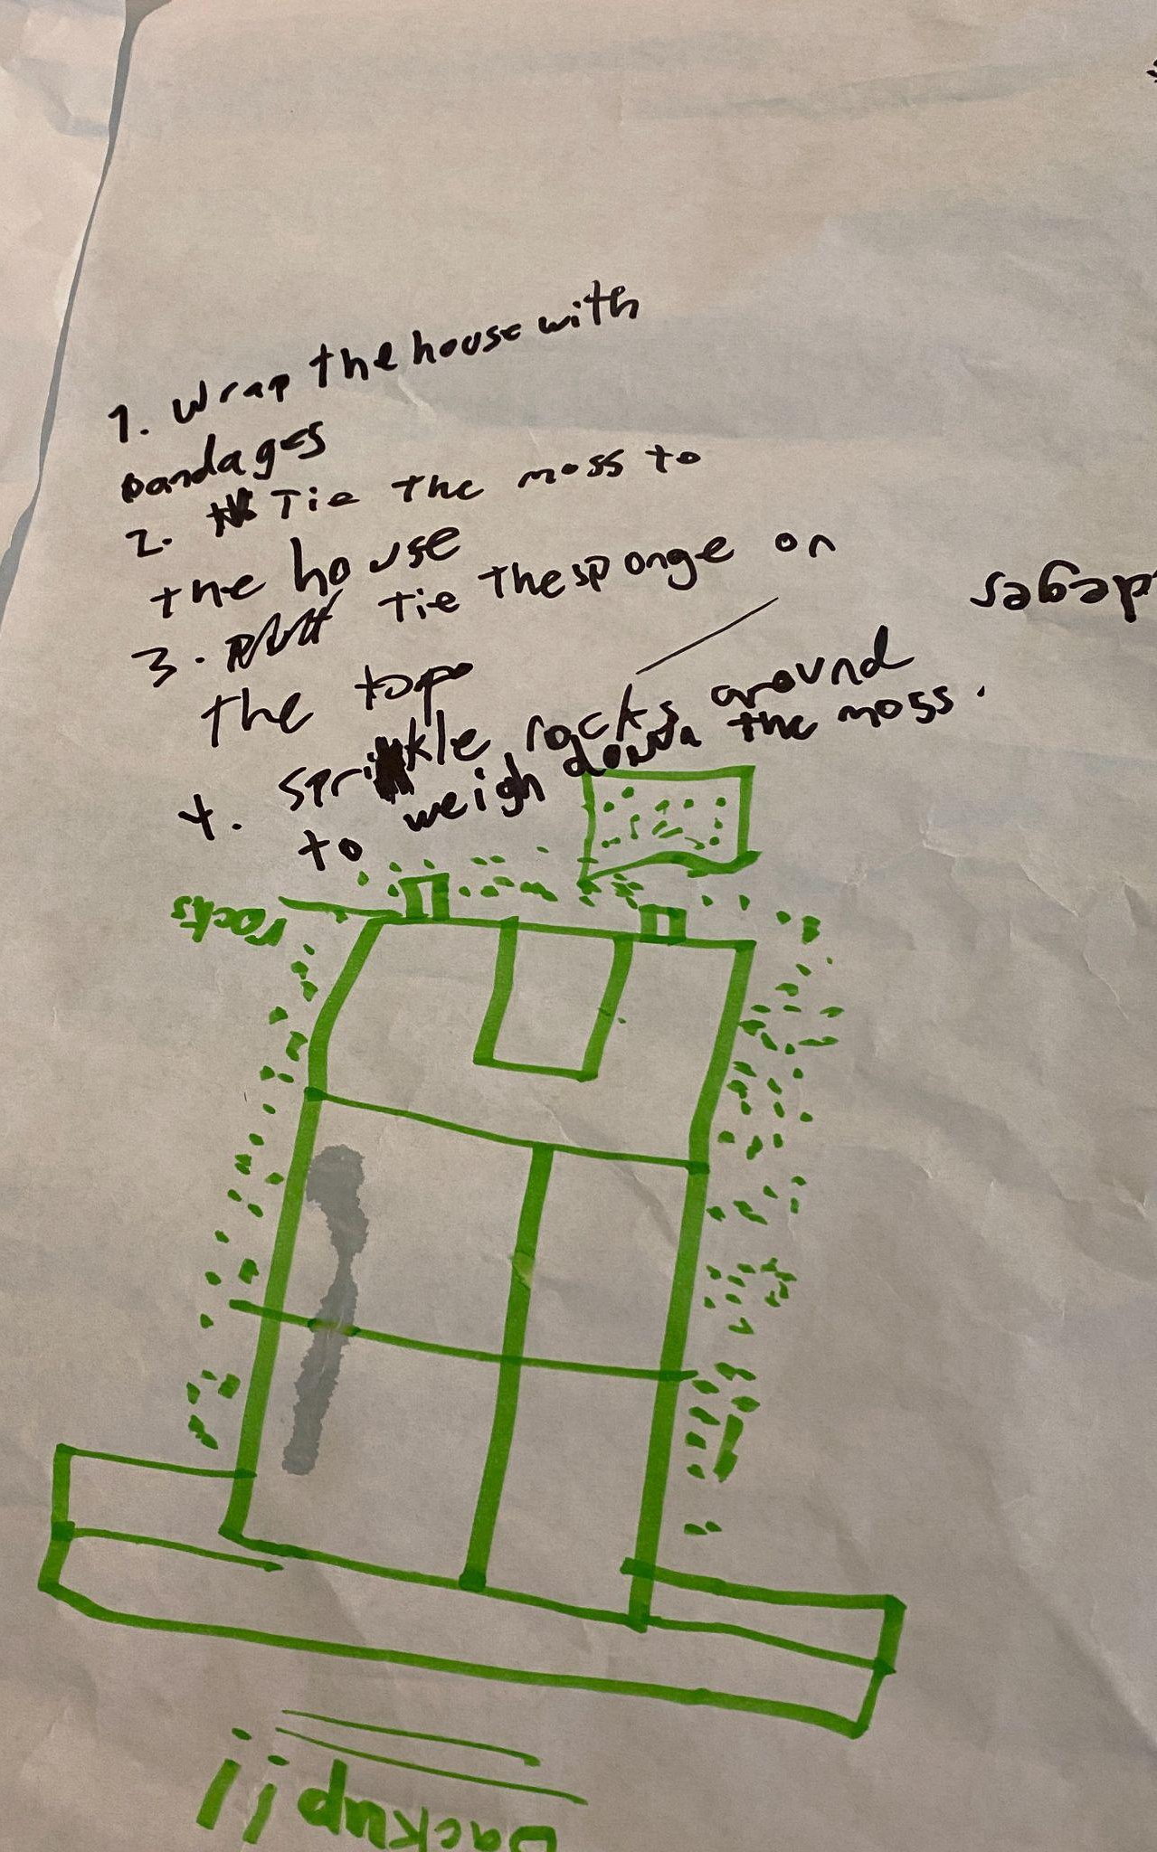
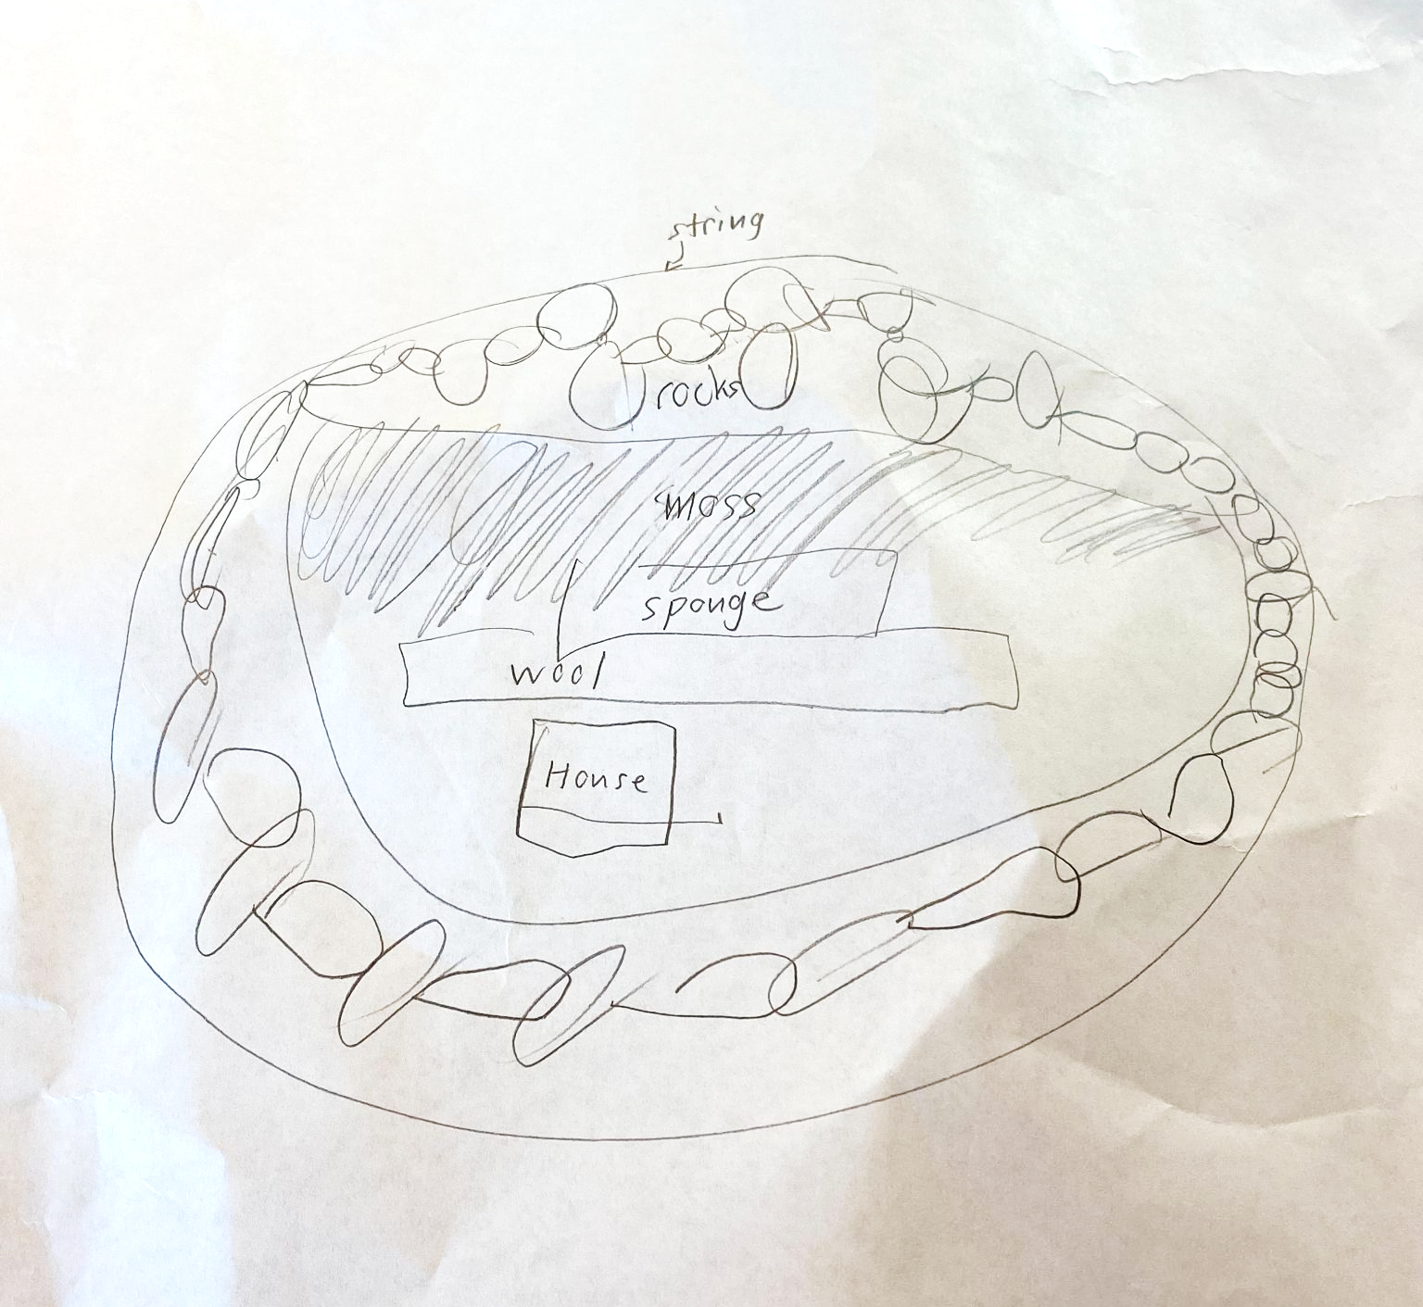
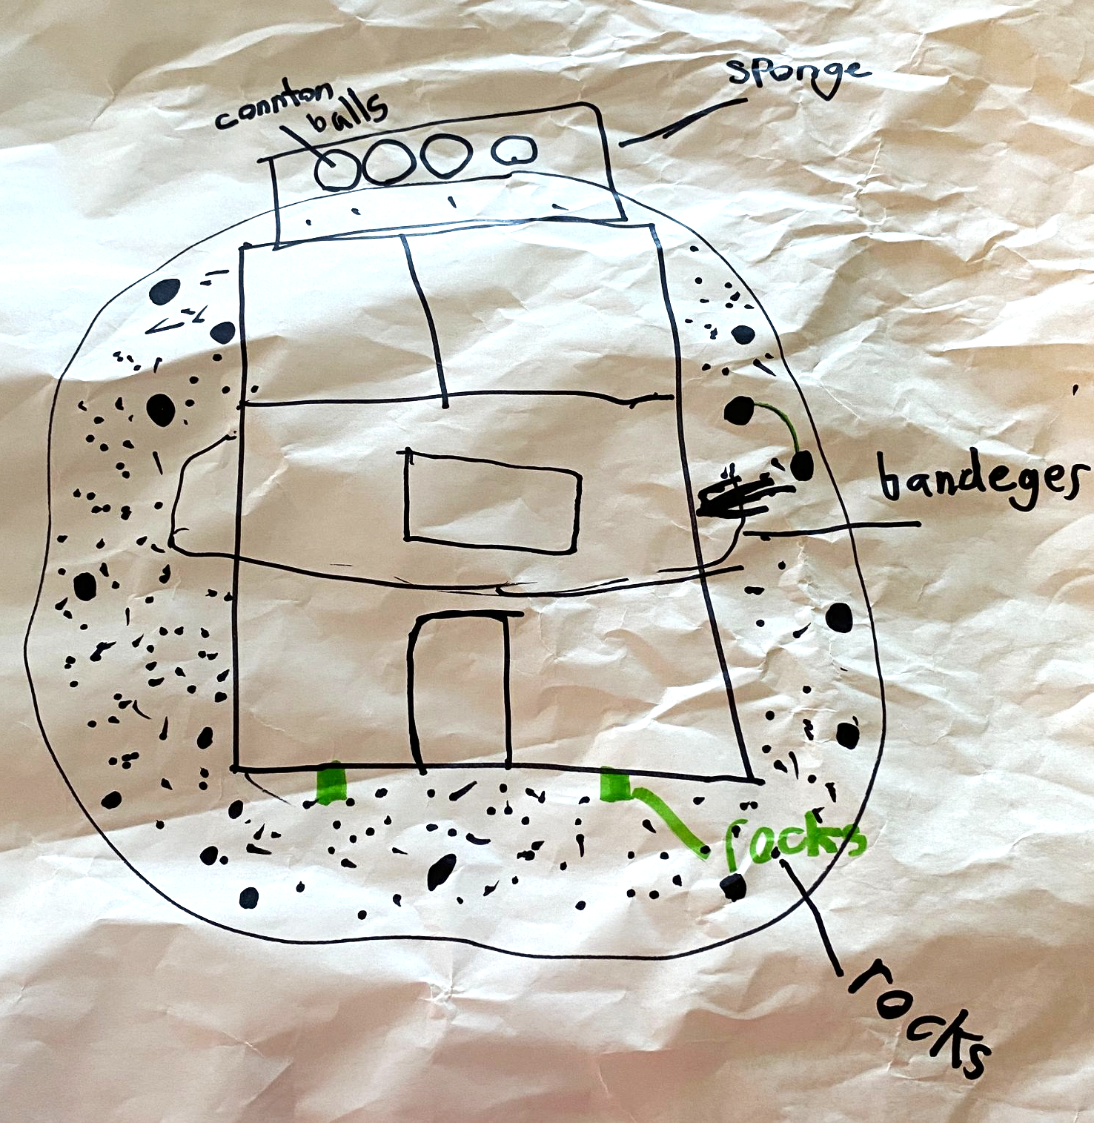
Example Swamp designs
Notes:
Your design should include notes about how you want to build your Swamp in A Sack.
You can label the materials you plan to use and where you want to put them, for example.
The design on the right side of the screen listed out the steps they would take to build their swamp in order.

Slide 34
Open your Water Journals to page 11. Draw your “Swamp in a Sack” design.
Notes:
Now we are finally ready to build! Please open your Water Journals to Page 11. Draw your swamp in a sack design here, but remember that you can change your design before you actually build your Swamp. When you’re done, answer the question at the bottom of the page.

Slide 35
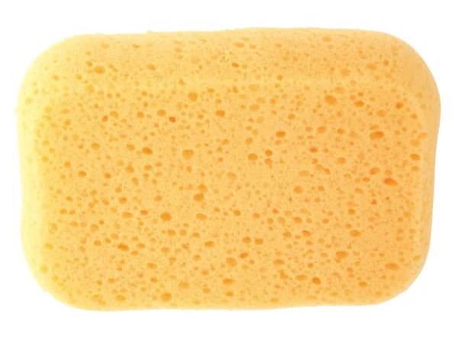
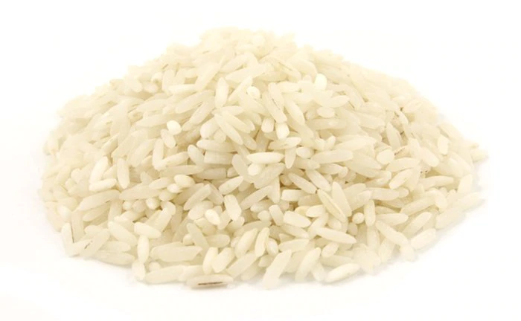
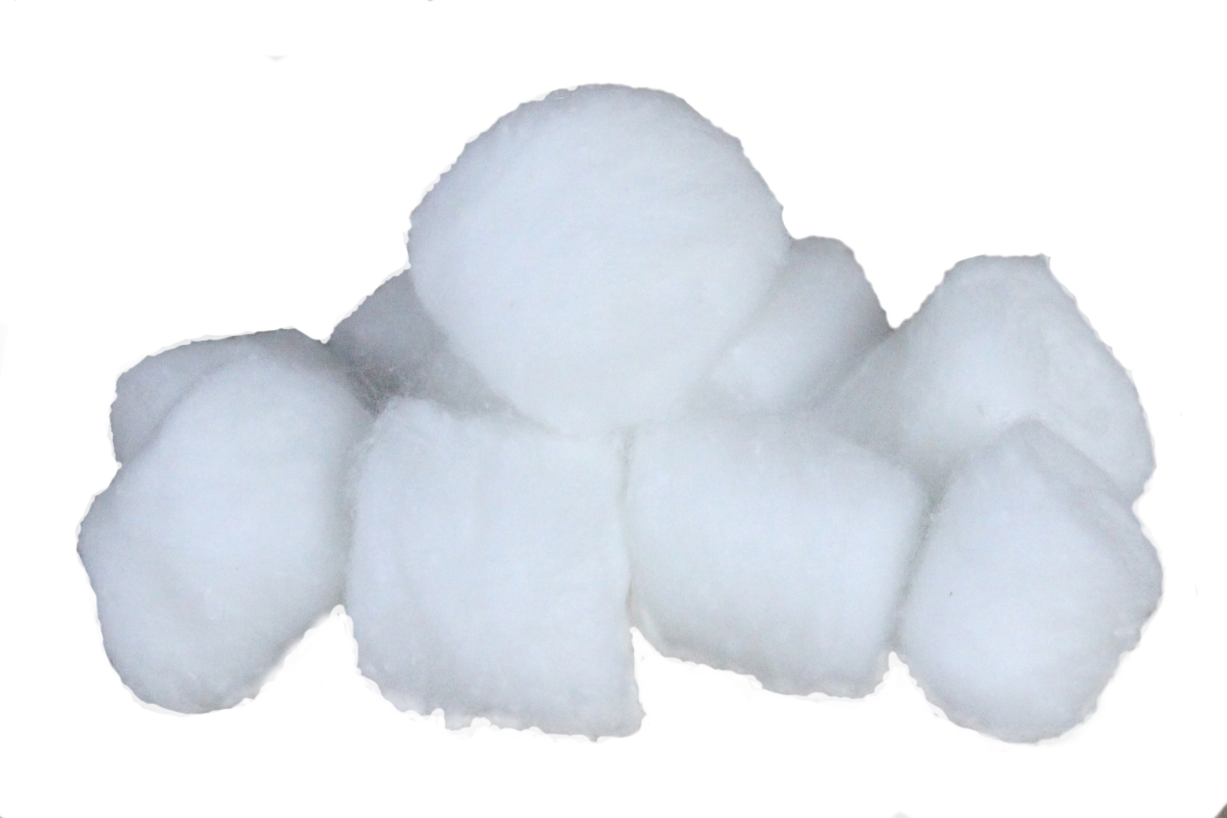
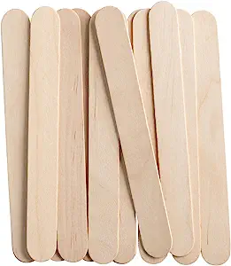
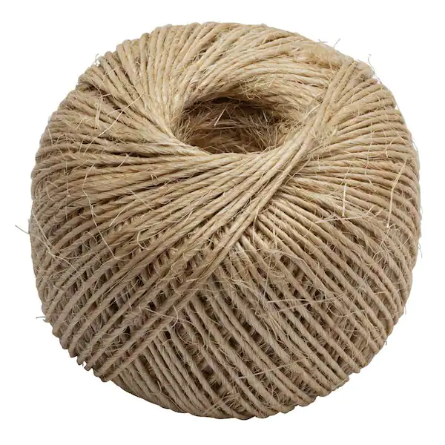
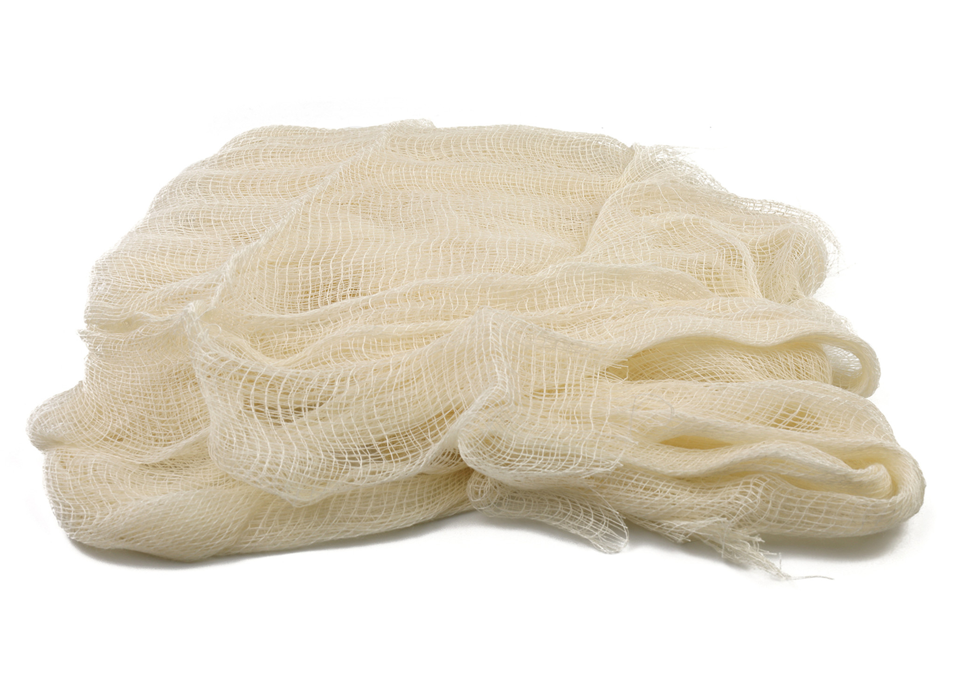
Building a “Swamp in a Sack”
Step 1: Collect materials that will act like the soil of your wetland swamp.
Wetland soils absorb like a squishy sponge.
Step 2: Collect materials that will act like the roots of wetland vegetation.
Roots help sediment stick together.
Step 3: Use the materials you have collected to design your own “Swamp in a Sack.”
Notes:
Look back at page 10 if you need help building your swamp in a sack.

Slide 36
Once you’ve finished building, turn your Journal to page 11 and answer the question

Slide 37
Great work! Please put away your Swamp and your Water Journal, and keep them safe until our field trip to the Children’s Museum!

Slide 38
Lesson 3:
We’re going to the Children’s Museum!
Notes:
Today we are going to talk about what you will be doing during your field trip to the Children’s Museum.

Slide 39
Open your Water Journals to page 12 to follow along!
Notes:
If you’d like, open our water journals to age 12 to follow along.

Slide 40
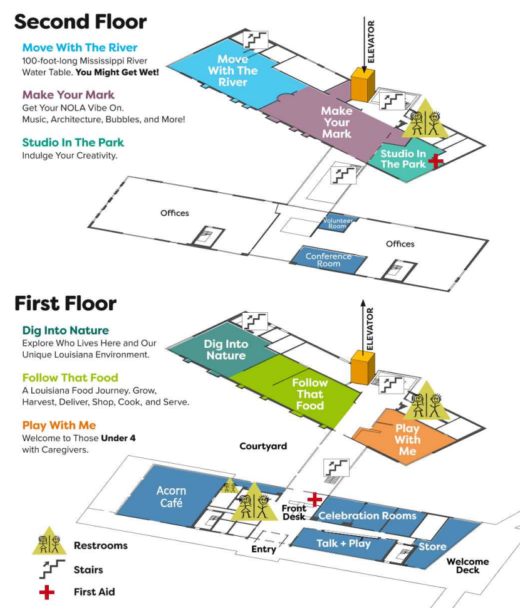
What’s next:
In a few days, we will be visiting the Louisiana Children’s Museum!
The map on page 13 of your Water Journal will help you find your way around the museum.
Notes:
In a few days, we will be visiting the Louisiana Children’s Museum!
The map on page 13 of your Water Journal will help you find your way around the museum.

Slide 41
What to expect:
At the museum, you will test your “Swamps” on the Sedimentation Table to see how absorbent and strong they are.
We will take turns at the Sedimentation Table
Pay attention to your classmates’ Swamp’s to see what designs work best.
When not at the Sediment Table, explore and play in the other galleries of the museum
Notes:
We are visiting the children’s museum so that you can test your swamp in a sack on the sedimentation table. While we are at the museum…
We will take turns at the Sedimentation Table. There should be only three groups at the table at a time.
Pay attention to your classmates’ Swamp’s to see what designs work best. Take notes in your water journals during the trip!
When not at the Sediment Table, explore and play in the other galleries of the museum. There will be a ton for you to do there!

Slide 42
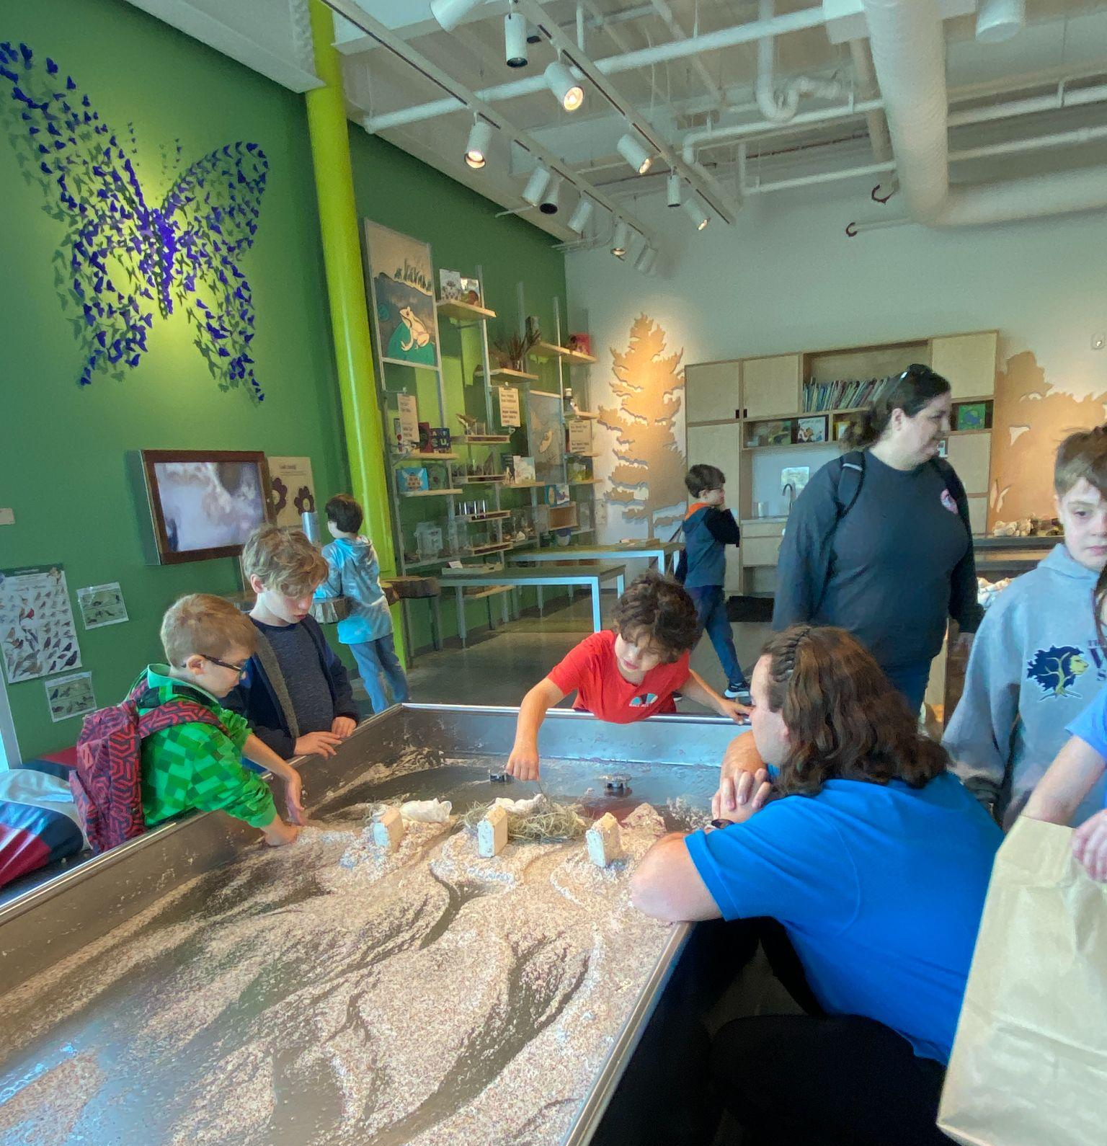
At the museum:
Dig Into Nature - test your “Swamp in a Sack”
In groups, take turns placing your swamp on the sedimentation table.
To protect the city, where is the best place to put your swamp? Why?
Notes:
If you look at the map on page 13, you can see some of the other exhibits at the museum.
Dig into nature is the green area on the first floor. This is where the sedimentation table is, but there are other fun things to do in this exhibit as well!

Slide 43
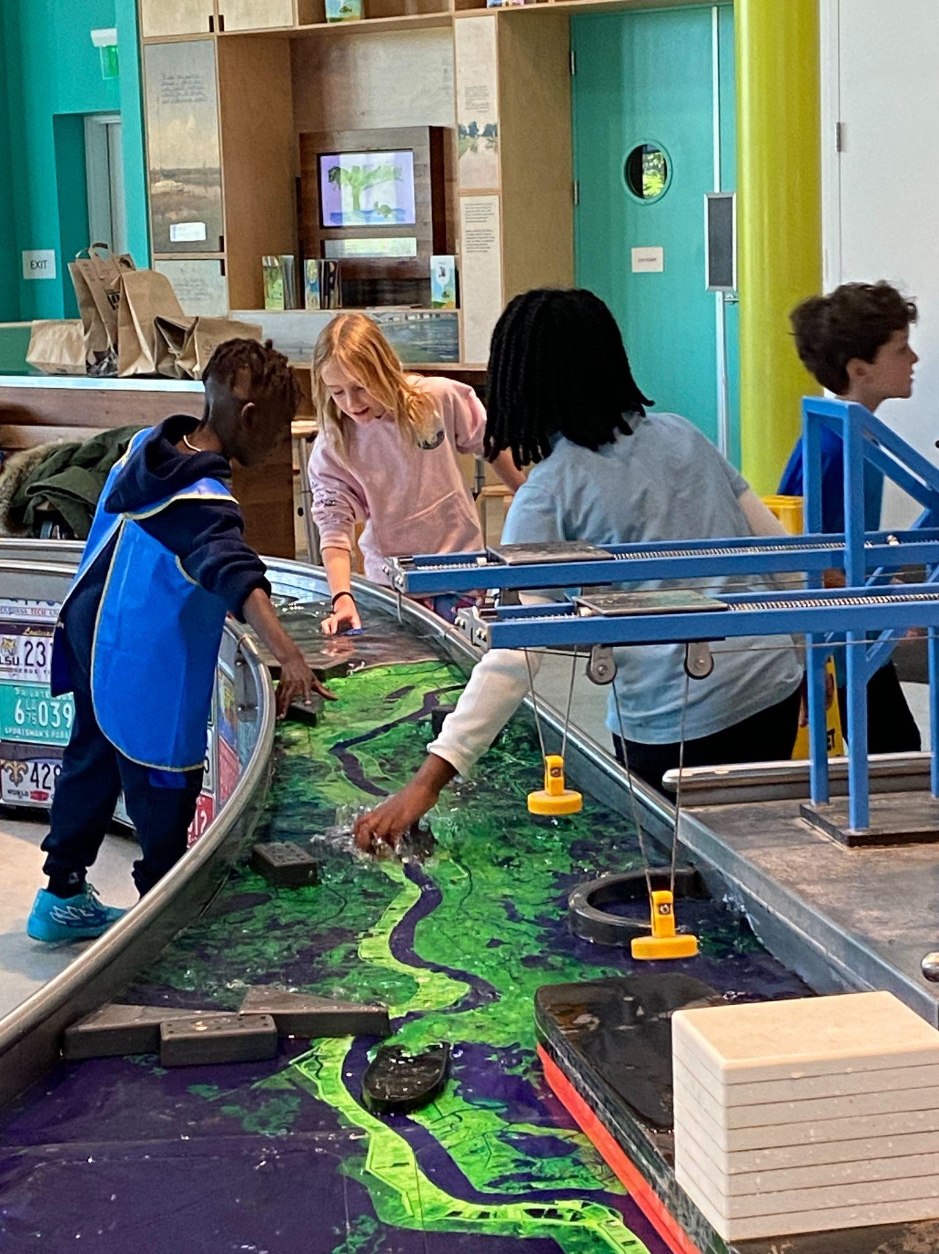
At the museum:
Move with the River - work as engineers and cargo captains
Use the locks, spillway, and retention pond to change the River’s flow.
Grab a boat and some “cargo” blocks, then let them float downstream. This cargo is an export because it was made in the U.S. but sold elsewhere.
Cargo brought up the river is called an import. Do you know why?
Notes:
Upstairs on the second floor in light blue, you will find a giant water table shaped like the Mississippi River. In this exhibit, you get to control the river! Just like engineers, there are levees, dams, spillways, and reservoirs for you to open and close in order to change the flow of water. There is also a miniature Port of New Orleans, where you can import and export items just like cargo captains do on the real Mississippi River.
Check out the definitions on page 12 before we visit the museum if you don’t know what an import or an export is.

Slide 44
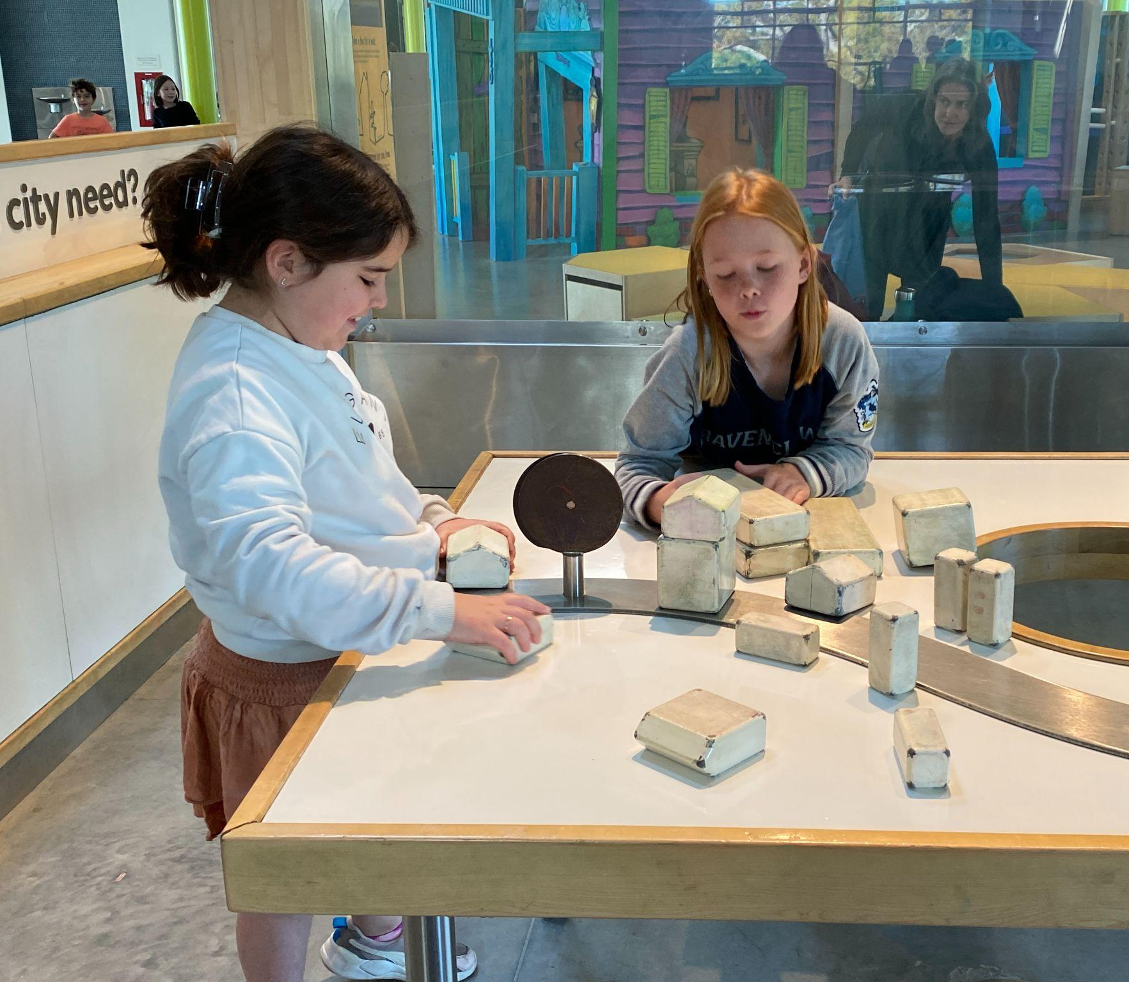
At the museum:
Make your Mark - plan and build a city that works with water
Use blocks and markers to design a city safe from storms and floods.
How did you adapt your design to make your city resilient and safe?
Notes:
Also upstairs, shown in dark red on your map, you will be able to Make your Mark. In this area, you can draw a map that shows what you would do if you were building a city such as New Orleans. Remember everything you’ve learned about protecting cities from storms and land erosion.
What would you include in your perfect city to make sure that wetlands were protected and people were safe from floods?

Slide 45
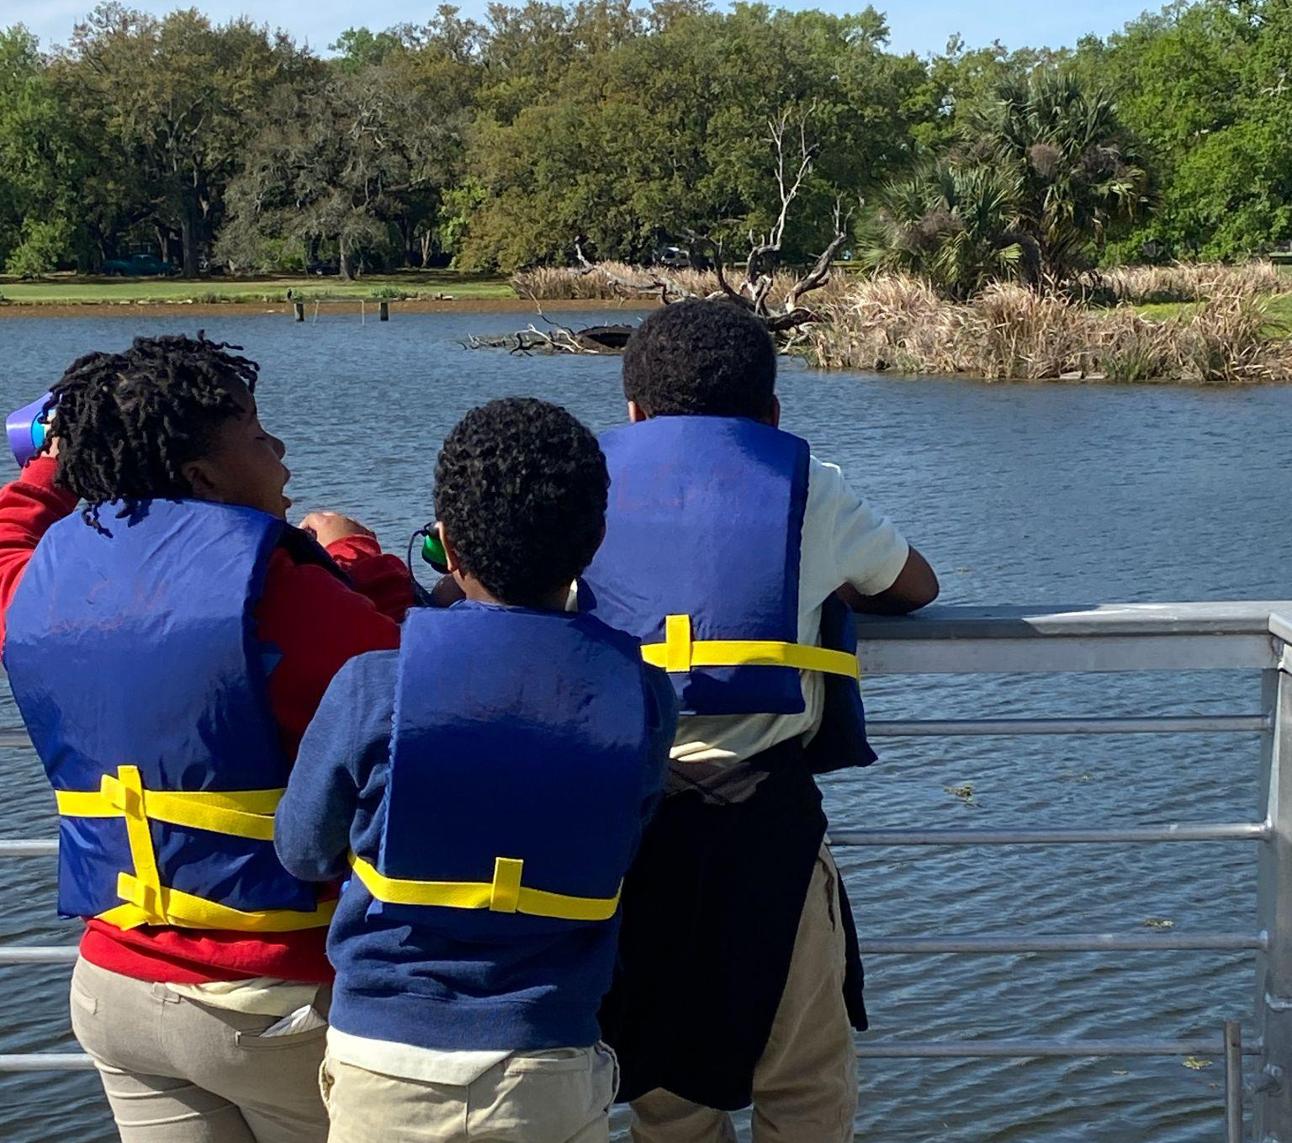
At the museum:
You will wear your walking feet
You will bring your bag lunch
You will bring your Water Journal
You will bring your group’s Swamp in a Sack
You will have fun!
Notes:
Before we get to the museum, I want to go over some things you will need to remember. First of all, you should always wear your walking feet when at the museum. We don’t want anyone to get hurt by running or jumping!
You should bring your water journal so that you can take notes and look at your map while at the museum.
Don’t forget your swamp in a sack! This is the most important! Your teachers will help you keep track of all of your things while you play at the museum.
Most of all, you should all remember to have fun! Our class is very lucky to be able to visit the museum and we want to show them our gratitude by having a great time!

Slide 46
Great work! Please put away your Water Journal, and keep them safe until our field trip to the Children’s Museum!

Slide 47
Lesson 3:
We went to the Children’s Museum!
Notes:
I hope you all had an amazing time at the Children’s museum! Let’s take a minute to reflect on what we we did while we were there. Does anyone have any stories from the field trip that they’d like to share with the class?

Slide 48
Open your Water Journals to page 14 and make a treasure map of your time at LCM!
Notes:
Please open your Water Journals to page 14. This blank treasure map shows the layout of the Children’s Museum. If you can’t remember where things were at the museum, try to figure it out using the clues on the page
For example, the squiggly lines show the location of the stairs.
The boxes represent the elevators. Try to remember where you were in relation to the stairs and elevators.
If you need an extra memory boost, look back at the map on page 13.

Slide 49
Next, answer the questions on page 15 of your Water Journals.
Notes:
After you’ve finished your treasure map, answer the questions on page 15 of your Water Journals.
Think back to your time at the Sedimentation Table and recall what did and did not work well.
Next, think about the ways that humans use the Mississippi River, and ask yourself why they would want to travel up river against the flow of water.
How do humans use the Mississippi River for transporting goods from outside the United States to be sold throughout the nation?
Think about how people who don’t live in Louisiana depend on the Mississippi River.

Slide 50
Lesson 4:
Wetland Wrap-up
Notes:
Now that we’ve learned so much about Louisiana’s environment and the ways that human beings have adapted to it, let’s talk about what that means for you and me!

Slide 51
Open your Water Journals to page 16
to follow along!
Notes:
Please open your Water Journals to page 16 to follow along.

Slide 52
At the museum:
“Louisiana’s coastal wetlands are the nursery grounds of the Gulf of Mexico.” - Dr. Bob Thomas
Notes:
“Louisiana’s coastal wetlands are the nursery grounds of the Gulf of Mexico.” These words are written on the wall of the Louisiana Children’s Museum to remind visitors of the importance of relationship to water. We know that The Mississippi River provides fresh sediment and nutrients to the coast of Louisiana, and wetland habitats offer these resources to the special species that thrive in a swampy region. As you’ve learned, human beings have changed the way we build our cities to adapt to water using boats, bridges, levees, & man-made wetlands to travel around water and live within it as well.
On page 16 of your Water Journal, please draw one example that shows how people change the way that water moves. Think back to your time at the Children’s Museum for clues if you need.

Slide 53
Think about everything you’ve learned about Living with Water. Answer the 4 questions on page 17 and 18.
Notes:
Next, pages 17 and 18 of your Water Journal will challenge you to think about WHY human beings behave the way we do.
Why do we want to control the flow of water?
What happens to the Cypress trees and Roseate Spoonbills that live in the wetlands when we change the flow of water too much?
Why is living with water dangerous and threatening?
Why are we lucky to live around so much water, and how can we see water as an asset?
All of these questions ask you to make connections between the place where you live and yourself! In order to protect the wetlands and save the environment, you need to understand why things are as they are today.
Use this space to document your ideas, and remember there are no wrong answers!

Slide 54
Great work! Expect a special surprise visitor the next time we work in your Water Journal.

